Slide 1
EFFECT OF INSERT POROSITY ON COMBUSTION INSTABILITY IN A LEAN PREMIXED COMBUSTOR ANALYZED BY A POD-BASED PHASE RECONSTRUCTION TECHNIQUE
Mitchell A. Johnson, Ashley M. James, and Ajay K. Agrawal
2023 Turbo Expo, June 26-30, Boston, MA

Slide 2
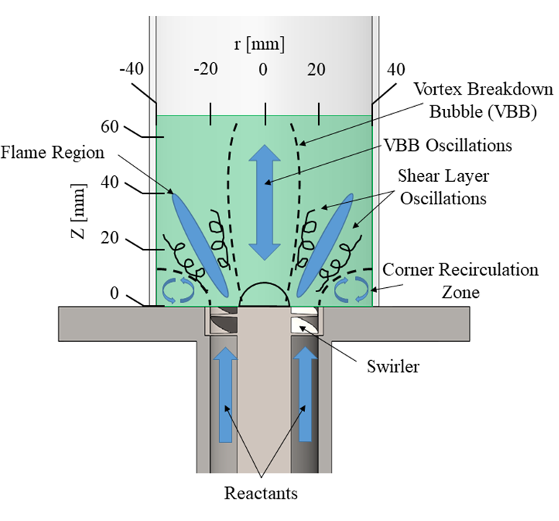
Background
Lean Premixed (LPM) combustion for power-generation gas turbines.
Premixing facilitates globally lean, low temperature flames.
Lower emissions of NOx, CO, and UHCs.
LPM is vulnerable to thermoacoustic instabilities.
Swirl-stabilized combustion systems rely on recirculation zones to stabilize flame.
Hot products feed back to reactants, initiate reactions.
Combustor can become excited at certain frequencies to produce instability.
Instability can be acoustically driven or result from other phenomena.

Slide 3
Porous Inert Media (PIM) Insert
Previously, we have shown PIM’s effectiveness at mitigating thermoacoustic instability.
An annular ring of PIM is placed at the dump plane of the combustor.
PIM alters the flow/flame structures:
Reduces jet divergence
Eliminates recirculation zones
Allows reactant flow through porous structure
Produces flamelets to stabilize core flame
Although PIM is known to stabilize instabilities, questions remain about
Role of porosity vs geometry.

Slide 4
Objectives
Evaluate effects of insert shape and porosity in isolation.
No insert
Porous insert
Solid insert
Examine details of combustion instability at a fixed equivalence ratio
Acoustic probes
Particle image velocimetry (PIV)
OH* Chemiluminescence (OH*CL)
Apply POD analysis to assess differences in flow structure
Apply phase reconstruction to study differences in oscillation patterns

Slide 5
Experimental Setup
Swirl-stabilized LPM combustor
Optically-accessible flame tube
Inlet swirl number of 1.5
Internal acoustic measurements were taken upstream of flame, in the mixing tube.
Water-cooled PCB 106B, flush mounted, 40 kHz
Operating Conditions
Air mass flow rate 1.02 kg/min (800 SLPM)
Φ = 0.78 for detailed analysis

Slide 6
Particle Image Velocimetry (PIV)
Image acquisition
3500 image pairs per second
16.7 μs between laser pulses
Spatial resolution of 84 μm per pixel
Laser Sheet Optics
F = 250 mm spherical lens
F = -15 mm cylindrical lens
Seed
1-2 μm silicon carbide
Stokes number ~10E-6
1
3
2
4
SA-5
SA-5
7
6
5

Slide 7
OH* Chemiluminescence (OH*CL)
1
Images acquired at 3.5 kHz
Synchronized with PIV at 1 μs delay from the 2nd laser pulse
UVi Model 1850-10 intensifier
750 ns exposure
Filtered at 315 nm,
15nm bandwidth
3
2
4
SA-5
SA-5
7
6
5

Slide 8
Velocity Field Calculations
Two-pass recursive Nyquist grid
Initial spot size 64x64 pixels
Final spot size 24x24 pixels
FFT computes correlation function
Peak found using bilinear peak finder
Three modes of validation
Each pass – global and local median test
Must exceed S/N ratio of 1.75
Must not exceed 3 standard deviations away from local mean
~15% of vectors rejected
Typically, in the area of two large laser reflections
Results from low S/N ratio
Holes in data are recursively filled
Preference given to holes with most valid neighbors
Results in vector field resolution of 1.36 mm / node.

Slide 9
Total Acoustics Measurements
Three distinct regions in equivalence ratio.
φ = 0.75 to 0.78
Solid insert and no-insert configurations destabilize.
φ = 0.70 to 0.74
All three configurations behave similarly.
φ = 0.65 to 0.69
Both inserts behave very similarly.
Modest improvement on no-insert.
φ = 0.78 chosen for detailed analysis

Slide 10
Time-Averaged Velocity Field
No Insert
Very large CTRZ
Presence of central jet
Porous Insert
No flow recirculation
Jet divergence reduced
Solid Insert
Large recirculation zones
High velocity diverging annular jet

Slide 11
Acoustics Measurements
At φ = 0.78
No insert and solid insert experience large amplitude pressure oscillations.
Porous insert does not demonstrate large amplitude oscillations.
Similar frequency of oscillation, but significant variability in waveform.

Slide 12
Spectral Analysis of PIV and OH*CL Data
Solid insert experiences peak oscillations at 497 Hz
Minor velocity peak near 300 Hz
No coupling in porous case
No-insert experiences peak oscillations at 309 Hz
Minor second harmonic in OH*CL data.

Slide 13
Proper Orthogonal Decomposition
Technique useful to isolate modes of oscillation in a fluctuating quantity u’.
$$u^{′}\left(x,t\right)= \sum_{i}{a_{i}\left(t\right)φ_{i}\left(x\right)}$$
Each mode consists of a temporal function a and a spatial function φ.
φ describes on how u’ at a point in space correlates with every other point.
a details how all points simultaneously oscillate in time.
Orthogonality dictates that data contained in one mode is duplicated in no other mode.

Slide 14
PIV & OH*CL Modal Dynamics
Both modes highly cyclical at 309 Hz
Both modes incoherent
Significant LF activity in Mode 1
Both modes contain significant oscillations at 497 Hz
Unstable configurations concentrate far more of total oscillations in low-order modes

Slide 15
No-Insert Modal Decomposition
Axial Velocity
OH*-CL emissions
Mode 1
Mode 2
Mode 1
Mode 2
Mode 1:
All jet velocities anti-correlated with flame activity
Mode 2:
Central recirculation zone velocity anti-correlated with flame locally
Stronger central recirculation zone enhances flame activity

Slide 16
Solid Insert Modal Decomposition
Axial Velocity
OH*-CL emissions
Mode 1
Mode 2
Mode 1
Mode 2
Mode 1:
High velocity in downstream regions of jet at peak full-field OH* activity.
Mode 2:
Full field velocity is anti-correlated with core region of flame.
Again, central region of flow coupled with flame activity

Slide 17
Porous Insert Modal Decomposition
Axial Velocity
OH*-CL emissions
Mode 1
Mode 2
Mode 1
Mode 2
Mode 1:
Velocity at outlet of insert core directly correlated to full-field flame activity
Mode 2:
Central flow region correlated with downstream flame
Flame oscillations notably absent from near field of porous surface

Slide 18
Phase Reconstruction
We utilize time coefficients of POD modes for phase reconstruction
If process is cyclic, this offers a way of overcoming cycle-cycle variations
Signal noise complicates this process
Thus, we filter data prior to POD to isolate structure of interest.
$$\arctan\left(θ_{j}\right)= \frac{a_{2j}\sqrt{2λ_{1}}}{a_{1j}\sqrt{2λ_{2}}}$$

Slide 19
No-Insert Phase Reconstruction
Diverging jet oscillates radially
As jet flow is reduced and shifts outward, recirculation zones expand
Strengthened flow recirculation enhances flame activity

Slide 20
Solid Insert Phase Reconstruction
Diverging annular jet oscillates in length, velocity
Accompanying expansion and contraction of recirculation zones
Flame activity is enhanced by increasing recirculation zone strength

Slide 21
High Resolution Phase Reconstruction – No Insert
At Z = 10 mm
Jet Velocity and central recirculation zone velocity fluctuation together
As diverging jet shifts inwards (θ = 180°), central jet weakens
Central recirculation zone separates
As diverging jet shifts outwards, vortex breakdown occurs
Central recirculation zone split by central jet

Slide 22
High Resolution Phase Reconstruction – Solid Insert
At Z’ = 20 mm
As central recirculation zone strengthens, flame activity in core of jet begins to increase (θ = 0°)
Overall velocity is impacted across combustor
Result of jet interactions with standing acoustic wave
Peak flame activity occurs directly after high-velocity region

Slide 23
Conclusions
No-insert configuration experiences KH instability.
Solid insert eliminates KH-instability present in no-insert configuration.
Still vulnerable to direct acoustic excitation.
Porous insert preserves effects of overall geometry.
Eliminating recirculation zones prevents acoustic coupling.
Allows perturbations to convect downstream.
Recirculation zones not necessary for static flame stability.
Flamelets on downstream porous surface act as pilot flames.
This region is completely uncorrelated with major modal dynamics.

Slide 24
Acknowledgements
This work was funded in part by NASA Grant NNX13AN14A.
Mitchell Johnson was supported by Graduate Assistance in Areas of National Need (GAANN) Fellowship Program.
The authors would like to thank James Allen and John Kornegay for their contributions to this work.

