Slide 1
Flow Characterization of a Rotating Detonation Combustor Integrated with Various Convergent Nozzles
Shaon Talukdar, Dalton Langner, Apurav Gupta, and Ajay K. Agrawal*
Dept. of Mechanical Engineering, University of Alabama, Tuscaloosa, AL, 35401, USA
AIAA SciTech Forum and Exposition 2023, 23-27 January 2023
Copyright © by Shaon Talukdar, Dalton Langner, Apurav Gupta, and Ajay K. Agrawal*
Dept. of Mechanical Engineering, University of Alabama. Published by the American Institute of Aeronautics and Astronautics, Inc., with permission.
*Corresponding Author Email: aagrawal@eng.ua.edu
Notes:
Hello everyone and thank you for attending this session
Name
From
Title
Authors

Slide 2
Presentation Overview
Motivation
Background
Experimental Setup
Wave Dynamics
Pressure Measurement
Flow Characterization
Conclusions

Slide 3
Motivation
Rotating Detonation Combustion (RDC) offers potential for higher fuel efficiency for power generating gas turbines
High-frequency periodic and unsteady supersonic/subsonic flow is one of the major challenges for successful RDC-turbine integration
Strategies need to be developed to reduce the spatio-temporal flow unsteadiness at the RDC exit
Thus, the unsteady flow field at the RDC exit must be characterized using high-fidelity measurements
Prior works on RDC flow fields were mostly computational. Experiments are required to validate the models

Slide 4
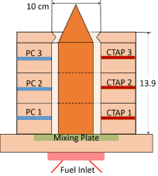
Background
RDC with Diffuser
PIV (30 kHz) was employed to characterize the flow field at RDC exit without and with diffuser aimed at attenuating the flow unsteadiness.
FFT plots of axial velocity:
Without diffuser: a sharp peak at 6.2 kHz (same as the detonation wave frequency)
With diffuser: no definite spectral peak (no/very weak shock structure)
The 2D histograms show that the diffuser successfully orients the flow towards the axial direction
However, this diffuser design did not mitigate the problematic period axial flow oscillations (axial velocity: 300 m/s to 1,200 m/s)
RDC without Diffuser

Slide 5
Objectives
Implement convergent nozzles with different area ratios at RDC exit to increase the chamber pressure
Investigate wave dynamics of RDC operation under varied backpressure conditions
Characterize flow field at the nozzle throat utilizing high speed PIV at 100 kHz

Slide 6
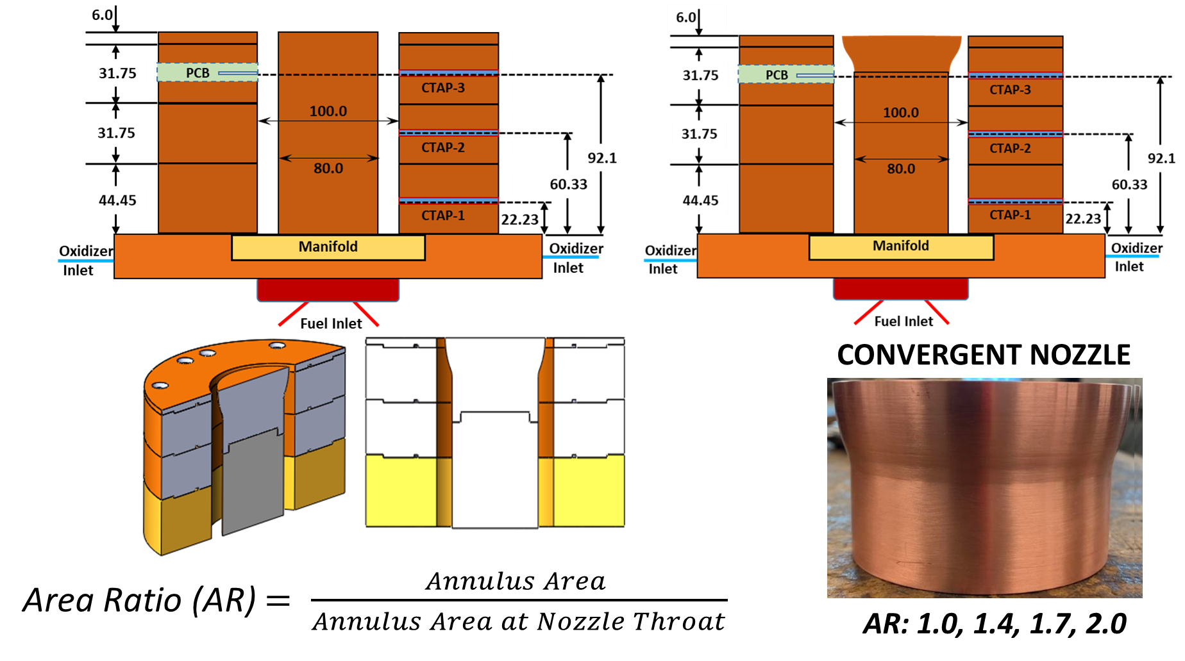
Converging Nozzles with Various Area Ratios

Slide 7
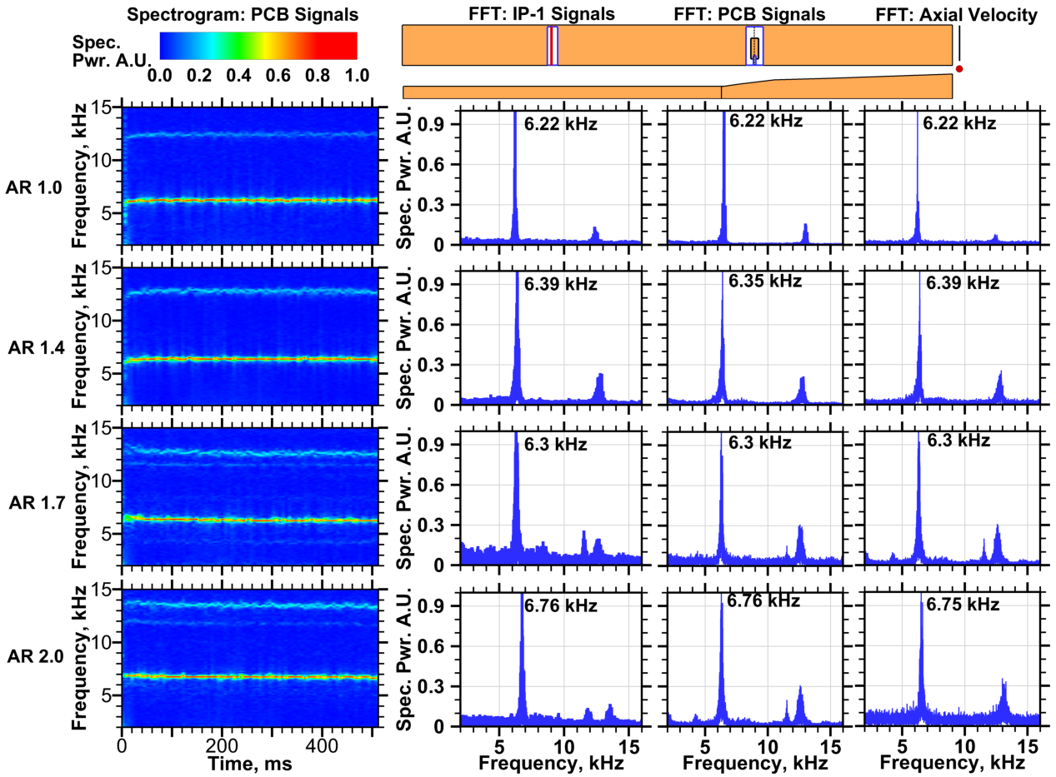
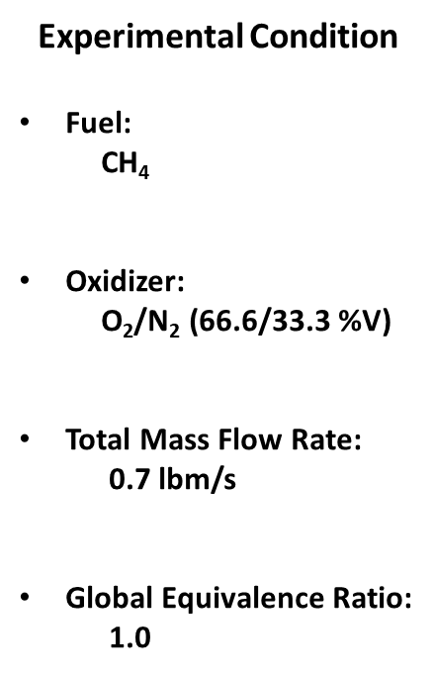
Wave Mode Analysis

Slide 8
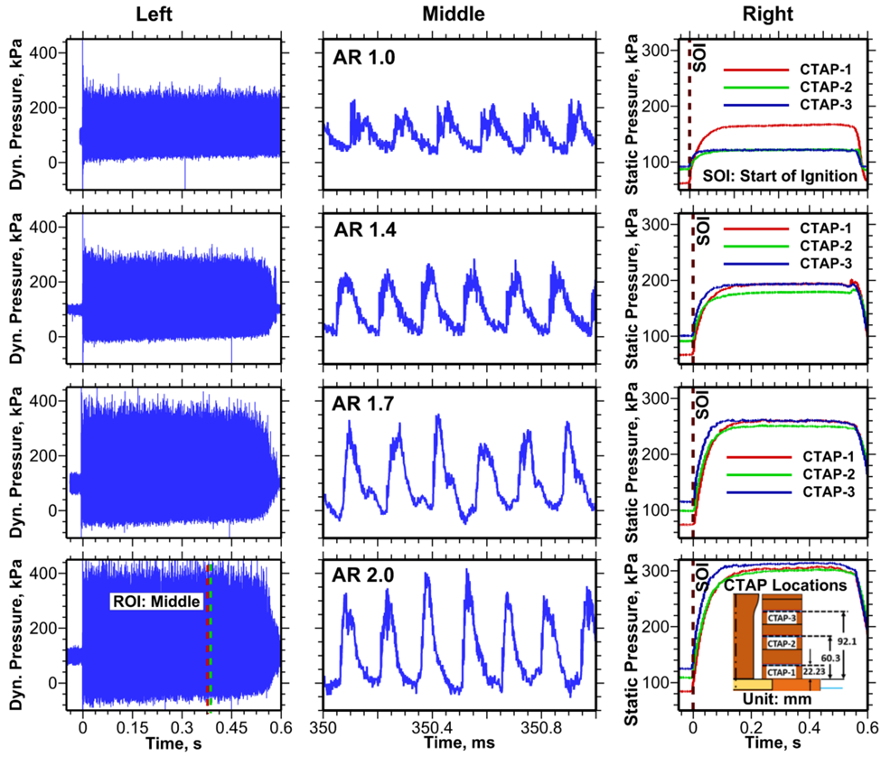
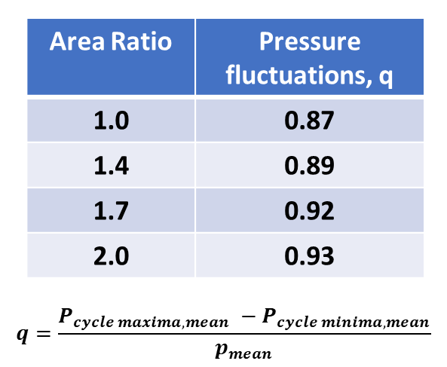
Pressure Measurement
As area ratio increases:
Increased chamber pressure
Increase pressure fluctuations

Slide 9
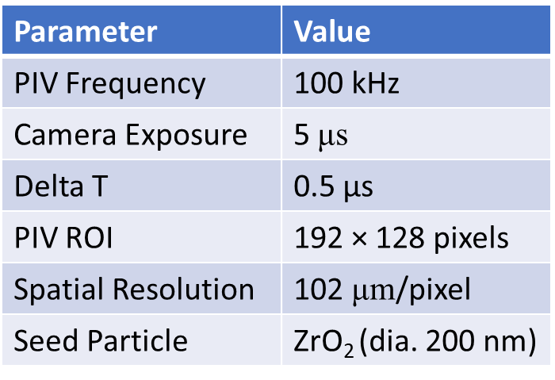
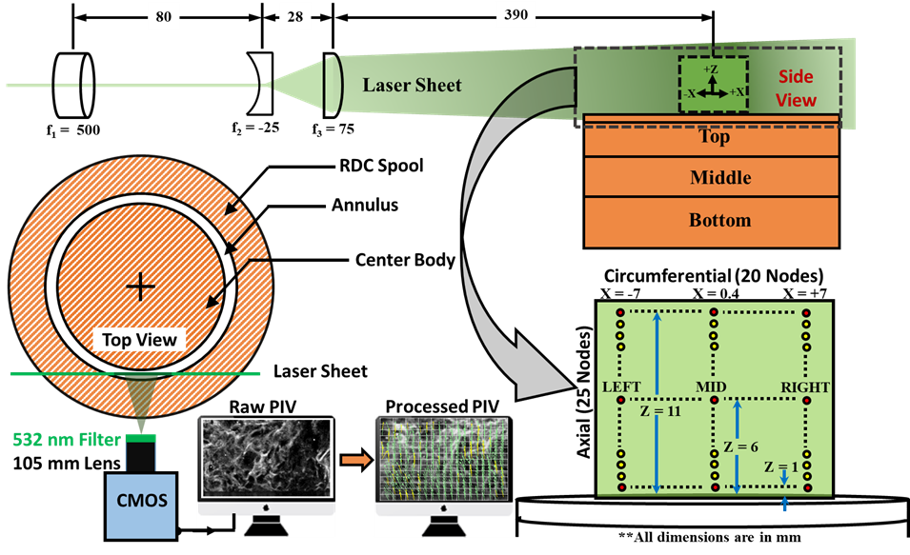
PIV Setup
PIV Features
Image pairs/detonation cycle: 14-16
Detonation cycles/Test: 3800-4300
PIV image pairs/Test: ~ 60000

Slide 10
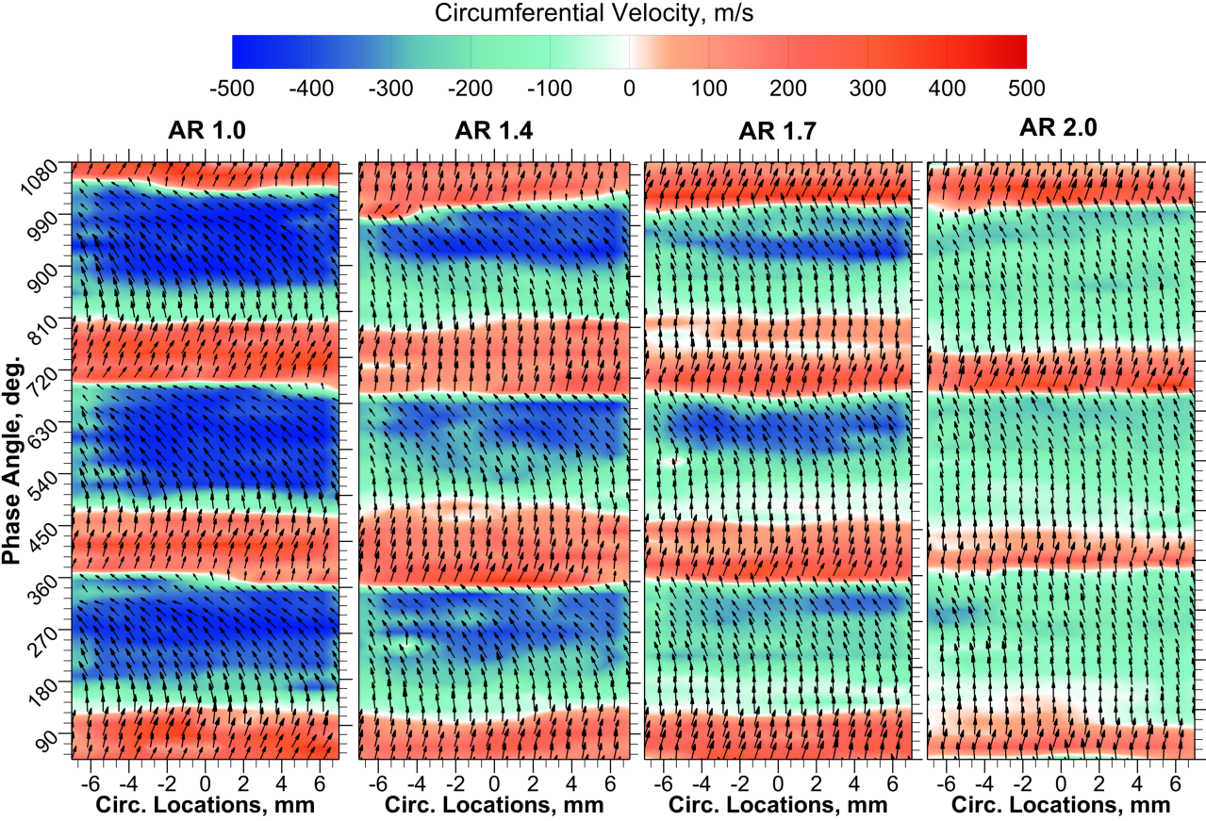
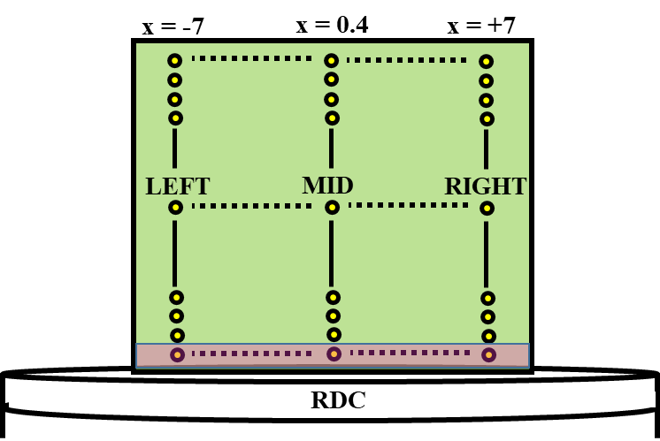
Cyclic Flow at the Nozzle Throat

Slide 11
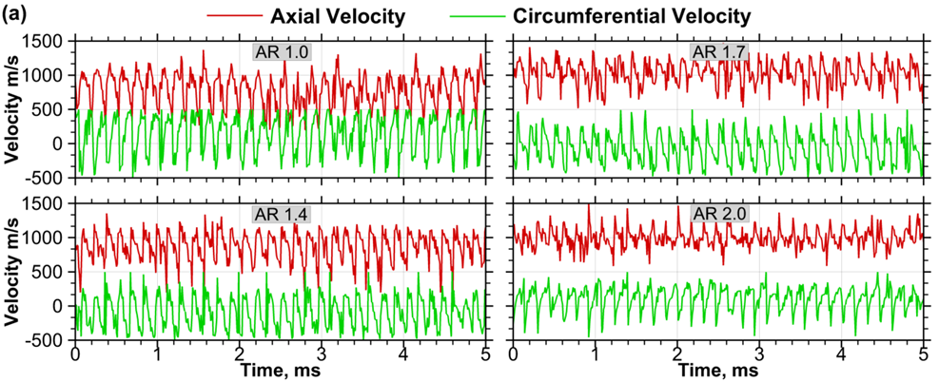
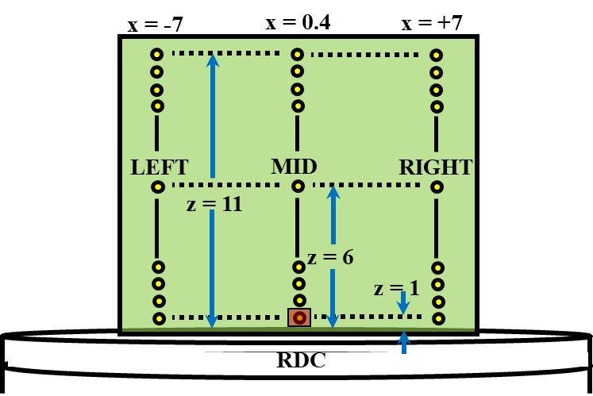
Time History of Flow at RDC exit

Slide 12
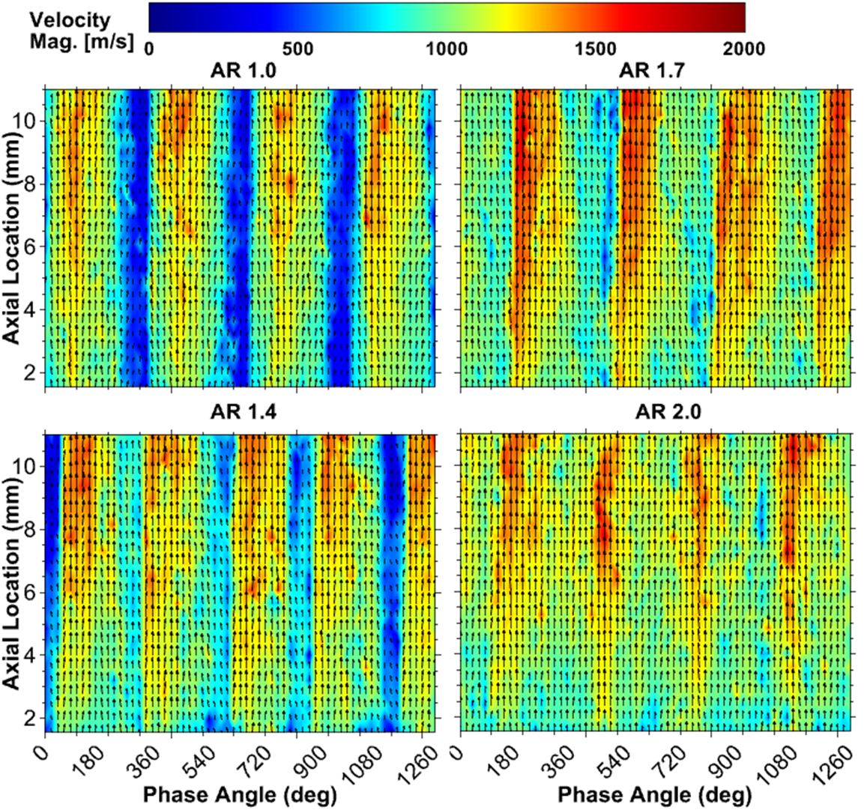
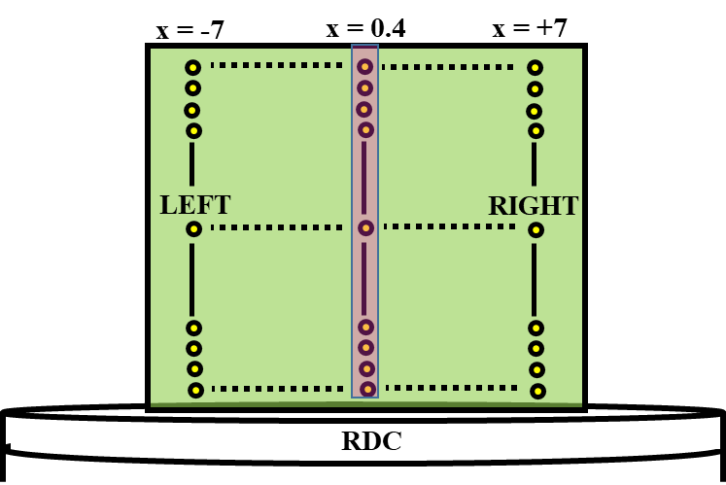
Cycle Flow along the Axis

Slide 13
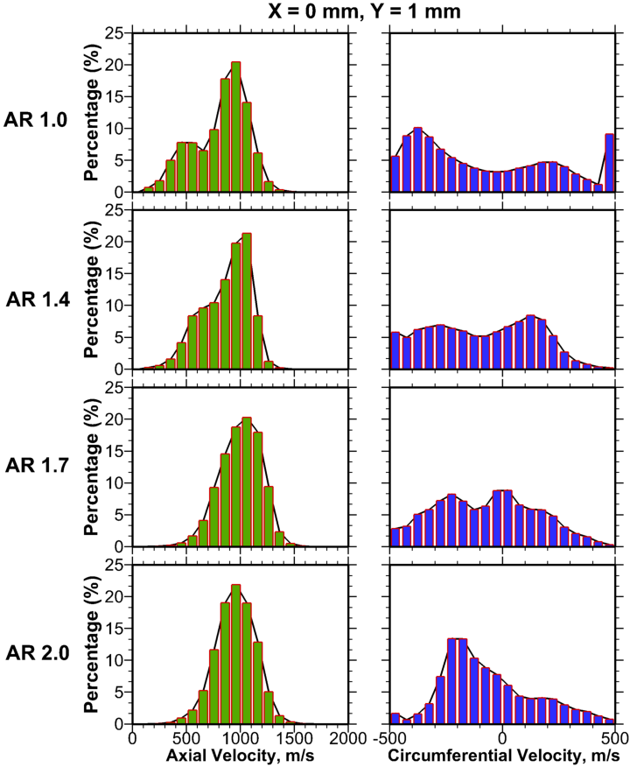
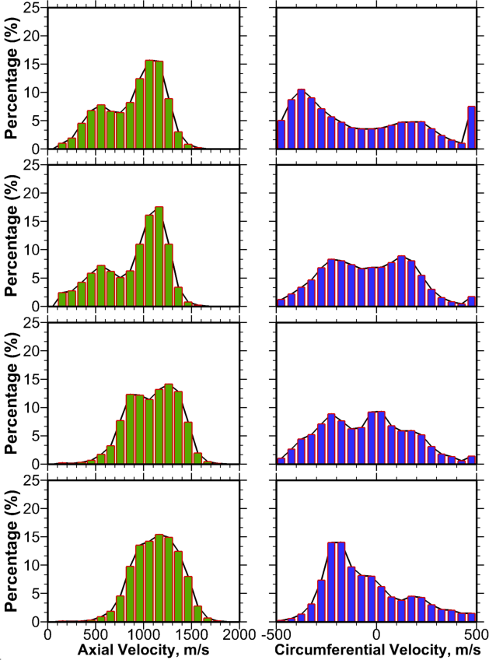
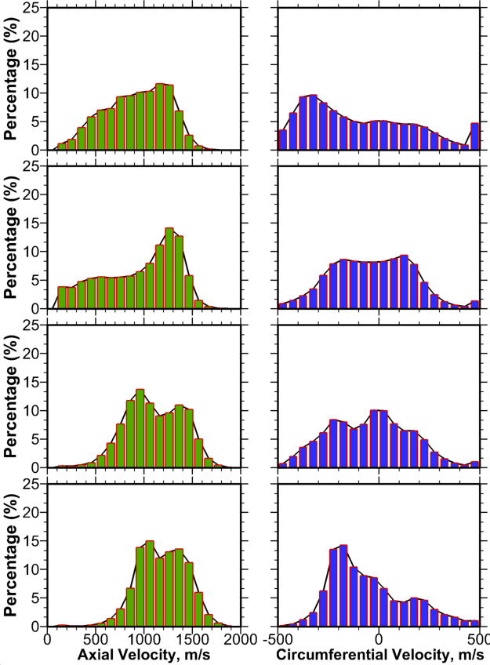
Flow Field Statistics Along Axial Direction
X = 0.4 mm
Z = RDC exit
X = 0.4 mm
Z = 6 mm
X = 0.4 mm
Z = 11 mm

Slide 14
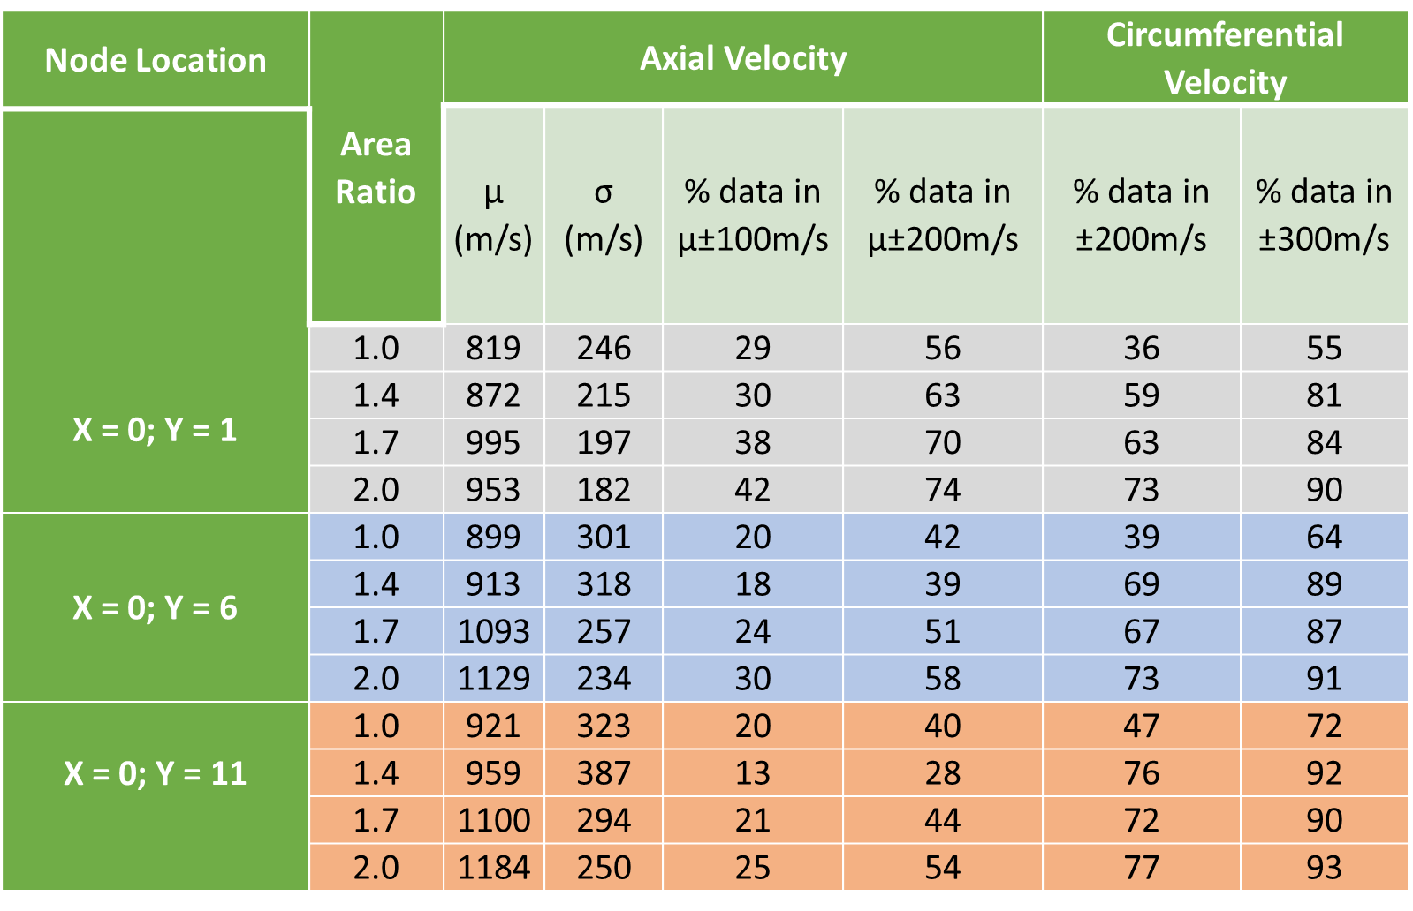
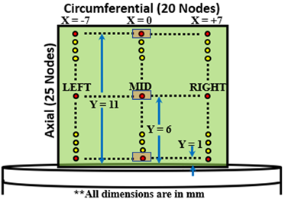
Summary of Results

Slide 15
Conclusions
We investigated the exhaust flow field of a RDC integrated with convergent nozzles with different throat areas utilizing high speed PIV
Single wave RDC operation for all cases at frequency ranging from 6.2 to 6.8 kHz.
For the same reactants and operating conditions, converging nozzle elevated RDC pressures, resulting a stronger detonation wave.
Increasing area ratio of convergent nozzle reduced the circumferential velocity indicating weakening of the oblique shock wave.
Increasing area ratio of convergent nozzle facilitated the mixing of subsonic/supersonic flow and reduced flow fluctuations at the RDC nozzle throat.

Slide 16
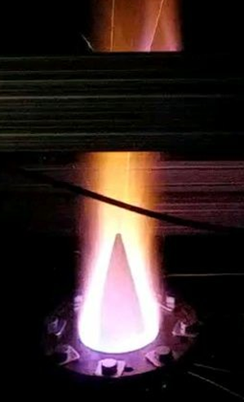
Acknowledgments
This research was supported in part by Department of Energy under Award Number(s) DE-EE-0032077. RDE hardware used in this work was developed by Aerojet Rocketdyne Inc. through funding by the Department of Energy under Award Number(s) DE-FE0023983.

Slide 18
Intra Cycle Flow Dynamics at Nozzle Exit

