Slide 1
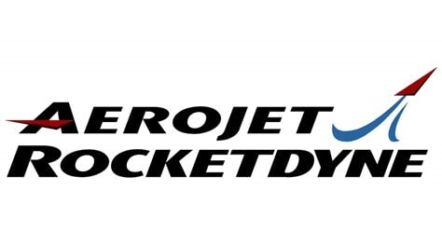
Integrating a Rotating Detonation Combustor with a
Power Generating Gas Turbine to Realize the Pressure Gain
Ajay K Agrawal, PI, University of Alabama
Joseph Meadows, co-PI, Virginia Tech
DOE Program Monitor: Richard Dalton
Graduate Students: Shaon Talukdar and Piyush Raj
2023 UTSR Meeting
State College, PA, November 01, 2023

Slide 2
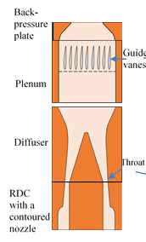
Project Objective
Integrate rotating detonation combustor (RDC) with turbine inlet to extract maximum work in power generating gas turbines.
Note that gas turbines are designed to operate with relatively small pressure, temperature, and flow fluctuations at the inlet

Slide 3
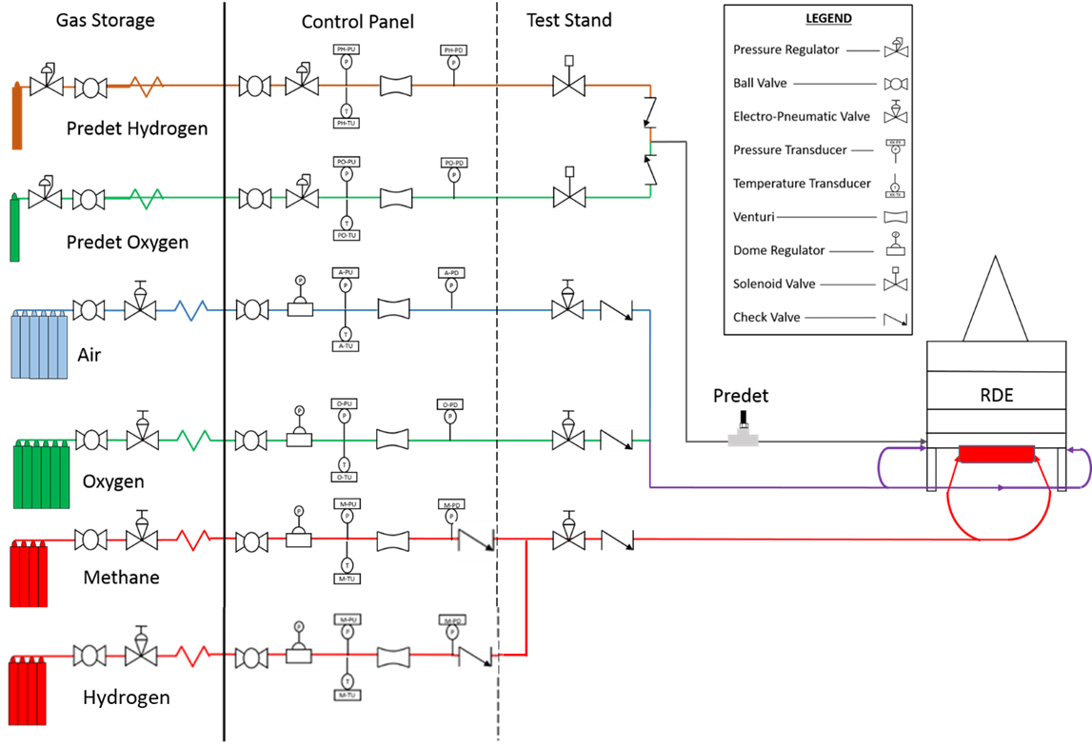
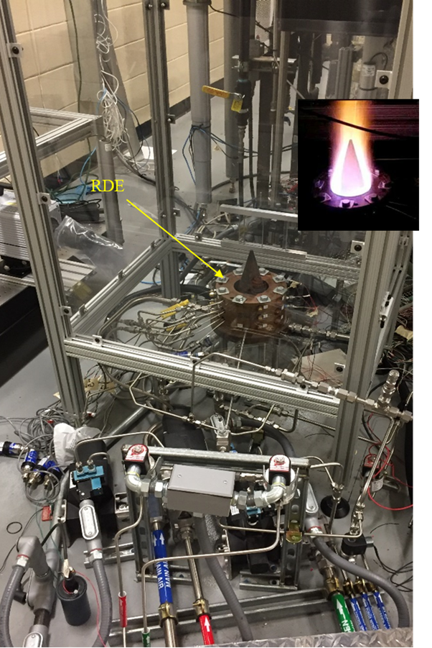
Reactant Supply System and Annular RDE Test Stand
Wave Speed ≈ 2000 m/s, Max Flow Velocity > 1000 m/s
10 cm Diameter RDC Power Output: Up to 10 MW
Notes:
Mixing
1) Pressure taps
2) Back Pressure Plate : Simulate real back pressure from a gas turbine

Slide 4
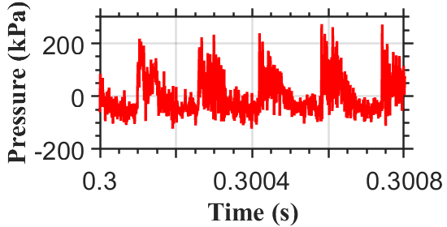
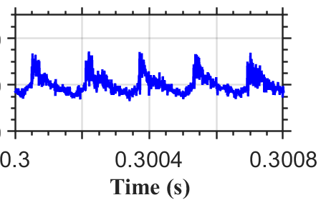
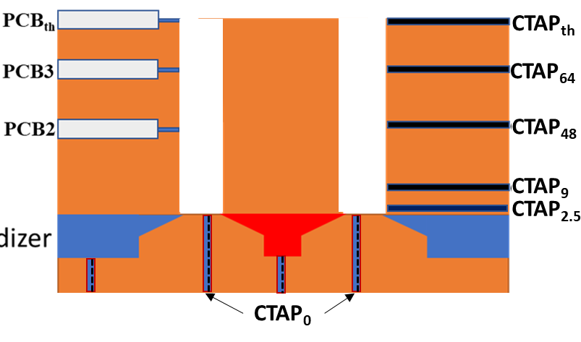
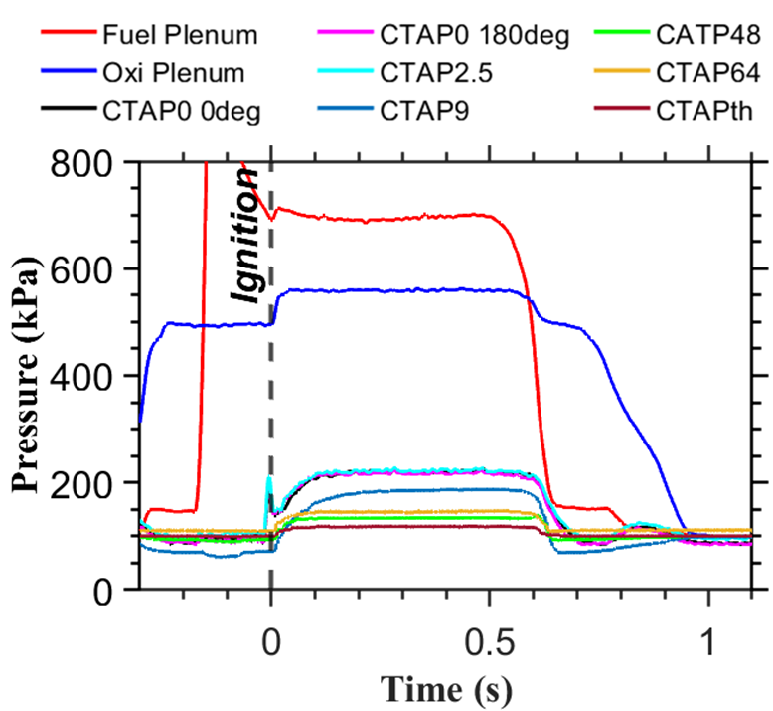
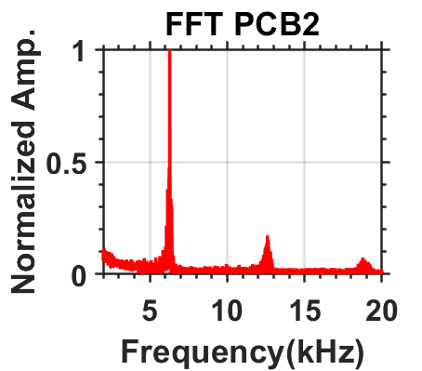
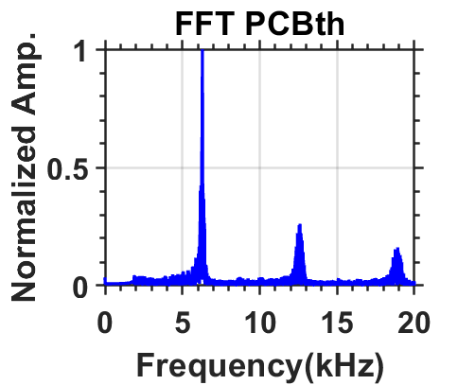
Integration Challenges
$$P_{ox}$$
$$P_{fuel}$$
6.3 kHz
6.3 kHz
Operating Conditions
$${\dot{m}}_{total}$$ (kg/s) | $X_{O_{2}}^{Ox} (\%$) | ER | A_{c}/A_{inj} | A_{c}/A_{th}
0.32 | 67 | 1.0 | 10.5 | 1.0
100 kHz PIV, Region of Interest: RDC Exit
High Speed Video

Slide 5
RDC with Constant Annulus Area
Large pressure drop across the injector (60%)
Substantial pressure drop across the combustor (2-19%).
Pressure oscillations (at 6.3 kHz) remain at the RDC exit
Unsteady and spatially non-uniform (hydrodynamically and thermally) RDE exit flow with high periodicity.
RDC exit flow contains oblique shock wave.
Oblique shock wave – turbine hardware interactions create complex flow structures, including reflected shock waves affecting upstream detonation itself.
Gas turbines are designed to operate with relatively uniform flow at the inlet.
$$P_{ox}$$
$$P_{fuel}$$
RDC Operational Mode
$$CJ Speed$$ ($m/s)$ | $$CJ Freq.$$ $$(kHz)$$ | $$RDC Freq.$$ $$(kHz)$$ | $$\% CJ$$
2250 | 7.2 | 6.3 | 88
Pressure Measurement (kPa)
$$P_{ox}$$ | $$P_{fuel}$$ | $${CTAP}_{0}$$ | $$∆P_{inj}$$ | $${CTAP}_{th}$$ | P_{t}
530 | 680 | 220 | 330 | 117 | 209
Pressure Gain/Loss
Injector | Pressure Gain
-60.0 % | -79% to -62.0%

Slide 6
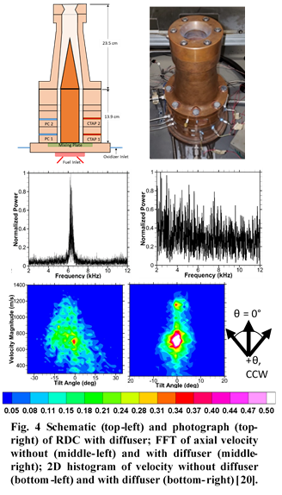
Prior Work
In our prior work with Aerojet-Rocketdyne, the RDC was integrated with a diffuser as shown.
Diffuser eliminated the oblique shock wave.
However, diffuser did not eliminate flow fluctuations; axial velocity varied between 300 m/s and 1,200 m/s.

Slide 7
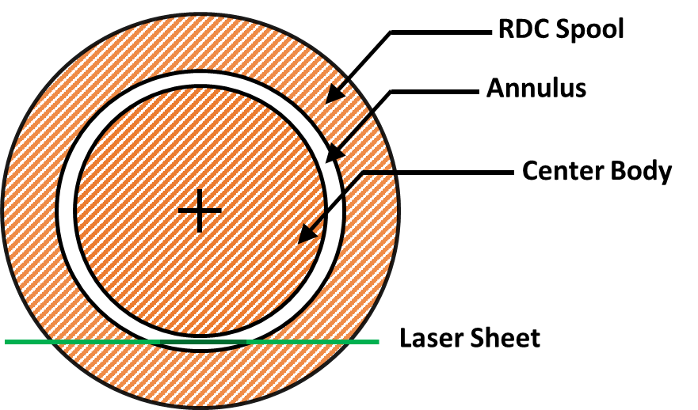
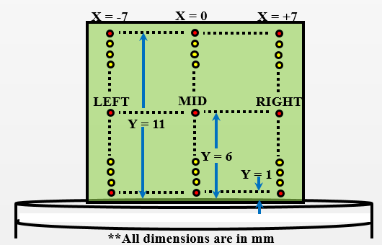
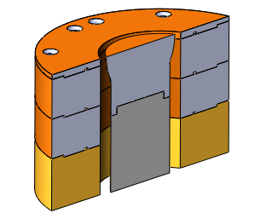
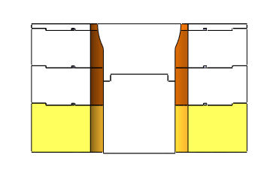
Mitigation: Place a Nozzle at the RDC Exit
**Units are mm
PIV ROI
Area Ratio (AR) $= \frac{Annulus Area }{Annulus Area at Nozzle Throat}$

Slide 8
RDC Performance Summary
Area Ratio (A_{c}/A_{th}) | $$\overline{P_{fuel}}$$ (kPa) | $$\overline{P_{oxi}}$$ (kPa) | $$\overline{CTAP 1}$$ (kPa) | $$\overline{CTAP 2}$$ (kPa) | $$\overline{CTAP 3}$$ (kPa) | $$\overline{P_{total}}$$ (kPa) | %PG | $$\overline{PCB}$$ (kPa)
1.0 | 642 | 631 | 163 | 121 | 122 | - | Up to -79 | 224
1.4 | 732 | 619 | 193 | 178 | 194 | 223 | -65 | 295
1.7 | 721 | 594 | 259 | 250 | 260 | 283 | -53 | 362
2.0 | 751 | 685 | 305 | 301 | 313 | 334 | -51 | 415
Assumption: M_{th} = 1.0
$${Total Pressure at Throat, P}_{total}={P_{CTAP}(1+\frac{γ−1}{2}M_{}^{2})}^{\frac{γ}{γ−1}}$$
Pressure Gain Calculation:
$${\%PG}_{}=\left(\frac{P_{total}}{(0.86∗P_{ox}+ {0.14∗P}_{fuel})}−1\right)∗100$$

Slide 9
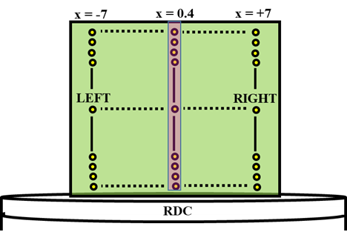
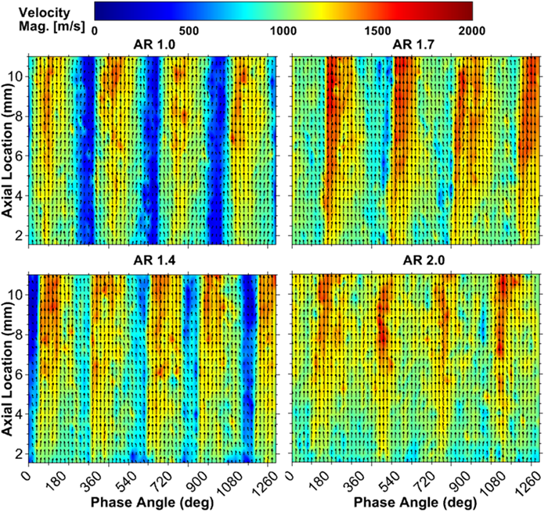
Periodic RDC EXIT Flow

Slide 10
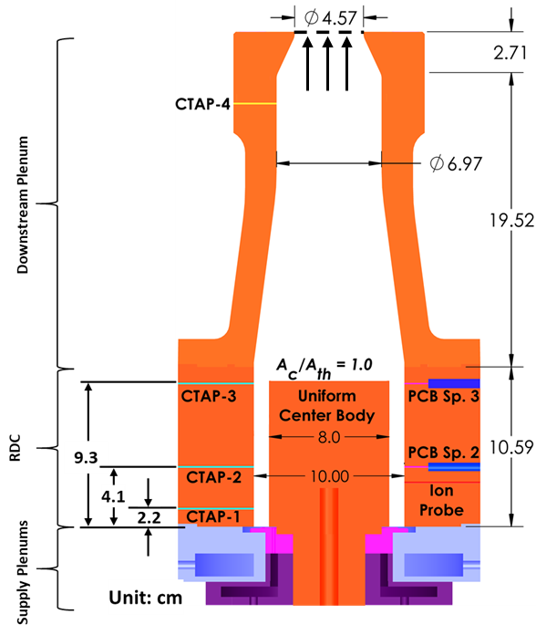
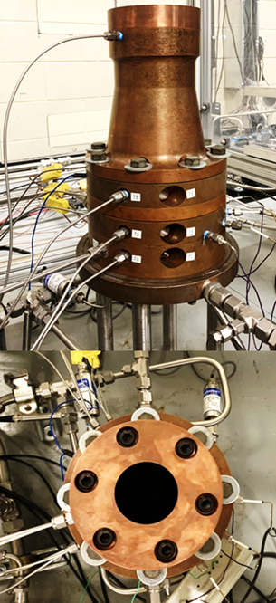
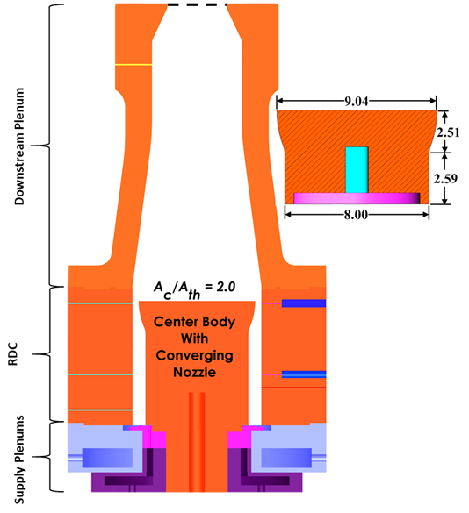
RDC test with backpressure plenum
Notice PCB Probe is Placed at the RDC Exit
Notes:
Talukdar et al. “PERFORMANCE CHARACTERISTICS OF A ROTATING DETONATION COMBUSTOR EXITING INTO A PRESSURIZED PLENUM TO SIMULATE GAS TURBINE INLET,” Accepted for ASME TurboExpo 2023.

Slide 11
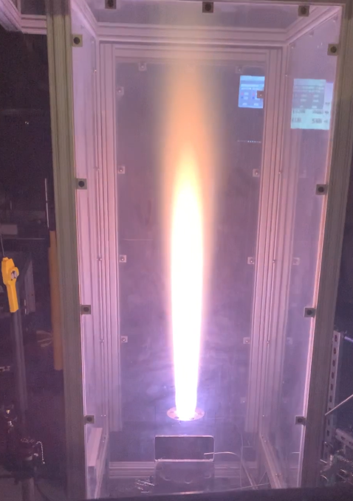
Test Conditions
Parameter | Value
Backpressure (atm) | 1.5-3.5
Total mass flow rate (lbm/s) | 0.5, 0.7, 1.0
A_{combustor}/A_{throat} | 1.0, 2.0
Fuel | CH₄
Oxidizer | O₂/N₂(0.667/0.33 by mole)
Equivalence ratio | 1.0

Slide 12
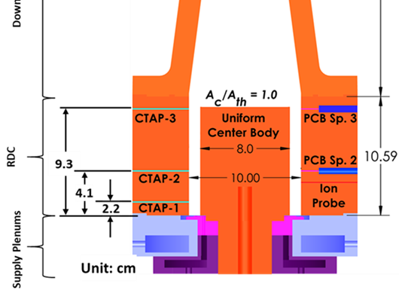
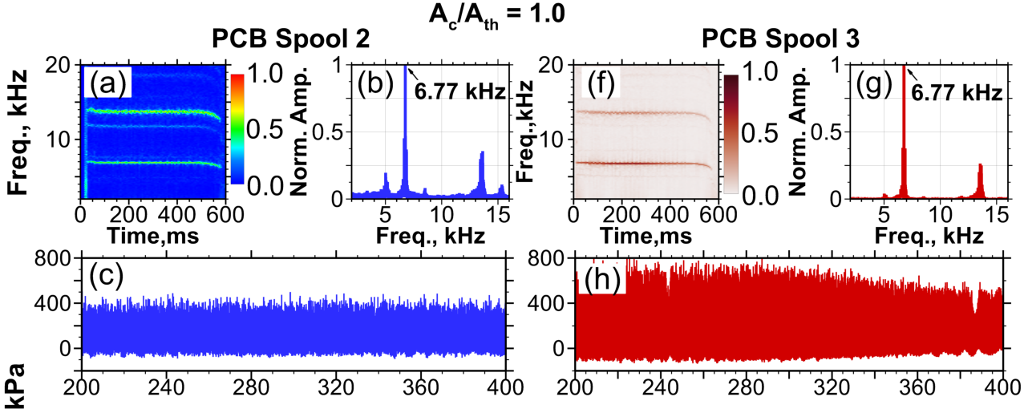
Shock Interactions (P_{exhaust}= 3.3 atm)
Higher pressure oscillations at the exit compared to those inside the RDC indicating coupling with the reflected oblique shock wave.

Slide 13
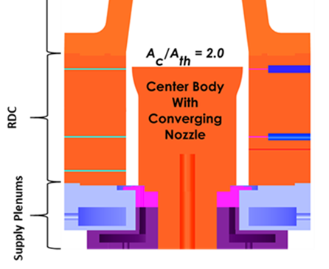
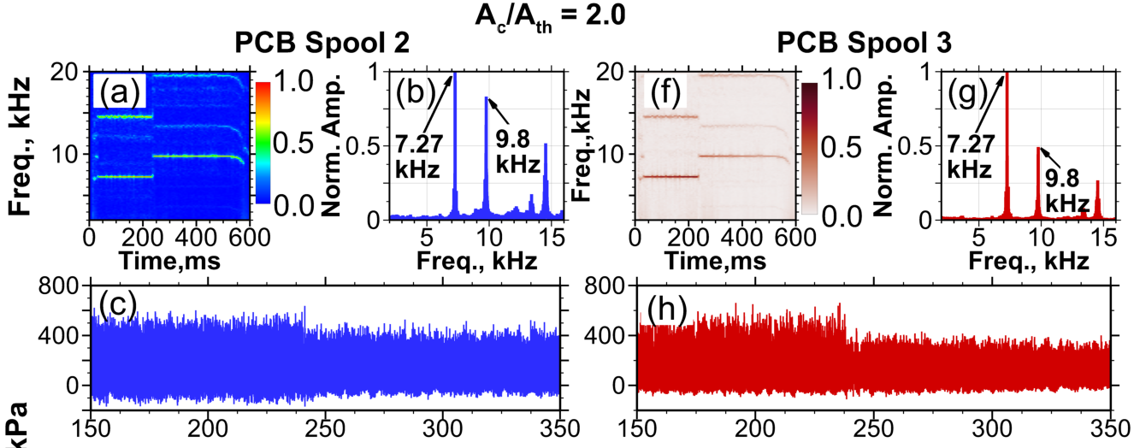
Combustor Dynamics (P_{exhaust}= 3.3 atm)
Pressure, kPa
Mode shift (single, 7.27 kHz→ double, 9.8 kHz ) at ~ 240 ms
Converging nozzle reduces strength of downstream propagating oblique shock & shields RDC from reflected shock

Slide 14
Summary, So Far
Increasing Area Ratio of the converging nozzle (from 1.0 to 2.0) at the RDE exit
Improves pressure gain (or rather reduces pressure loss) in RDC
Pressure oscillations decrease, but still remain at the RDE exit
Flow non-uniformities decrease, but still remain at the RDE exit
Oblique shock-wave is weaker, but shock still remains at RDE exit
Why not use even higher nozzle area ratio ?
We run into unstable detonation wave modes and shock reflections from the throat
Rapid to gradual (RTG) area profiling alleviates many these challenges

Slide 15
Rapid to Graduate (RTG) Area Profile
Our group introduced this concept in 2021
Bell, K., Schwer, D.A. and Agrawal, A.K., 2021. Effect of Cross-Sectional Area Profiling on the Performance of Disk Rotating Detonation Combustor. In AIAA SciTech 2021 Forum, AIAA 2021-1252.
Bell, K., Schwer, D. and Agrawal, A.K., 2023. Profiling cross-sectional area of a radial rotating detonation combustor to increase pressure gain. Aerospace Science and Technology, 133, p.108096.

Slide 16
RTG Area Profiling
CTAP0
CTAP0
Rapid decrease in area immediately after detonation
Followed by a gradual change in area towards the throat to increase residence time for subsonic-supersonic flows to mix together, which weakens the oblique shock
CTAP0

Slide 17
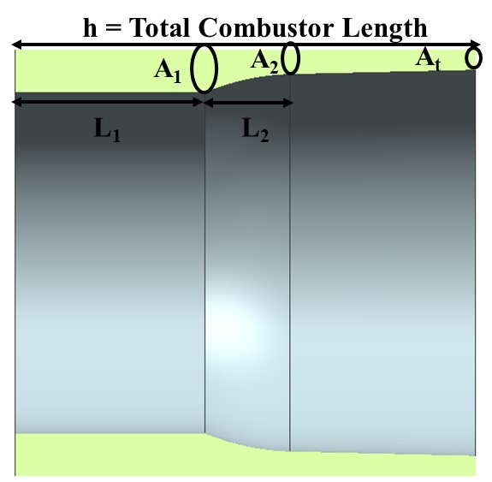
3D PROFILE OPTIMIZATION APPROACH
Objectives
Employs a 3D non-reacting CFD methodology to perform a design of experiment (DoE) study for optimization.
Objective of the design study:
maximizes pressure gain (EAP)
minimizes unsteadiness in axial and circumferential velocities.
Compare results from 3D reacting simulations between the optimized RTG profile and constant cross-section geometry along with the experimental data.
Figure: 3D RTG profile geometry of the RDE

Slide 18
Wave Dynamics of Conventional vs RTG Nozzle
Operating Conditions
$${\dot{m}}_{total}$$ (kg/s) | Fuel | $X_{O_{2}}^{Ox} (\%$) | ϕ | A_{c}/A_{th}
0.32 | CH₄ | 67 | 1.0 | 1.0-3.0
Observations
Baseline (no profile) shows a stable single wave mode operation.
Convergent nozzles with area ratio >2.0 show unstable operation, two pairs of counter rotating waves for area ratio 3.0.
RTG profile (area ratio 2.0-3.0) shows stable RDC operation with two corotating waves (8.4-8.7 kHz)

Slide 19
RDC Performance of Conventional vs RTG Nozzles
Pressure in kPa
AR | Profile | P_{ox} | P_{fuel} | CTAP₀ | %ΔP_{inj} | CTAP_{th} | P_{t_th} | %PG₁ | %PG₂
3.0 | Nozzle | 773 | 942 | 585 | 27% | 320 | 520 | -34.76 | -11.1
 | RTG | 765 | 950 | 570 | 28% | 327 | 566 | -28.44 | -0.7
Assumption: M_{th} = 1.0
Injector Pressure Drop:
$${ P}_{t_th}={P_{CTAP_th}(1+\frac{γ−1}{2})}^{\frac{γ}{γ−1}}$$
$${\%∆P}_{inj}=\left(\frac{\left(0.86∗P_{ox}+ {0.14∗P}_{fuel}\right)−{CTAP}_{0}}{(0.86∗P_{ox}+ {0.14∗P}_{fuel})}−1\right)∗100$$
Pressure Gain Calculation:
$${\%PG}_{1}=\left(\frac{P_{t_th}}{(0.86∗P_{ox}+ {0.14∗P}_{fuel})}−1\right)∗100$$
${\%PG}_{2}=\left(\frac{P_{t_{th}}}{{CTAP}_{0}}−1 \right)$*100

Slide 20
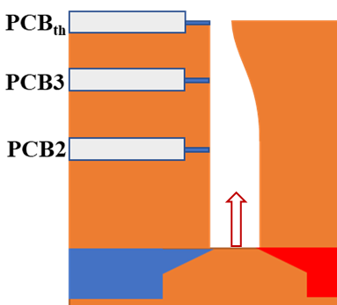
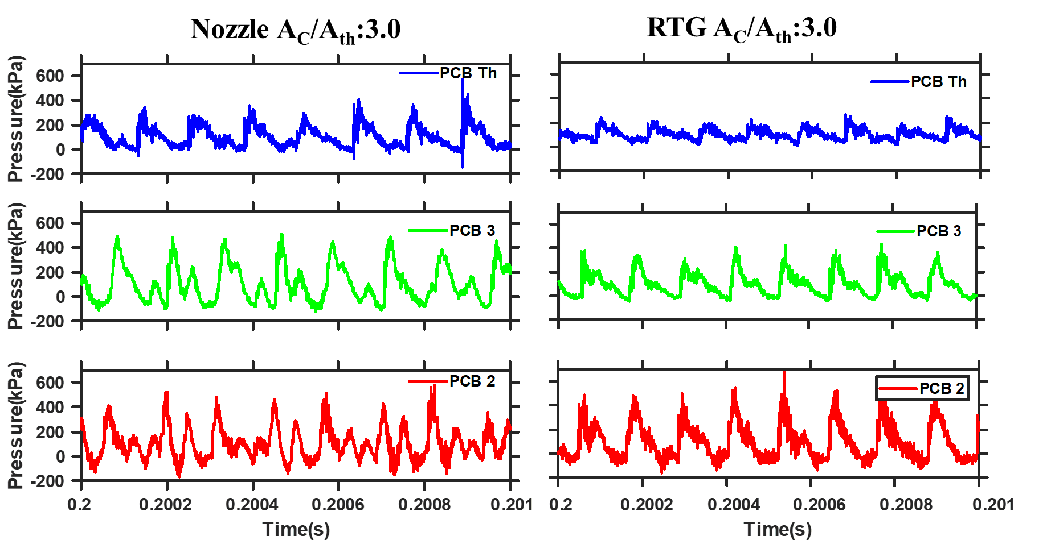
Pressure Oscillations of Conventional vs RTG Nozzle
Nozzle
RTG
RTG provides more uniform pressure at the throat

Slide 21
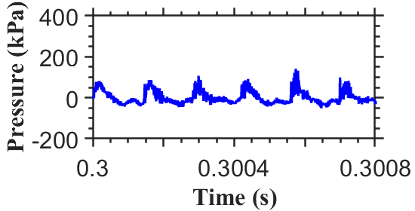
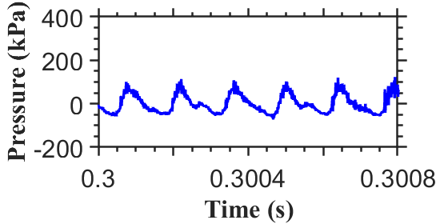
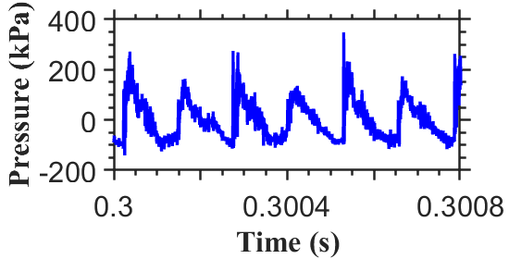
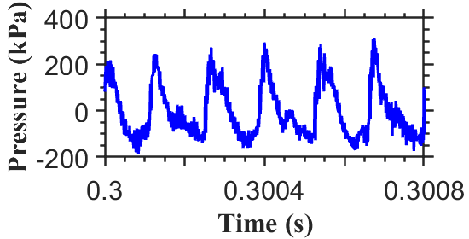
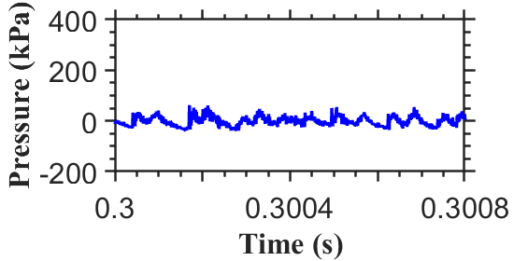
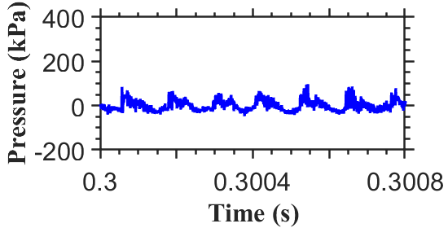
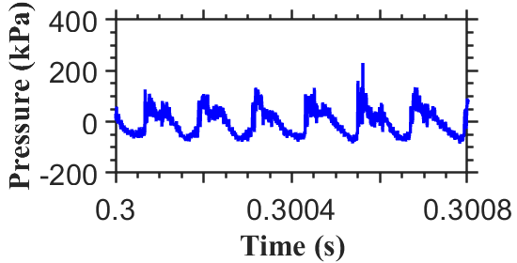
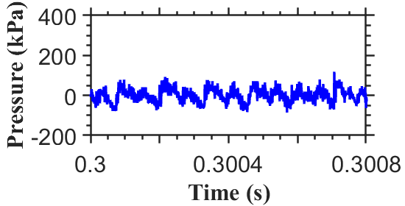
Comparing Pressure Oscillations at the Throat for Conventional vs RTG Nozzle
Convergent Nozzle
AR 2.0
AR 2.5
AR 3.0
AR 4.0
RTG

Slide 22
Benefits of RTG Area Profile
As AR increases above 2.0, RDC with convergent nozzle demonstrates unstable wave mode.
RDC with RTG profile showed stable two wave mode at higher ARs.
For a specific AR, RDC with RTG nozzle provides higher performance (pressure gain) compared to an equivalent conventional nozzle.
Pressure fluctuations at the throat reduce significantly with the RTG nozzle, indicating improved uniformity of the flow leaving the RDC.

Slide 23
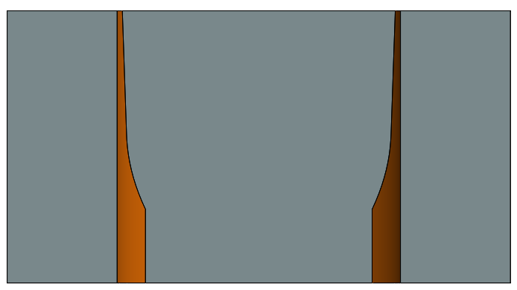
Pushing RTG Nozzle Further to AR5.0
Experiments performed for:
Varying mass flow rate
0.5, 0.7, 1.0 lbm/s
Equivalence ratio = 1.0
% O2 = 66.67%
Varying oxygen content in oxidizer
66.67%, 75%, and 85%
0.7 lbm/s
Equivalence ratio = 1.0
RTG AR5.0

Slide 24
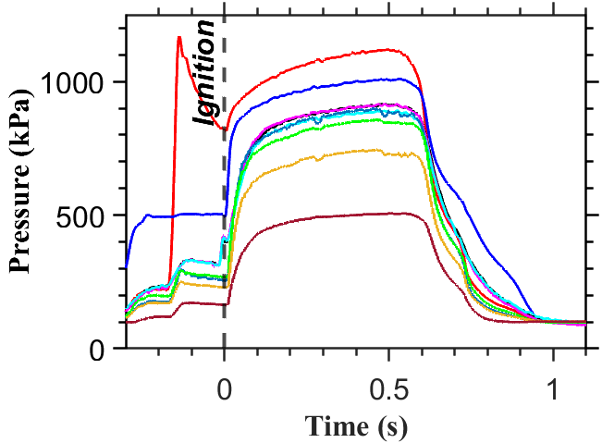
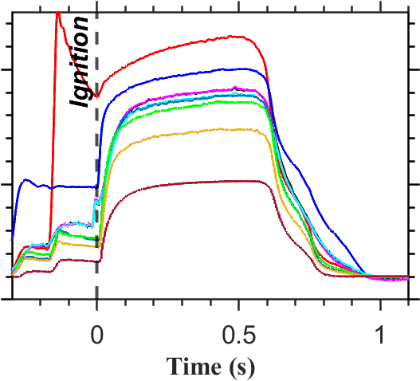
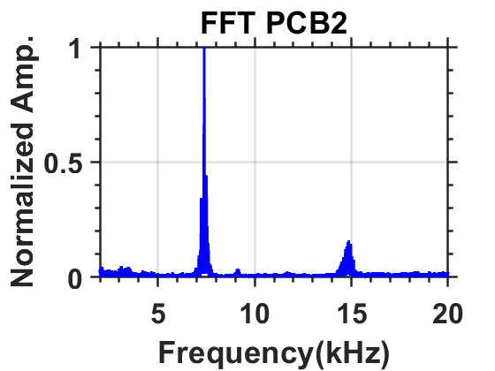
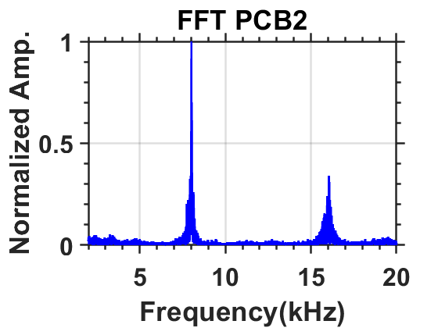
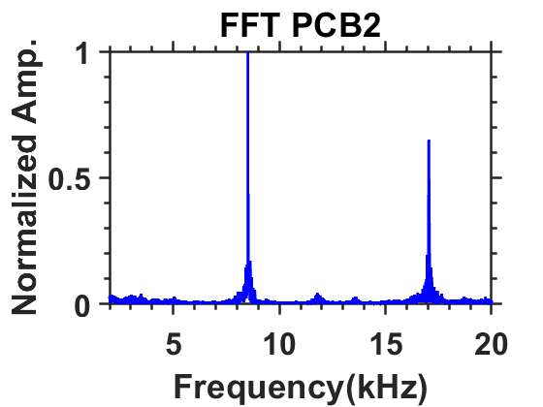
O2 Variation: Operation of RDC with RTG Profile
66.67%
75%
85%
7.4 kHz
8 kHz
8.5 kHz

Slide 25
RDC Performance Summary: Flow Rate Variation
Pressure in kPa
AR | % O2 | P_{fuel} | P_{ox} | CTAP₀ | %ΔP_{inj} | CTAP_{th} | P_{t_th} | %PG₁ | %PG₂
5.0 | 66.67 | 1107 | 997 | 902 | 10.9% | 501 | 893 | -11.8% | -0.2%
 | 75.0 | 1114 | 982 | 897 | 10.5% | 507 | 905 | -9.5% | 0.81%
 | 85.0 | 1191 | 995 | 919 | 10.6% | 521 | 928 | -9.0% | 0.85%
Pressure Gain Calculation:
$${\%PG}_{1}=\left(\frac{P_{t_th}}{(Y_{ox}∗P_{ox}+ {Y_{fuel}∗P}_{fuel})}−1\right)∗100$$
${\%PG}_{2}=\left(\frac{P_{t_{th}}}{{CTAP}_{0}}−1 \right)$*100

Slide 26
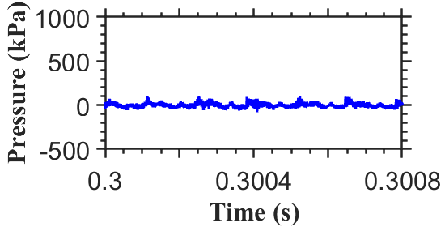
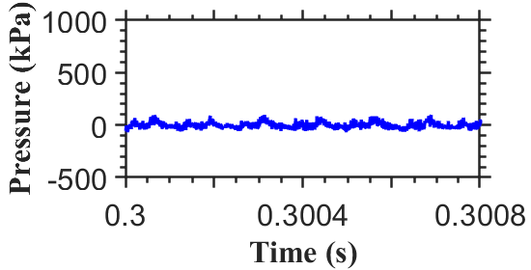
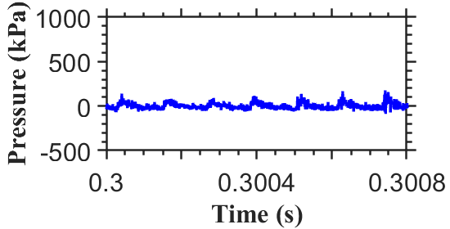
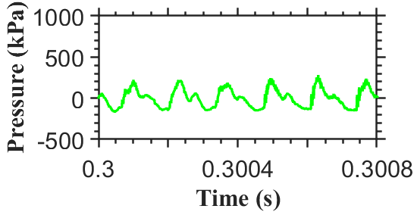
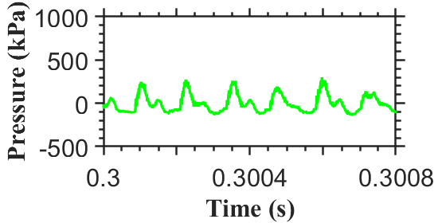
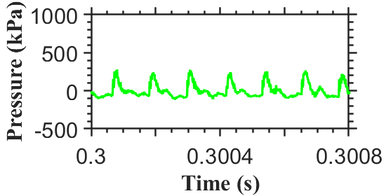
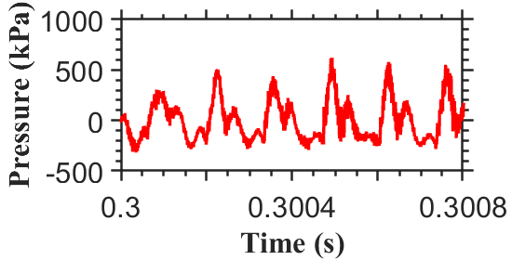
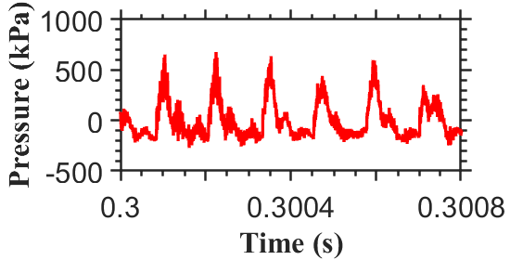
O2 Variation: Operation of RDC with RTG Profile
66.67%
75%
85%
PCBth
PCB3
PCB2

Slide 27
Concluding Remarks
Successful RDC operation requires an integrated approach considering both injectors and downstream components.
RTG nozzle is superior to conventional nozzle for RDC applications. It provides residence time needed to decelerate supersonic flow and accelerate subsonic flow in the combustor channel.
RDC can be operated with very high area ratio RTG nozzle
RTG nozzle eliminates integration problems of RDCs
Increased pressure gain, stable wave modes, no shock reflections
Highly unform exit flow without oblique shock wave
Next question:
Can we increase the number of waves to further increase the pressure gain?

Slide 28
Large pressure drop across the injector (60%) RTG 5.0: about 10%
Substantial pressure drop across the combustor (2-19%). RTG 5.0: slight gain
Pressure oscillations (at 6.3 kHz) remain at the RDC exit RTG5.0: No more
Unsteady and spatially non-uniform (hydrodynamically and thermally) RDE exit flow with high periodicity. RTG5.0: Likely no more
RDC exit flow contains oblique shock wave. RTG5.0: No more
Oblique shock wave – turbine hardware interactions create complex flow structures, including reflected shock waves affecting upstream detonation itself.
RTG5.0: Likely no more

