Slide 1

Performance of a Radial Rotating Detonation Engine with an Aerospike
Dalton Langner, Apurav Gupta, Ashley James, Ajay Agrawal
Dept. of Mechanical Engineering, The University of Alabama
AIAA SciTech Forum & Exposition , January 8-12, 2024
Copyright © by Ajay Agrawal
Published by the American Institute of Aeronautics and Astronautics, Inc., with permission.

Slide 2
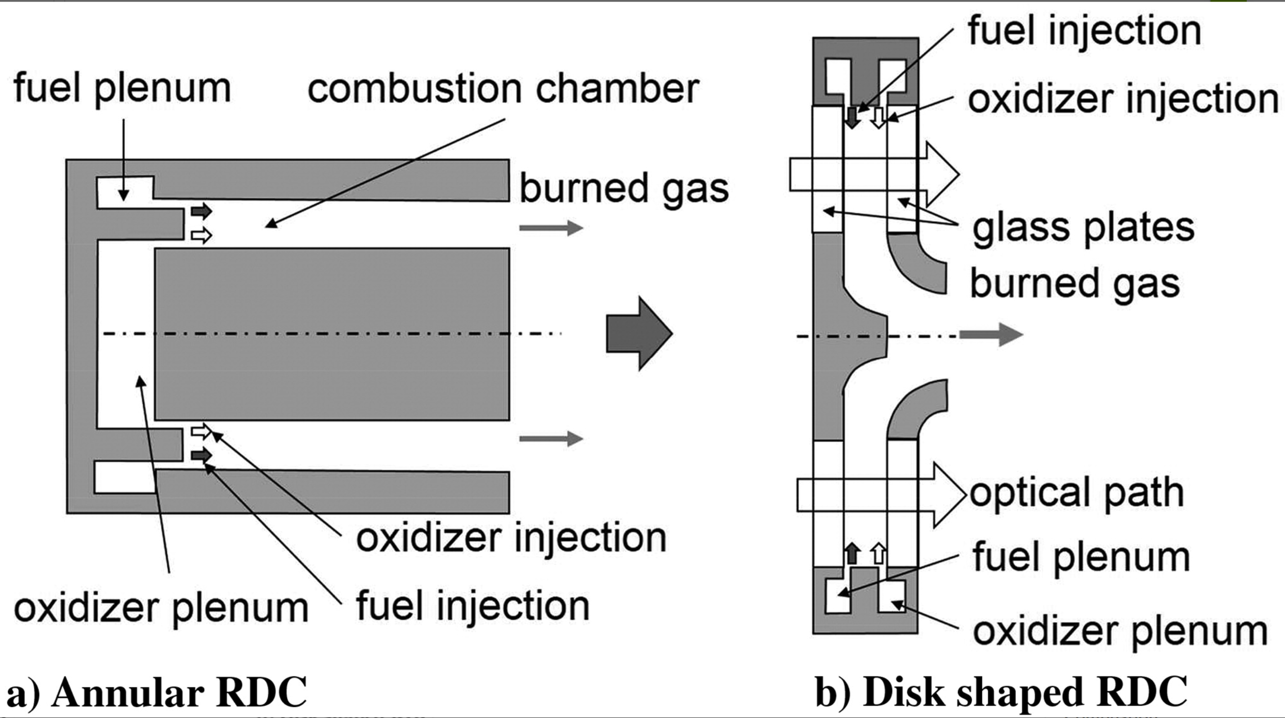
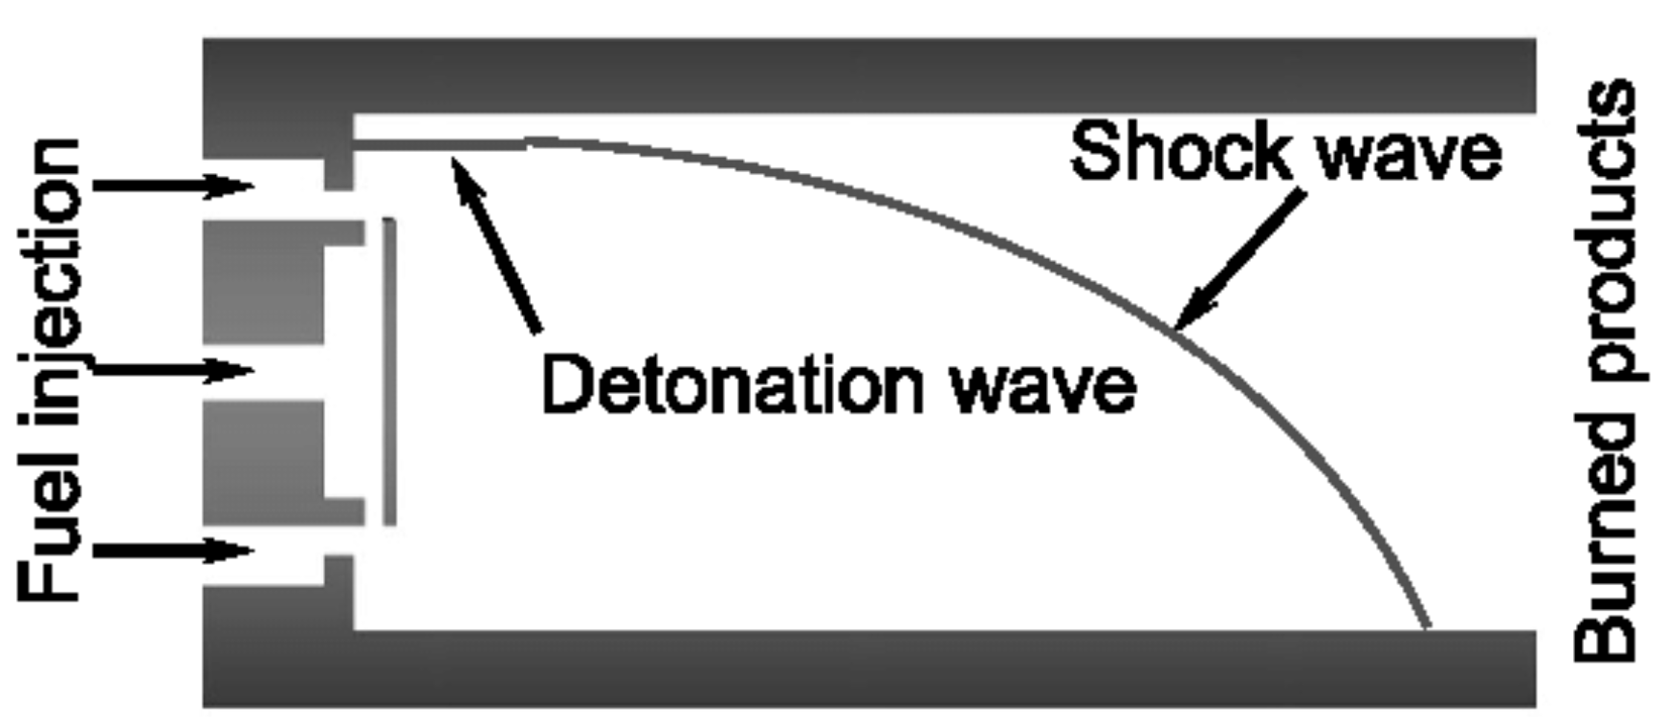
RDE Geometries
  Annular Hollow/ Cylindrical Radial/ Disk
Paxson ([1], 2020) has shown higher performance with radial RDE
Radial RDE reduces length, which is especially important for rocket propulsion.

Slide 3
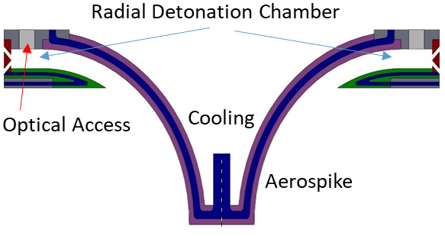
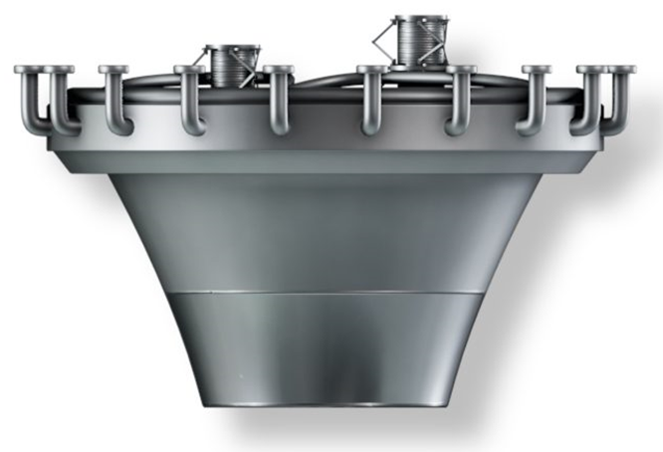
Radial RDE for rocket propulsion
Parallel Plates
  Constant height
Natural convergence
  Increased chamber pressures
  Flow conditioning
Integrated aerospike
  No bulky bell nozzle
  Further length and weight reduction
  Possible volume for rocket hardware
Rocketdyne J-2T

Slide 4
Objectives
Instrument and operate a Radial RDE integrated with an aerospike
Perform experiments to evaluate performance and operation
  CTAPs: internal, geometric throat, aerospike surface
  Thrust
  PCBs and wave modes
  Understand relationship between wave characteristics and performance

Slide 5
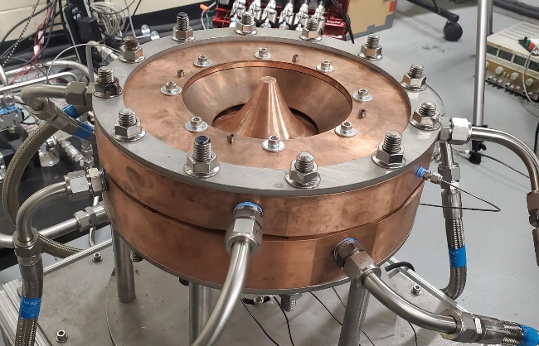
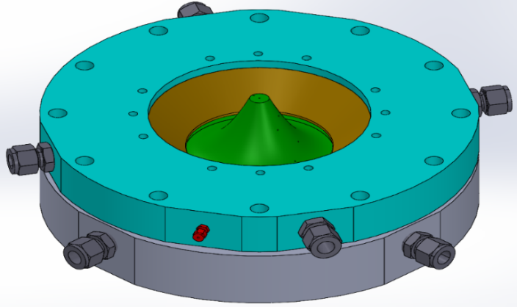
Radial RDE at The University of Alabama
10.4 cm injection plane, ~5.3 cm geometric throat

Slide 6
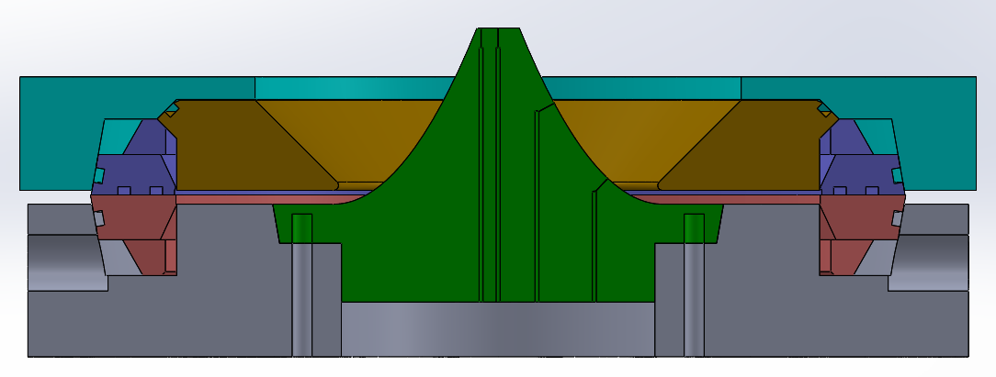
Radial RDE Components
1
5
2
3
6
4
1 – top support plate 2 – oxidizer injector ring 3 – fuel injector ring
4 – bottom support plate 5 – contour plate 6 – aerospike
Notes:
Parallel plates

Slide 7
Instrumentation
Internal CTAPs
  0A, 0B, 1, 2A, 2B, 3
  Throat to determine EAP using modified NPS method
Aerospike CTAPs
  1-8
  Not all used
Recessed PCBs, A & B
Thrust measurement
DETONATION
INT (INTERNAL) CTAP
AERO (AEROSPIKE) CTAP
PCB
7
8
6
5
4
3
2
1
0A
0B
.
1
2A
2B
Throat
A
B
3

Slide 8
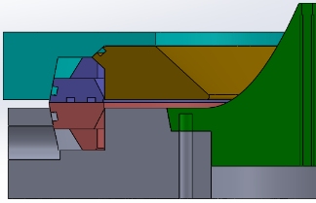
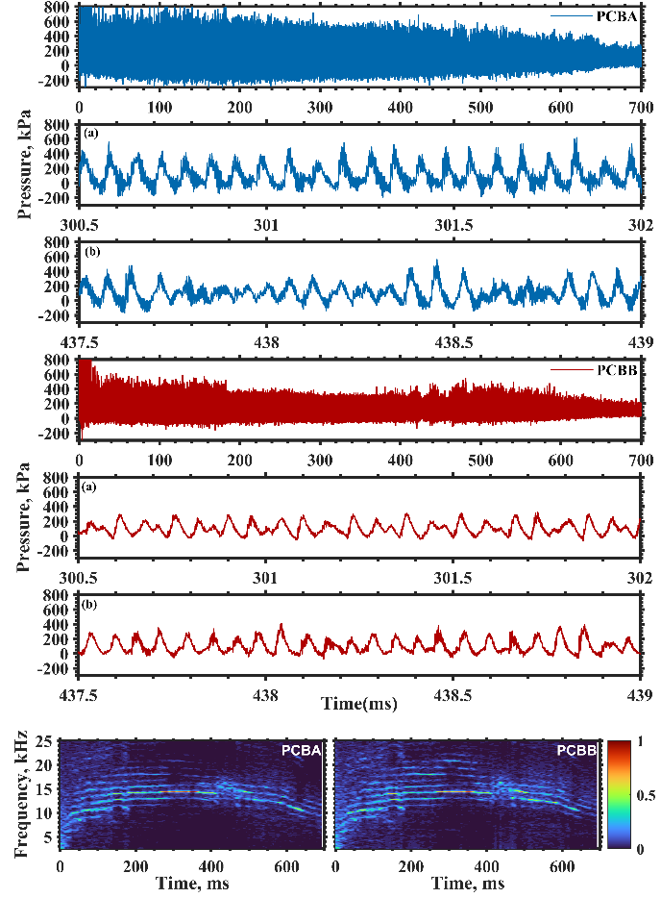
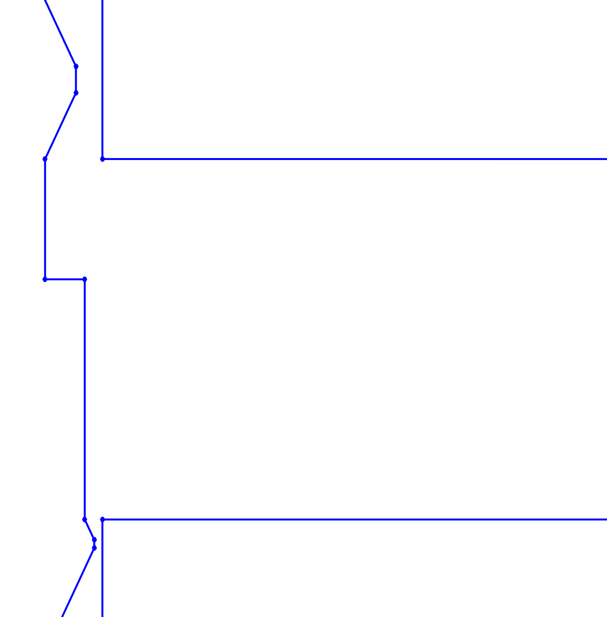
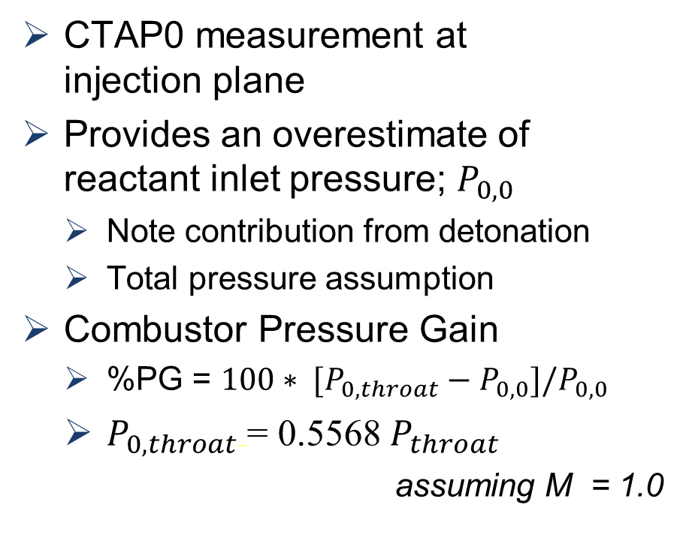
CTAP 0
CTAP0 measurement at injection plane
Provides an overestimate of reactant inlet pressure; $P_{0,0}$
  Note contribution from detonation
  Total pressure assumption
Combustor Pressure Gain
  %PG = ${{100∗ [P}_{0,throat}−P}_{0,0}]/P_{0,0}$
  $P_{0, throat}$= 0.5568$P_{throat}$
  assuming M = 1.0
Ox. flow
CTAP 0
Fuel flow

Slide 9
Test Conditions
Methane Fuel
67/33 O₂/N₂ “enriched-air”
  Mole basis
3 Test Cases
Baseline
  Φ = 0.7
  ṁ_{t}= 0.136 kg/s (0.3 lbm/s)
Increased reactant flow rate
  Φ = 0.7
  ṁ_{t} = 0.318 kg/s (0.7 lbm/s)
Increase Equivalence Ratio
  Φ = 0.8
  ṁ_{t} = 0.318 kg/s (0.7 lbm/s)

Slide 10
Baseline – Φ = 0.7, ṁ_{t}= 0.136 kg/s
Stable pressures
  Decreasing trend in flow direction
Low aerospike flow
115 N thrust
  100-pt moving avg.
  250 ms fluctuations
5.4, 7.0, 8.5 kHz
  2, 3, 4 waves
  ~ 78, 67, 62% CJ

Slide 11
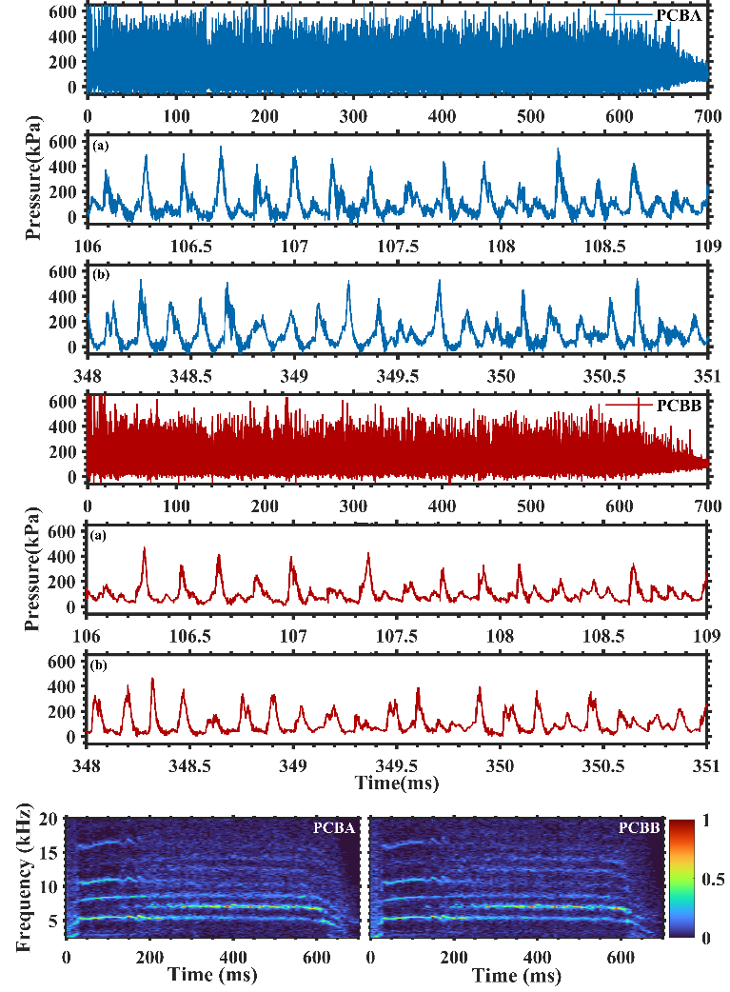
Baseline – Φ = 0.7, ṁ_{t}= 0.136 kg/s
Primary and secondary pressure peaks
5.4 and 8.3 kHz initial
Shifts to 5.4, 7.0, 8.5 kHz
Possible galloping wave mode
  Limit cycle oscillation
  3 major waves
7.0 kHz stronger at 250 ms
  Thrust fluctuations

Slide 12
Higher Flow rate - Φ = 0.7, ṁ_{t}= 0.318 kg/s
P shift ~350ms
Throat vs Aerospike
  Differing behavior
430 N to 330 N
Wide freq. band
>10% PG in combustor

Slide 13
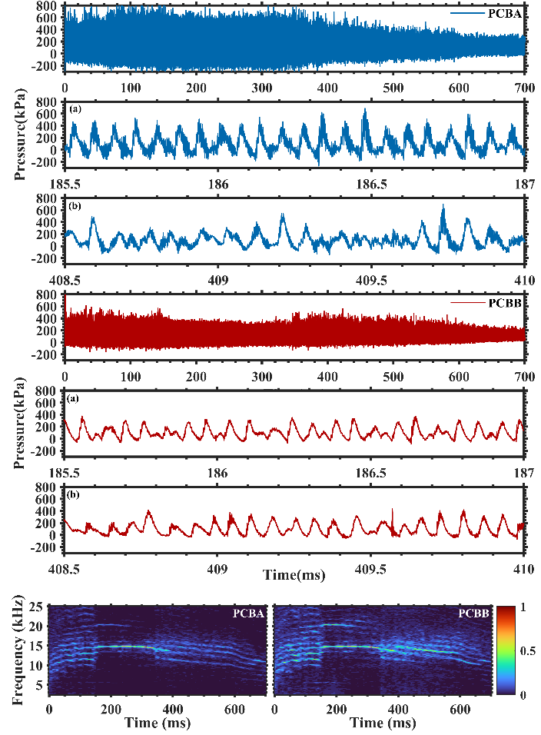
Higher Flow rate - Φ = 0.7, ṁ_{t}= 0.318 kg/s
Differing waveforms
  Consistent
  Sporadic
Many present frequencies
  Harmonics
  Complex galloping
  Counter-rotating
14.7 kHz
  7 waves, 61% CJ

Slide 14
Increased equivalence ratio - Φ = 0.8, ṁ_{t}= 0.318 kg/s
210 & 460 ms
  Internal & aerospike
410 to 350 N
  Behavior change
    300 – 420 ms
>11% combustor PG

Slide 15
Increased equivalence ratio - Φ = 0.8, ṁ_{t}= 0.318 kg/s
Differing waveforms
  Consistent
  Sporadic
Many present frequencies
  up to 20.7 kHz
14.4, 20.7 kHz
  7, 12 waves
  62%, 52% CJ
  Real CJ changes

Slide 16
Conclusions and Findings
Steady detonation was achieved with a Radial RDE integrated with an aerospike
Complex wave modes with likely large numbers of waves were observed
  “Wave shearing” postulation
Shifts in wave behavior have been observed to correlate with changes in pressure and thrust data
  Not inherently consistent throughout data (aka effects portions of flow/expansion differently)
Positive pressure gain in the combustor when viewed in isolation from supply and injection

Slide 17
Future Work
Different engine geometries
  Contour plates, area profiling
  Geometric optimization
Ion probe data correlation
  Understand wave modes

Slide 18
Acknowledgements
This research is supported in part by NASA Grant 80NSSC20K0305.
We would like to thank Dr. Dan Paxson of NASA GRC for insightful discussions and helpful advice.

Slide 19

Thank you
Questions?

