Slide 1


QUANTITATIVE MEASUREMENTS IN THE EXHAUST FLOW OF A ROTATING DETONATION COMBUSTOR
USING RAINBOW SCHLIEREN DEFLECTOMETRY
Apurav Gupta, Robert S. Miller, Kayla Bell, Dalton G. Langner, Ajay K. Agrawal*
The University of Alabama
PGC Session I, June 24, 2024, from 8:00 AM to 10:00 AM

Slide 2
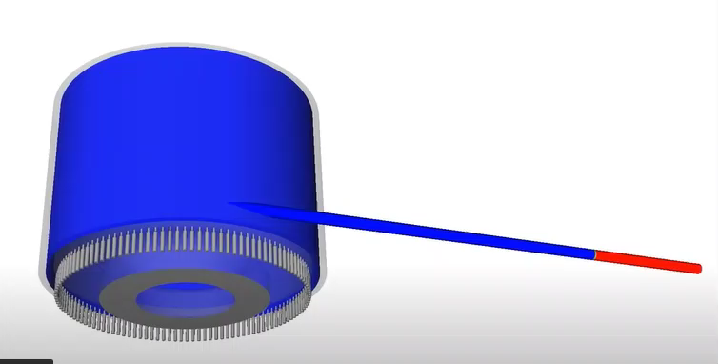
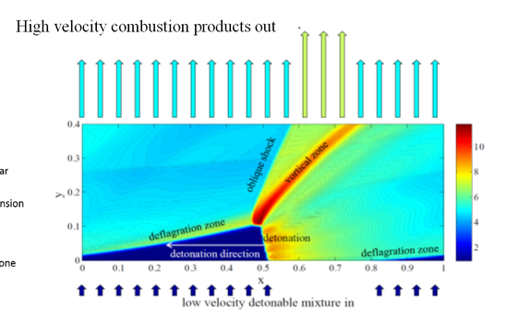
Rotating Detonation Combustors
Flame front moving at supersonic speeds.
Pressure gain during the combustion process
Potential for RDC-Turbine integration with increased thermal efficiency
Notes:
Power gen, rockets, jets use deflagration, subsonic Basic definition, can be used for both power generation and turbine application. Unwrapped version of RDE in numerical simulations. Bottom figure shows RDE in firing conditions at ECL

Slide 3
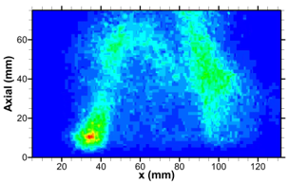
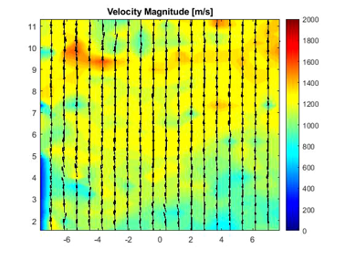
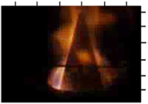
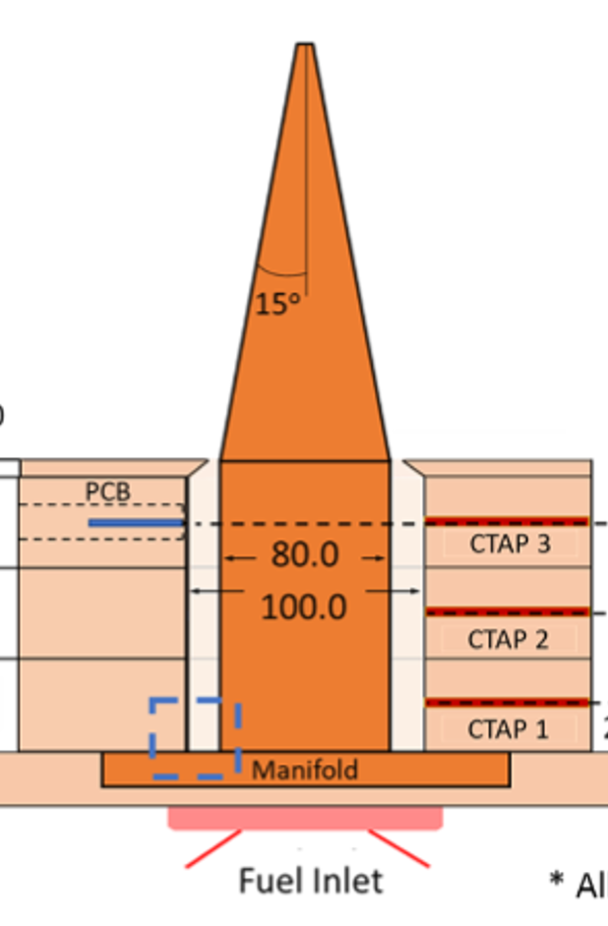
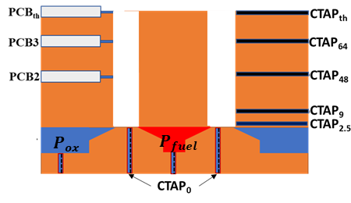
Optical Diagnostics
Chemiluminescence
Particle Image Velocimetry – Velocity Fields
PIV ROI
Tobias et. al. ^{[1]}
Talukdar et. al. ^{[2]}
30kHz OH* chemiluminescence taken at RDC exit.
Qualitative assessment.
100 kHz planar measurement at RDC exit.
Quantitative instantaneous vector fields.
[1] Tobias, Jonathan, Ajay K. Agrawal, and Ron Daniel Jr. "OH* chemiluminescence imaging of the combustion products from a methane-fueled rotating detonation engine." Journal of Engineering for Gas Turbines and Power 141, no. 2 (2019): 021021.
[2] Agrawal, Ajay K., Shaon Talukdar, Dalton Langner, and Apurav Gupta. "Flow Characterization of a Rotating Detonation Combustor Integrated with Various Convergent Nozzles." In AIAA SCITECH 2023 Forum, p. 1295. 2023.
Notes:
can provide in-depth information without disturbing the flow field or damaging the measurement apparatus, diagnostics used in the lab, Chemiluminescence imaging uses energy emitted by the target species to gain insights into reactive regions. Seed particles introduced in the flow are illuminated using a planar sheet of laser and the distance traveled by particles is tracked between subsequent frames of images captured.

Slide 4
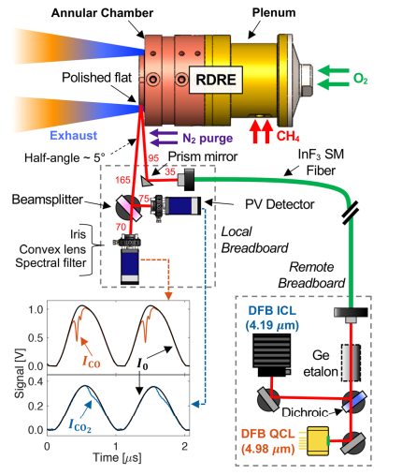
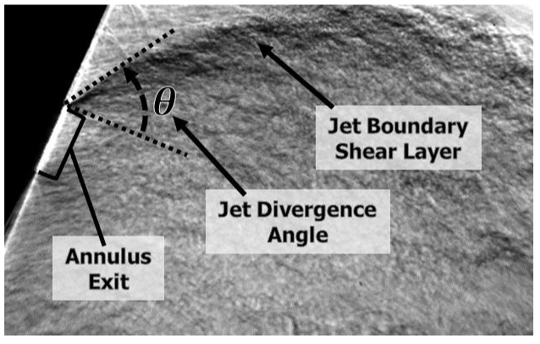
Optical Diagnostics
Tunable Diode-Laser Absorption Spectroscopy – Temperature, pressure, species
Schlieren Imaging
- Density Gradients
Dille et. al. ^{[2]}
Nair et. al. ^{[1]}
Developed procedure to calculate average stagnation pressure at the throat of RDC exit.
Line of sight measurements introduce spatial uncertainties.
[1] Nair, A. P., Lee, D. D., Pineda, D. I., Kriesel, J., Hargus, W. A., Bennewitz, J. W., Danczyk, S. A., and Spearrin, R. M., “MHzlaser absorption spectroscopy via diplexed RF modulation for pressure, temperature, and species in rotating detonation rocketflows,”Applied Physics B, Vol. 126, No. 8, 2020, pp. 1–20.
[2] Dille, K. J., Frederick, M. D., Slabaugh, C. D., and Heister, S. D., “Rotating detonation combustor performance informed through a novel megahertz-rate stagnation pressure measurement,” Physics of Fluids, Vol. 36, No. 2, 2024.
Notes:
TDLAS uses laser technology where the attenuation of the source ray due to photonic absorption by the target species can be used to quantify the parameter. AFRL CA base schematic, polished flat surface for the laser to reflect and N2 purge to eliminate changes in data due to water vapour

Slide 5
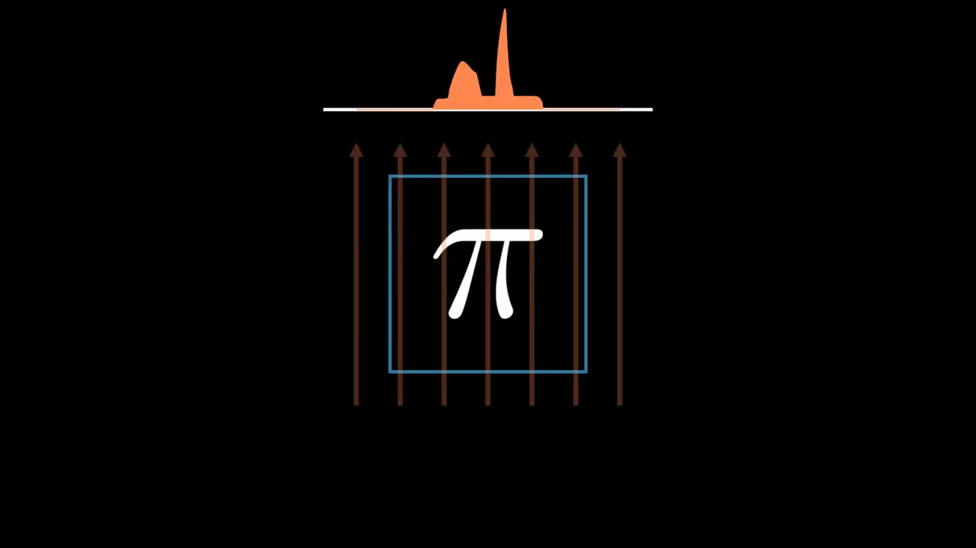
Tomographic Reconstruction
Obtain projections
Reconstruction
Resolves internal structures of a test media from conventional projection images.
Notes:
Resolve internal structures, projections at 0 deg and 180 are same inverted in sign. It has the ability to extend the number of spatial dimension of an optical diagnostic technique. Tomography employs simultaneous path-averaged measurements of light recorded from a unique perspective to extract planar or volumetric information about the target flow field through a reconstruction algorithm

Slide 6
GOALS OF THE STUDY
Measure 3D density field in RDC exhaust using schlieren tomography
Understanding shock wave patterns and interactions in RDC exhaust.
Visualizing these phenomena to optimize combustor design for maximum exhaust efficiency and combustor performance.
Notes:
We can resolve these

Slide 7
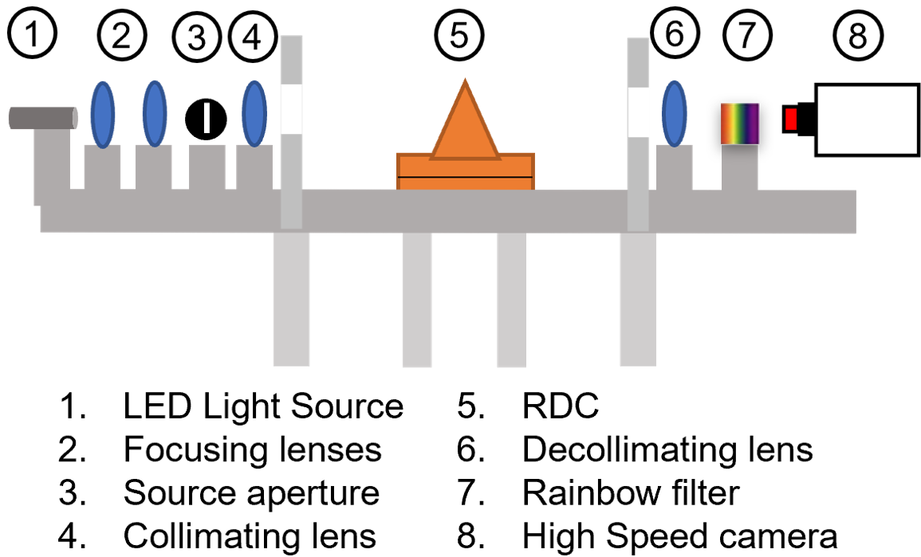
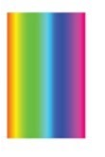
Rainbow Schlieren Deflectometry
Leverages differences in optical density into ray deflections
These deflections can be quantified with change in color of the filter.
Notes:
Better than conventional, can be used to quantify

Slide 8
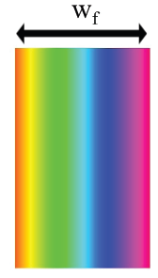
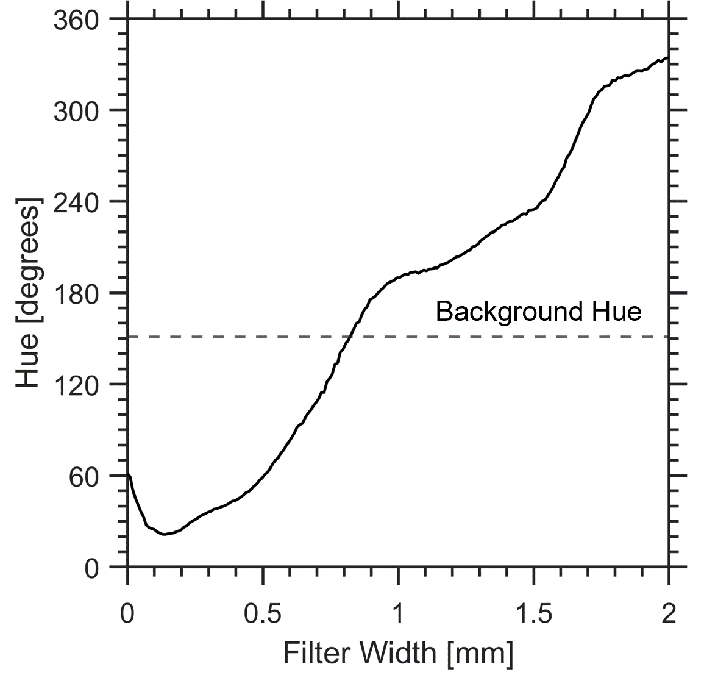
Quantitative Rainbow Schlieren Deflectometry
Hue
Deflection
Deflection Angles
Optical Density
d(x) ≅ f₂ ε(x)
f2
Numerical Algorithm
Rainbow Filter
Decollimating lens
Rainbow Filter
Calibration curve
Deflectometric data
Abel Inversion/
Tomography
Notes:
Traverse through the filter width, create calibration curve. Based on bckgrnd hue, can calculate displacement, convert to deflection angles, convert to optical density and then to a thermodynamic propoerty

Slide 9
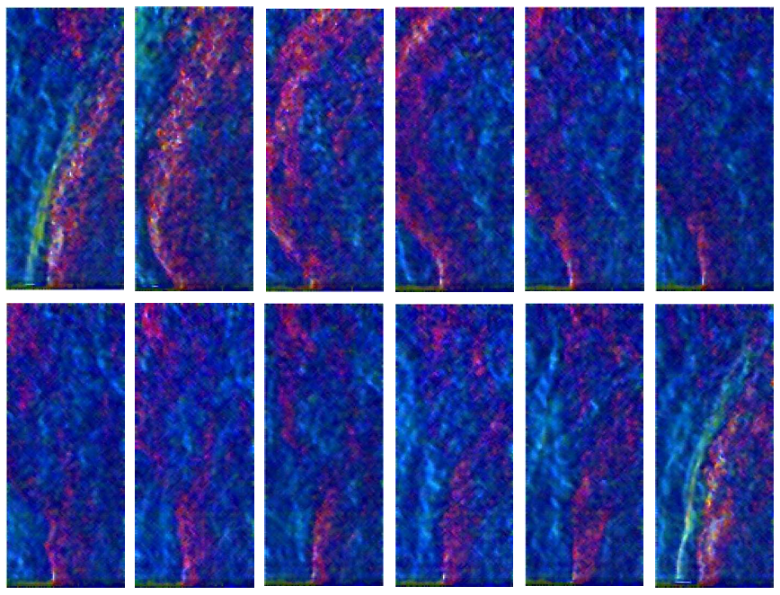
Rainbow Schlieren Deflectometry Images of RDE Exhaust

Slide 10
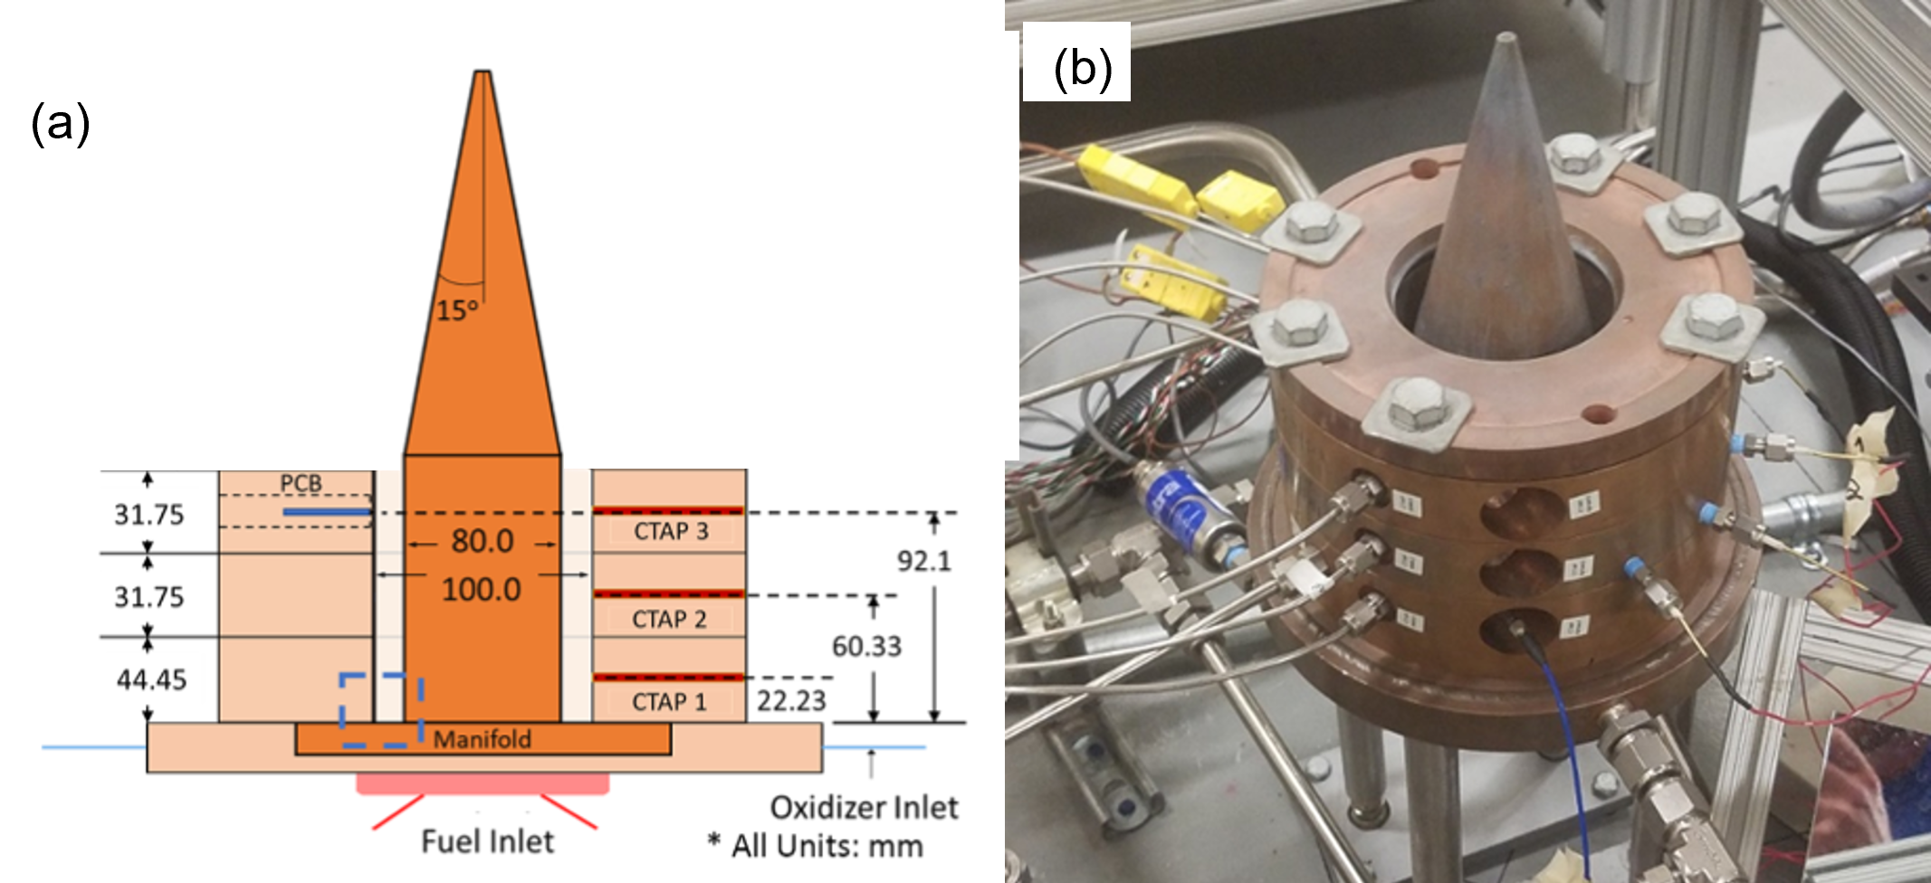
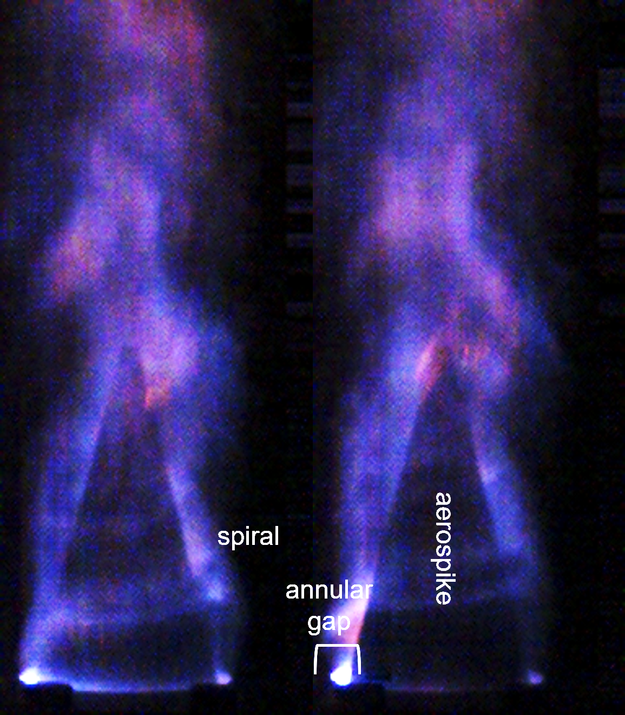
RDC Setup
(a)
(c)
RDC schematic and probe locations
RDE hardware
Consecutive snapshots during hotfire
Notes:
Wall measurements in the plenums and at each spool

Slide 11
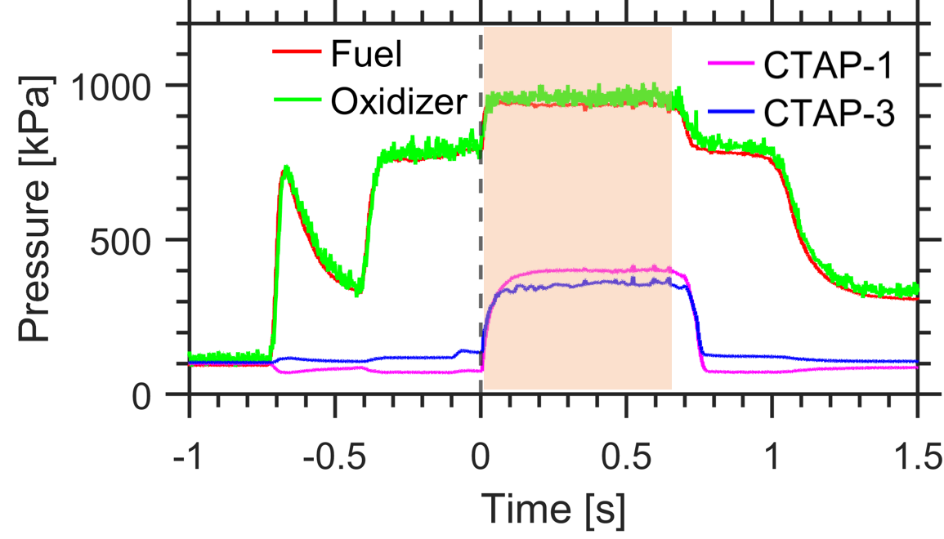
Operating Conditions
  Operated using CH₄ as fuel and 2/3 O₂ and 1/3 N₂ as oxidizer mixture
  Static pressure measurements show steady operating conditions
Test Duration
Test Duration | 500 ms
Total Mass Flow Rate | 0.422 kg/s
Equivalence Ratio | 1.0
Heat Release Rate | 3.63 MW
Operating Frequency | 6.96 kHz

Slide 12
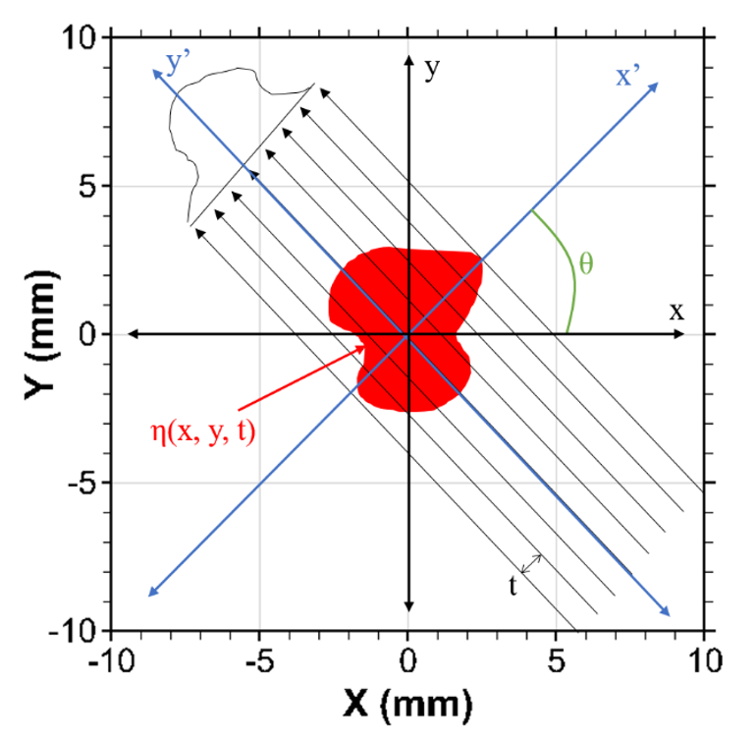
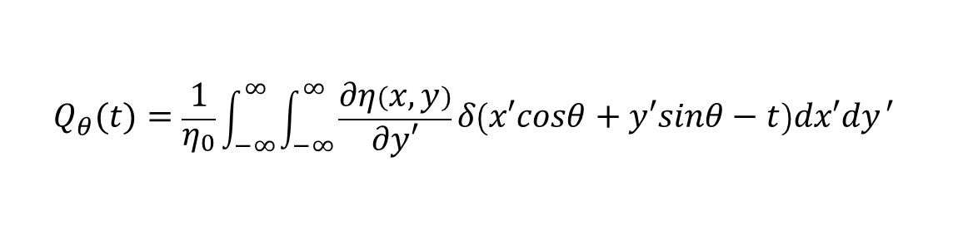
Projections
Projections are taken at different view angle
2D deflectometric projections can be reconstructed into 3D scalar fields given surrounding properties.
$$Q_{θ}(t)=\frac{1}{η_{0}}\int_{−∞}^{∞}{\int_{−∞}^{∞}{\frac{∂η\left(x,y\right)}{∂y′}δ\left(x′cosθ+y′sinθ−t\right)dx′dy}′}$$
Notes:
Explain the part for taking one time step, 50 views for 360 degrees,

Slide 13
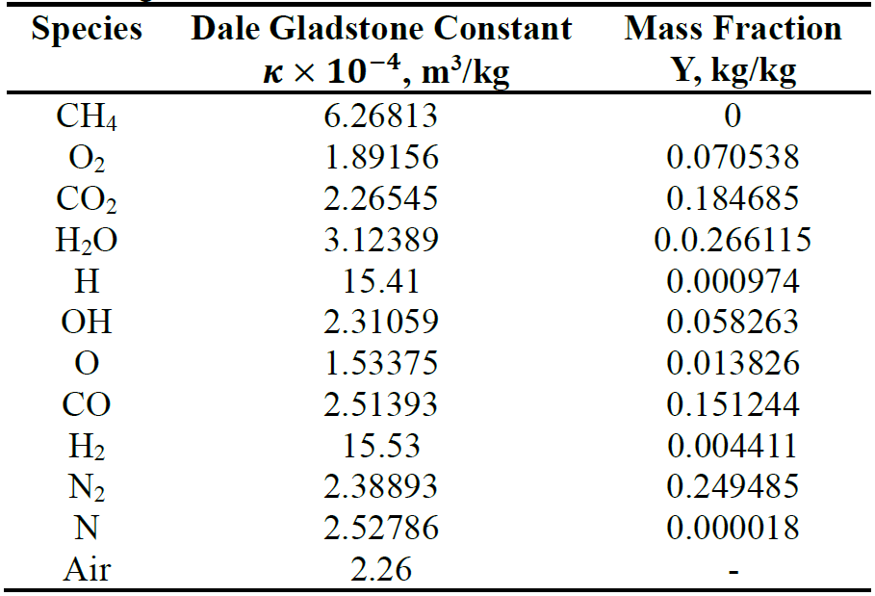
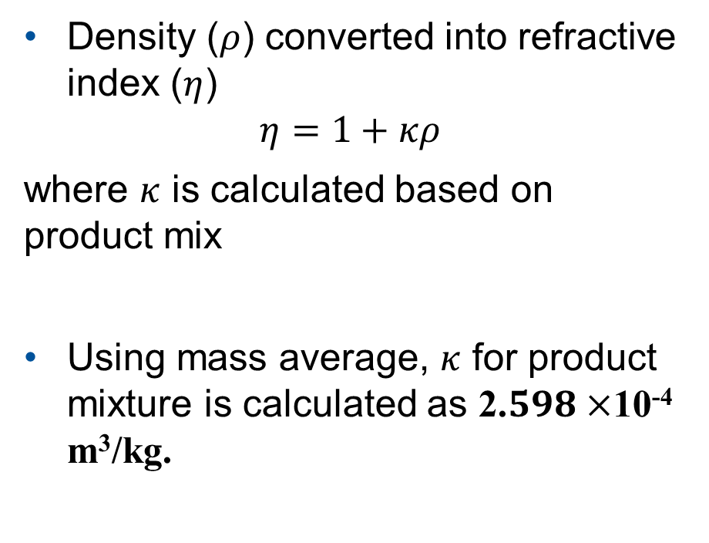
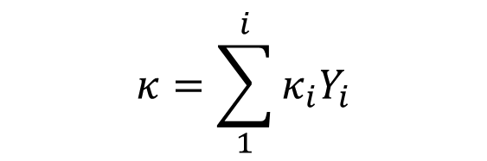
Dale Gladstone Calculations
0D CHEMKIN CJ calculations to get specie composition.
$$κ=\sum_{1}^{i}{κ_{i}Y_{i}}$$
Density ($ρ$) converted into refractive index ($η$)
$$η=1+κρ$$
where $κ$ is calculated based on product mix
Using mass average, $κ$ for product mixture is calculated as 2.$598×$10⁻⁴ m³/kg.

Slide 14
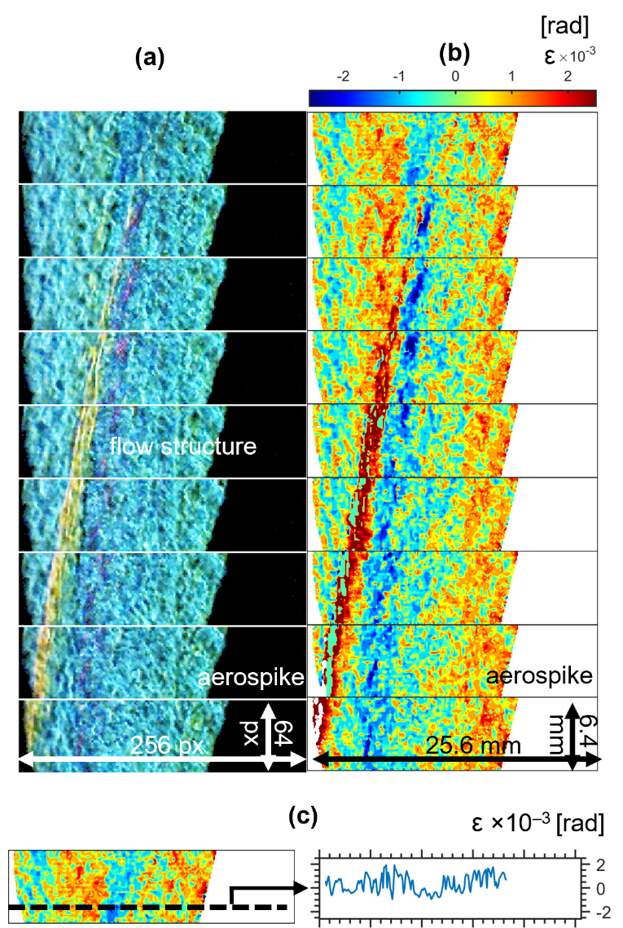
Deflection Angle Profiles
  Continuous snapshots of:
  (a) Raw RSD images
  (b) Contour of Deflection Angles
  Images taken at 300 kHz with spatial resolution of 100 μm/pixel and temporal resolution of 369 ns.
  44 consecutive images selected to represent one cycle of detonation.
  Each frame provides a flow field at a view angle, about 8 degrees apart

Slide 15
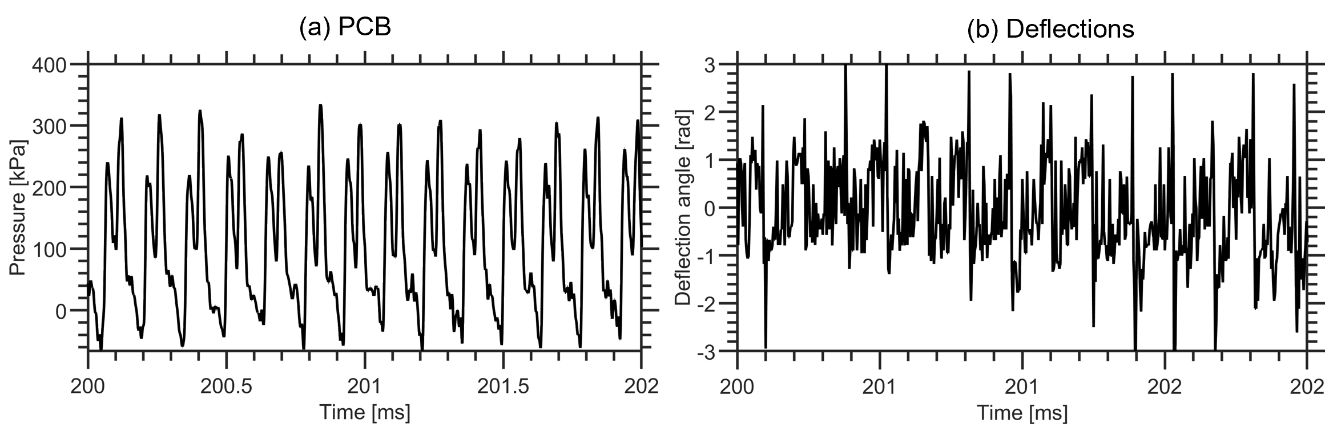
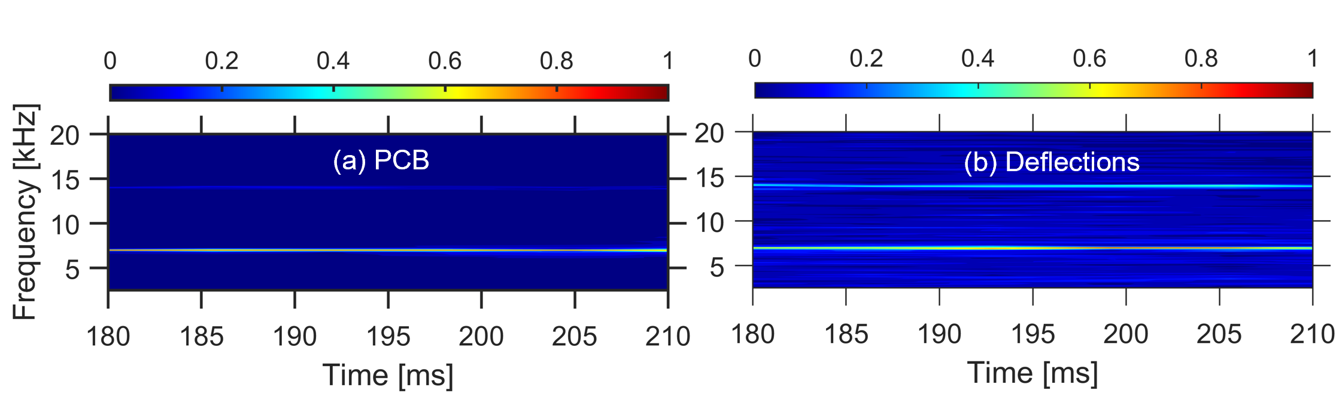
Comparison of RSD Deflection Angle and PCB Pressure Fluctuation Data
  Data compared between PCB probe and single pixel location in RSD field of view.
  Time series data showing instantaneous oscillations.
  Spectrograms giving the operating frequency.

Slide 16
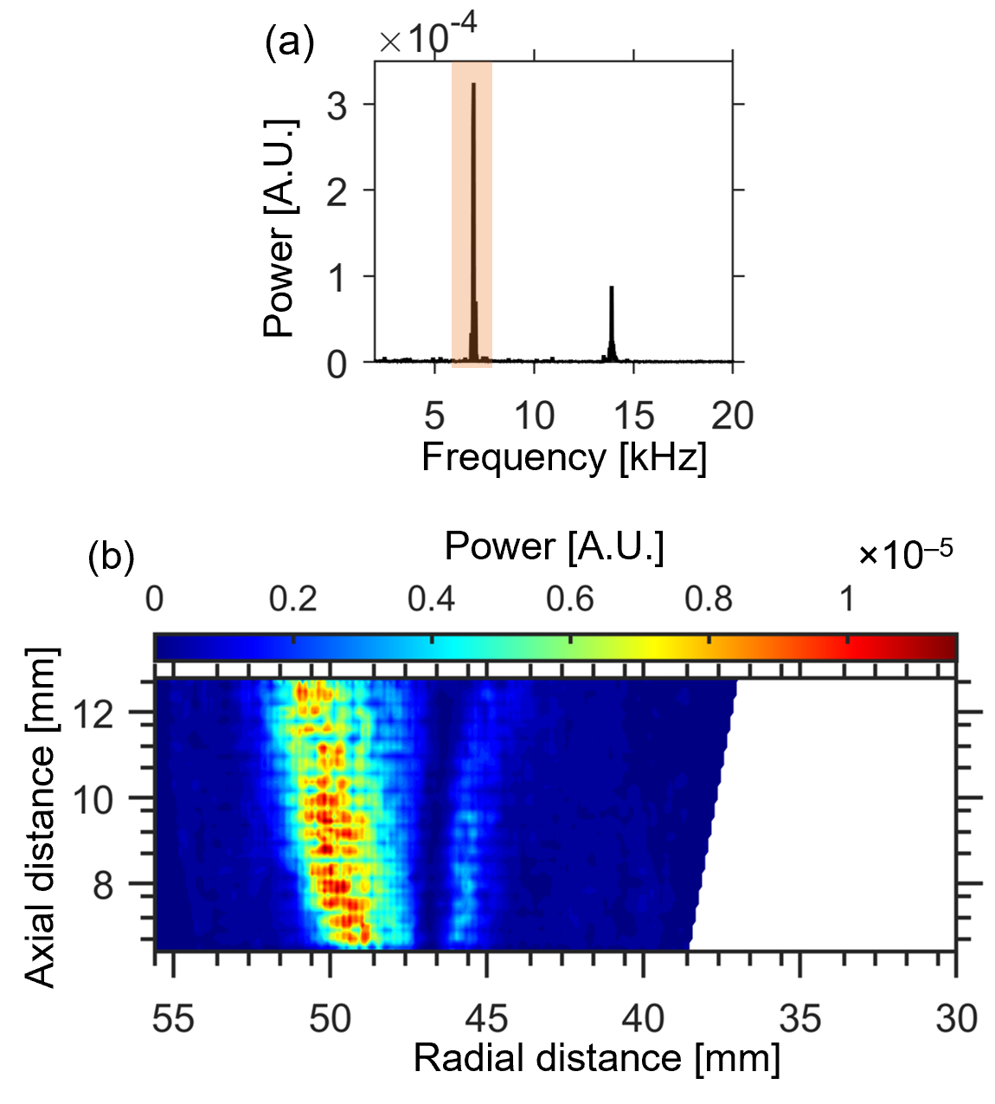
Spectral Analysis of RSD data
FFT Spectra at a single pixel location over 50 ms test duration.
Indicates the position and the relative strength of the oscillations in the exhaust domain.
Intense oscillatory region shows trailing expansion. Globally present with local high intensity.
Notes:
The contour indicates an intense oscillatory region tilted radially outwards at a radial location of around 49 mm. This region represents the trailing structure expanding beyond the shear layer. As the wave spreads radially outwards, the average strength in the contour shifts towards the left. Another less intensely oscillating structure tilted inwards is visible around the shear layer region at a radius of 45 mm, and it oscillates spatially with the passing of the wave. Other regions exhibited low intensity oscillations although flow periodicity at 6.96 kHz was observed at all pixel locations.

Slide 17
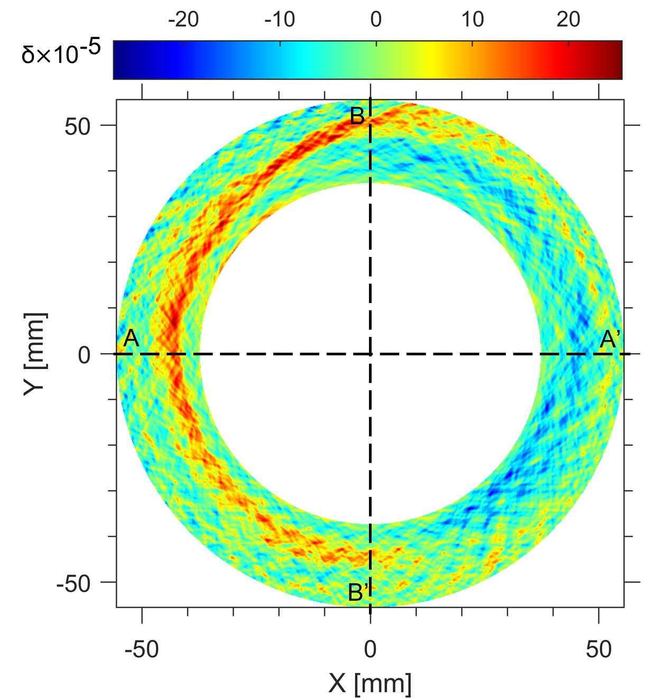
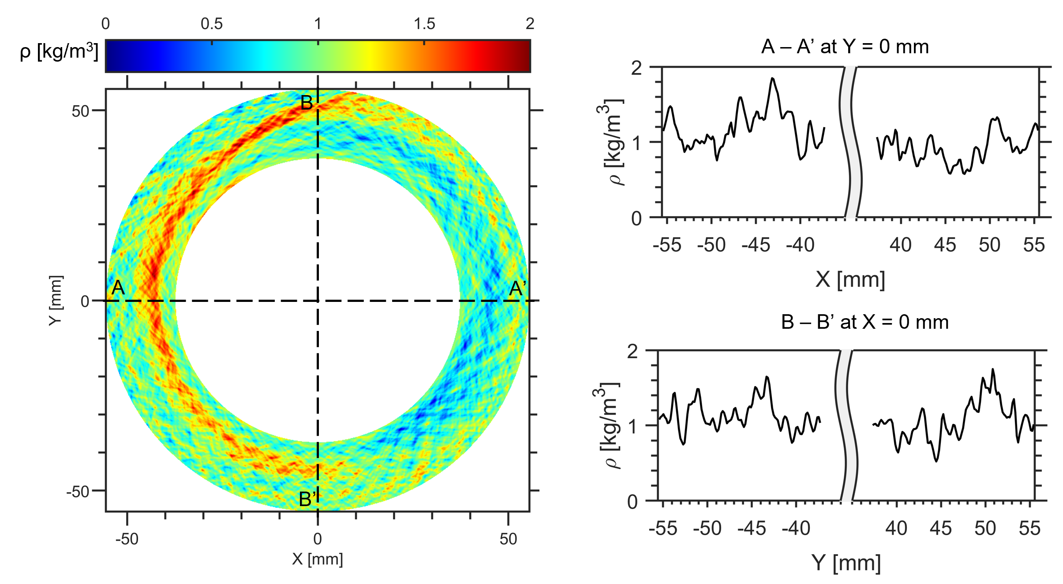
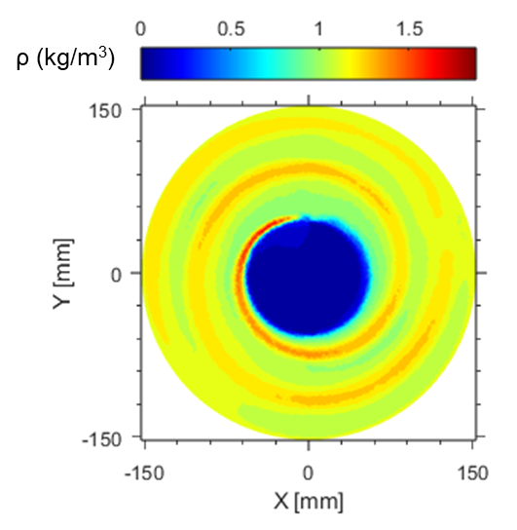
Density Field Reconstruction
Normalized RI
Density
Tomographic reconstruction produces δ field.
Density field is computed from δ.
CFD density field in RDE exhaust
Similar structures found in numerical simulation of exhaust plume of RDC.

Slide 18
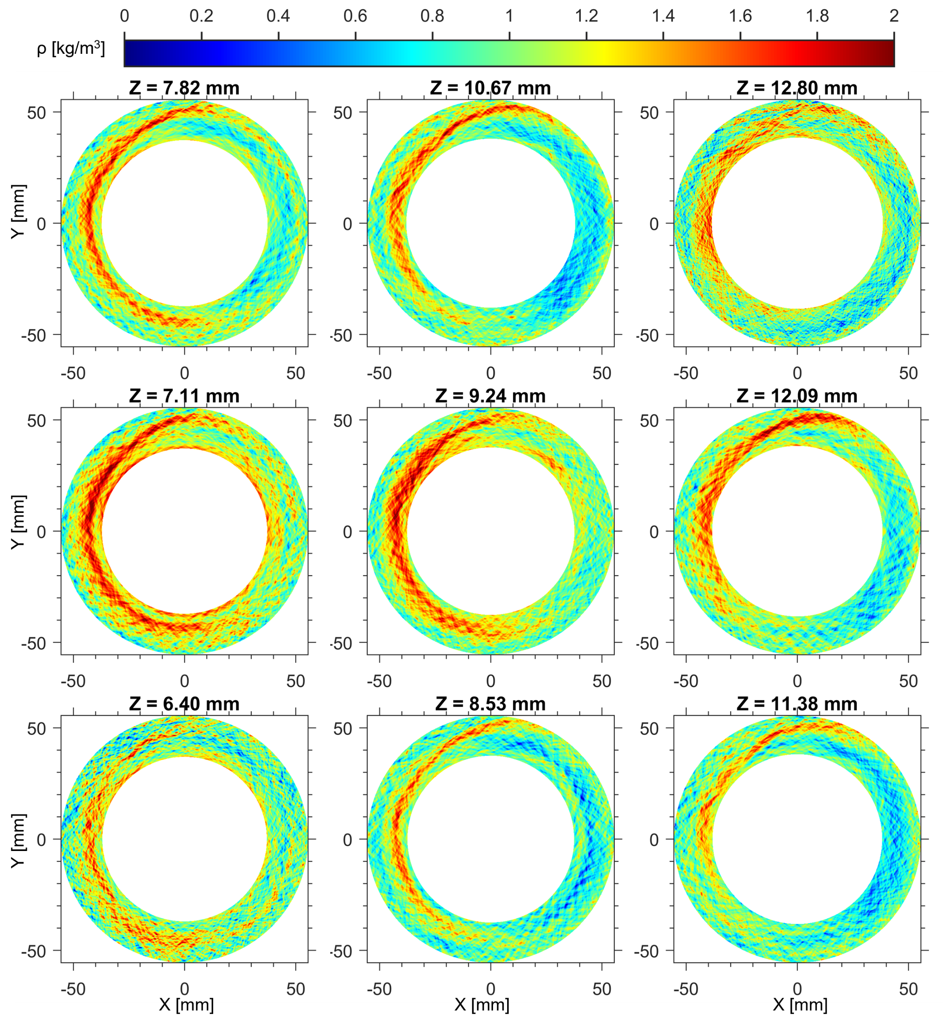
Density Field Reconstruction (Horizontal Slices)
Series of equally spaced horizontal slices.
Trends indicate the oblique shock moving counterclockwise.
Notes:
Bottom left to top right, move upwards in axial direction, Number of slices obtained = pixel height of RSD images

Slide 19
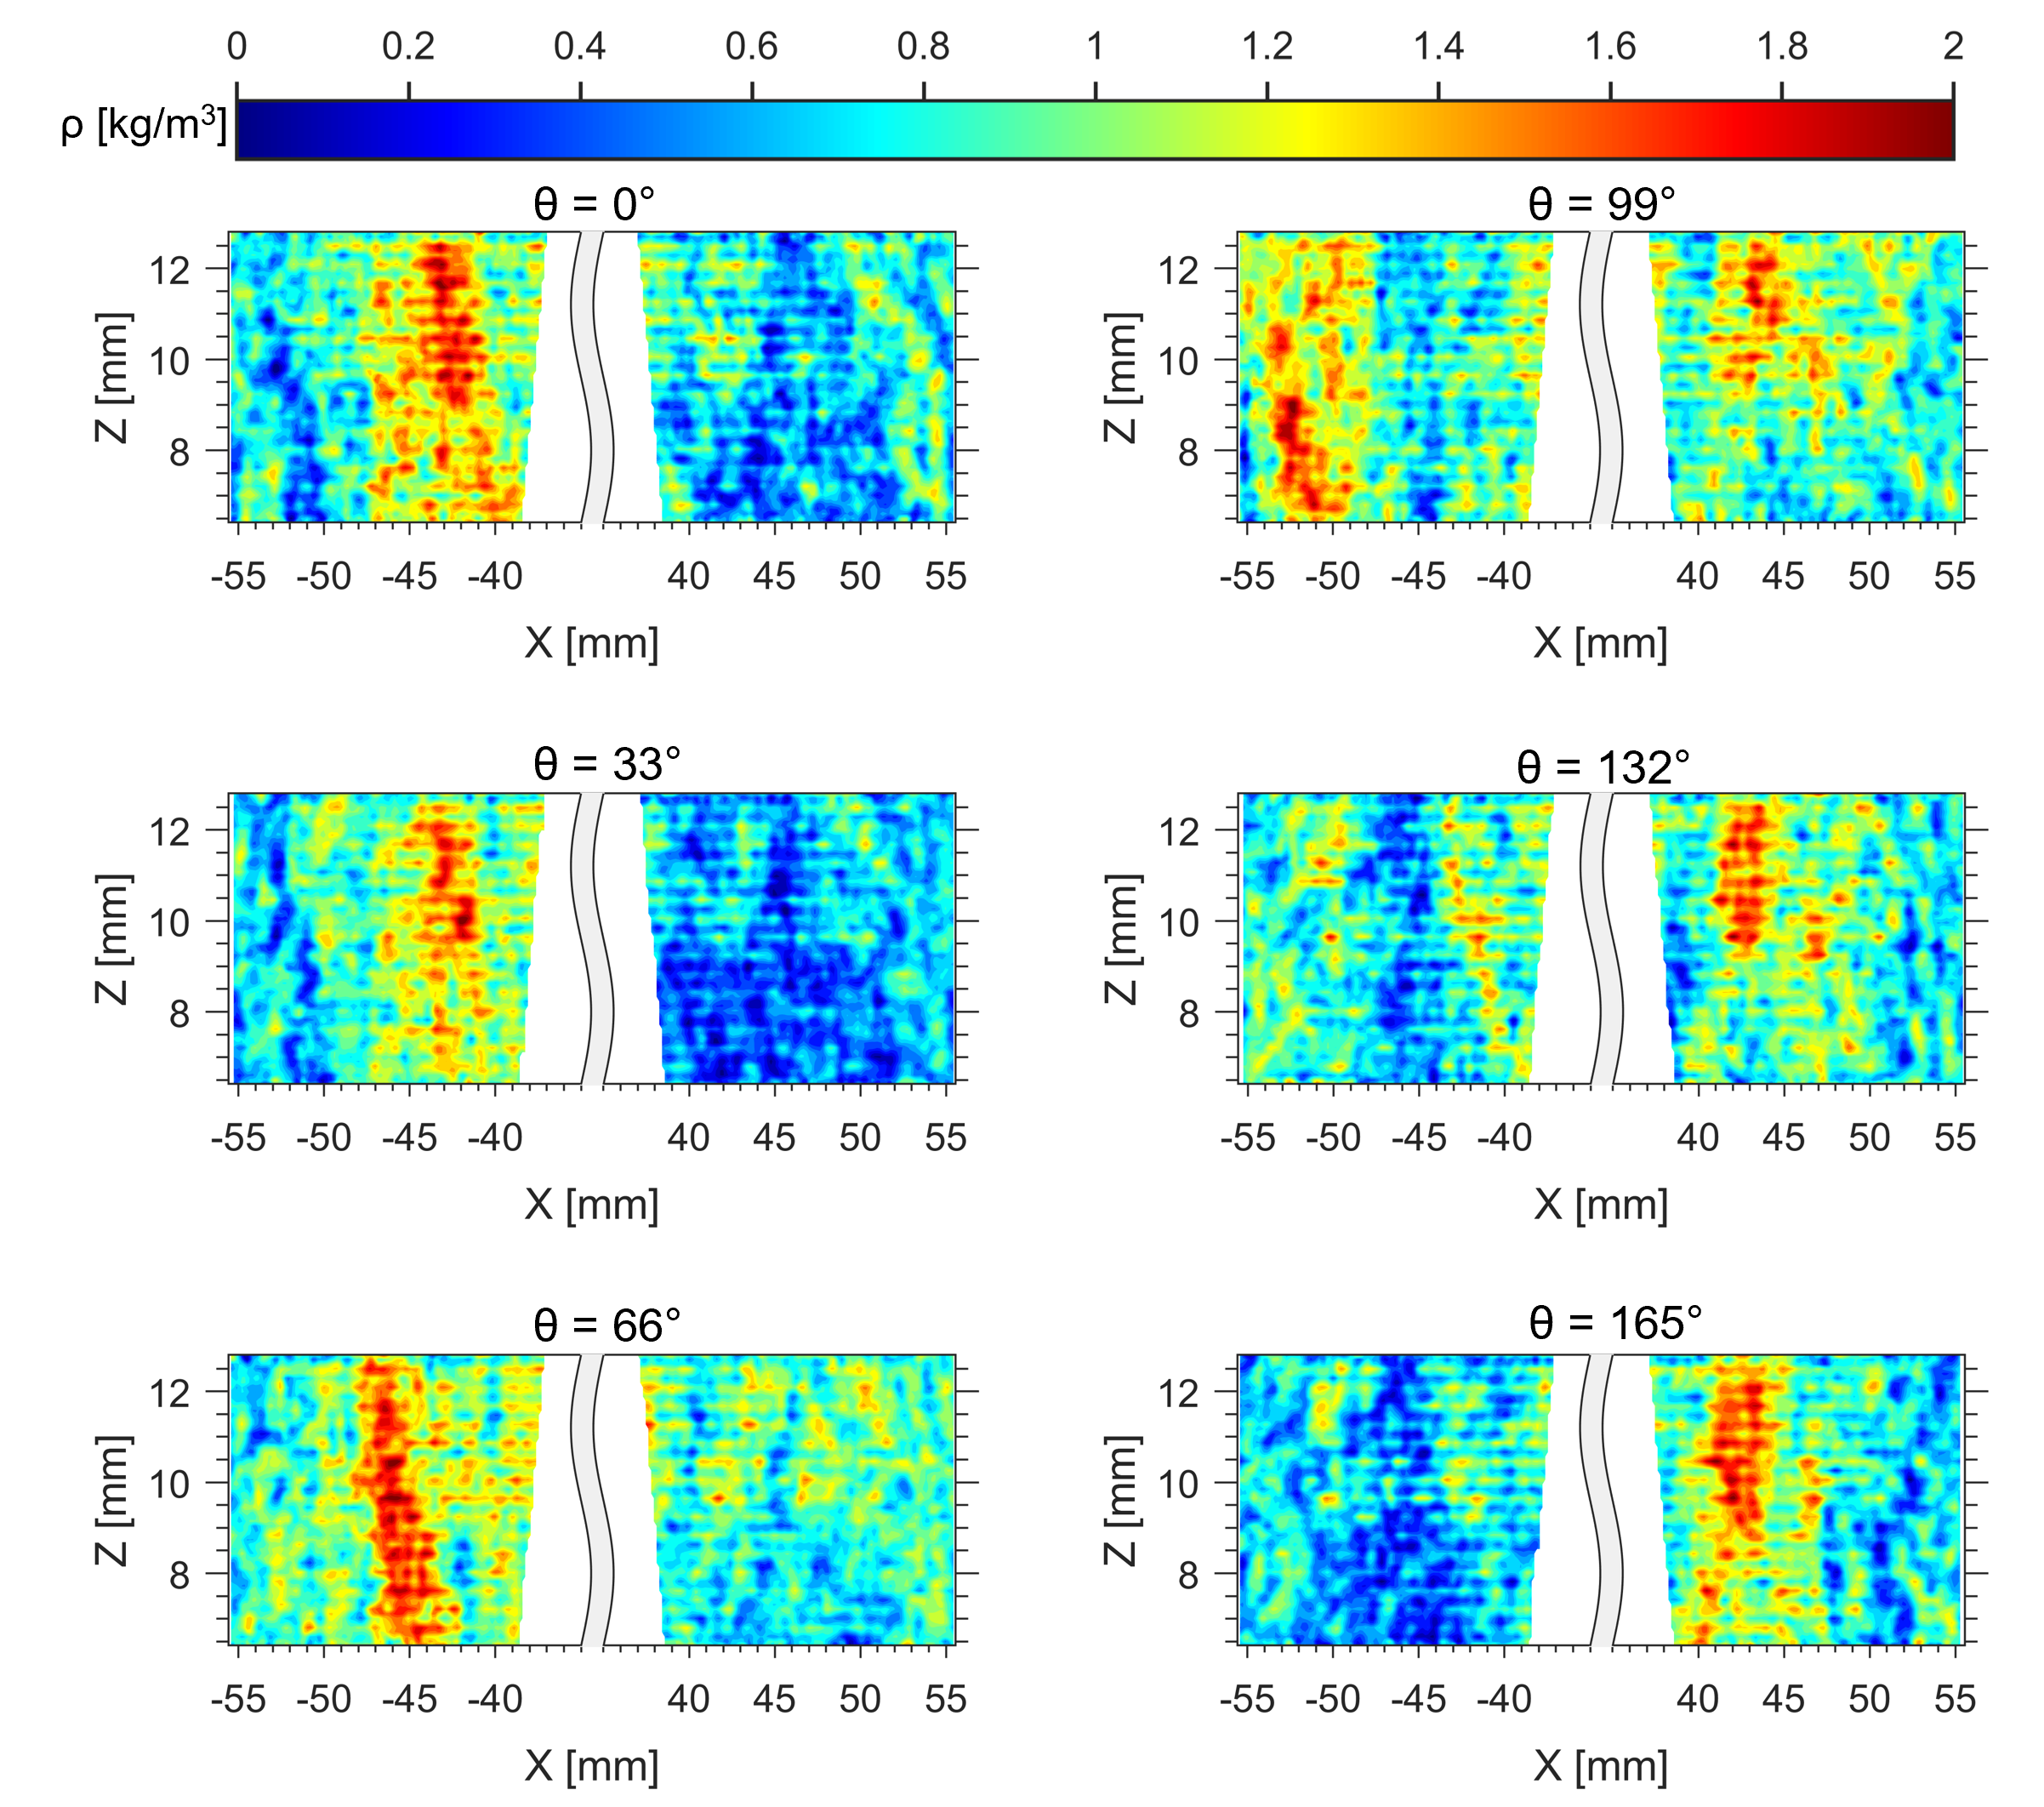
Density Field Reconstruction (Axial Slices)
Horizontal slices are stacked to give a 3D density field
High-density region moves left and reenters from the right, showing radial expansion.
Notes:
Each horizontal slice is stacked together to get a 3D field

Slide 20
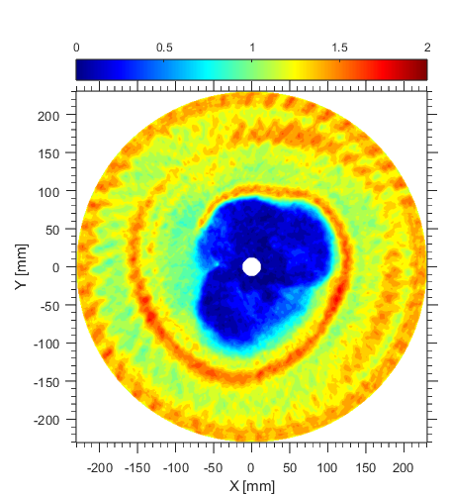

Numerical Validation
  Reconstruction using 50 views.
  Relative error of the order of 0.1% for most regions.
RECONSTRUCTED
ORIGINAL - CFD
A-A’
A
A’
A
A’
Notes:
Tomography should be validated both numerically. Numerical validation involves the use of a phantom to provide a truth reference, simulations of the projections generated from the phantom (image formation process), and reconstruction based on the simulated projected data using the selected tomography algorithm.

Slide 21
CONCLUSIONS
RSD images were obtained and processed to infer the deflection angle of light rays throughout the field of view.
Deflections were spatially resolved and reconstructed into 3D density fields.
Results show remarkable coherence with published numerical simulation.

Slide 22
FUTURE WORK
The study enables to explore techniques to compute thermodynamic properties, especially total pressure.
Numerical validation using transient data and complete uncertainty analysis introduced due to the algorithm.
Current work limited to single cycle, focus on evaluating density field in transient and average manner over multiple detonation cycles.

Slide 23
ACKNOWLEDGMENTS
This research work was supported by NASA under Grant# 80NSSC20K0305.
RDC hardware used in this work was developed by Aerojet Rocketdyne Inc. through funding by the Department of Energy under Award Number DE-FE-0023983

