Slide 1
Simultaneous Imaging of OH* and CH* Chemiluminescence in the Exhaust of a Rotating Detonation Engine
Ashley M. James and Ajay K. Agrawal
The University of Alabama
2024 Spring Technical Meeting of the Central States Section of The Combustion Institute

Slide 2
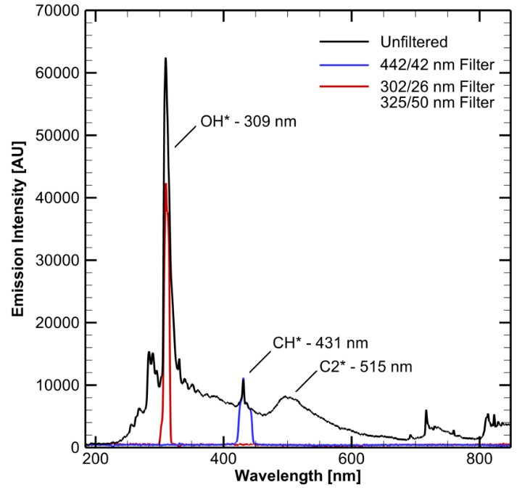
Background
Chemiluminescence (CL): electronically excited radical formed by a chemical reaction.
CL Imaging
Non-Intrusive, allows characterization of extreme environments without impacting the flow field or damaging sensors.
Species studied in hydrocarbon flames
CH*: Indicates fuel breakdown, intensity peaks at rich conditions
OH*: Indicates fuel oxidation, intensity peaks at stoichiometric condition.
CL intensities can vary with Equivalence ratio, Pressure, Temperature, etc.
Figure 1: Spectra of premixed methane flame.

Slide 3
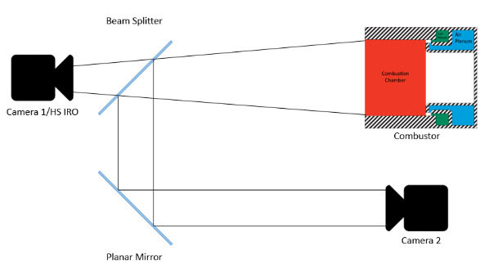
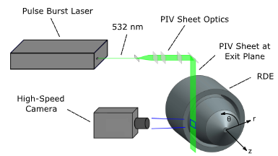
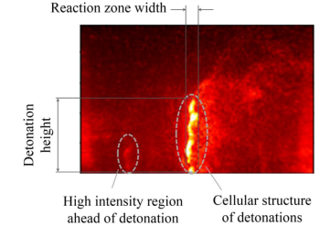
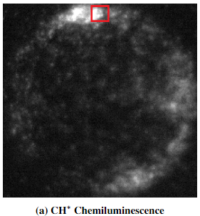
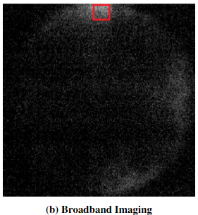
CL Imaging in RDEs
Figure 2: Rankin, Brent A., et al. [1]
Figure 3: Gaetano, Alec R., et al. [2]
Figure 4: Journell, Christopher L., et al. [3]

Slide 4
Optical Setup
Light from the test media is emitted
Split by a 50:50 beamsplitter
Light is passed through each bandpass filter
308nm OH*
434nm CH*
Filtered UV is reflected by the turning mirror onto the knife edge.
Knife edge directs signal to the camera.
Camera
Photron SA-5
Invisible vision UV intensifier
Outer Body
Annulus
Aerospike
Beamsplitter
Bandpass Filter
Bandpass Filter
Knife-Edge Prism
Turning Mirror
Turning Mirror
To Camera
Figure 6: Proposed optical configuration.

Slide 5
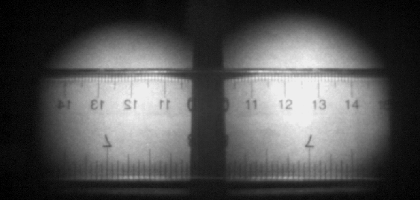
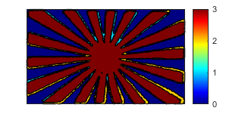
Optical Alignment
1. Laser Alignment
2. Target Alignment
3. Resolution
+Y
D
B
A
+X
E
C
Superimposed
D’
B’
B”
D”
A’
A”
E’
C’
C”
E”
Figure 7: Laser alignment target illustration.
Figure 8: Siemen Star target alignment.
Figure 9: Raw image of ruler for resolution.
Type: Rough Alignment.
Purpose: Addresses major mechanical misalignment.
How: Point spotting laser into apparatus at location of test media.
Pass/Fail: All point match without an indication of parallax.
Type: Fine Alignment.
Purpose: Addresses minor mechanical misalignment.
How: Set target at location of test media, take image and superimpose the right onto the left.
Pass/Fail: 90% or greater pixel alignment.
Type: Final/Focus/Resolution.
Purpose: Last alignment check, test image to acquire resolution and focus the camera.
How: Set ruler at location of test media, take image.
Pass/Fail: Any indication of misalignment.

Slide 6
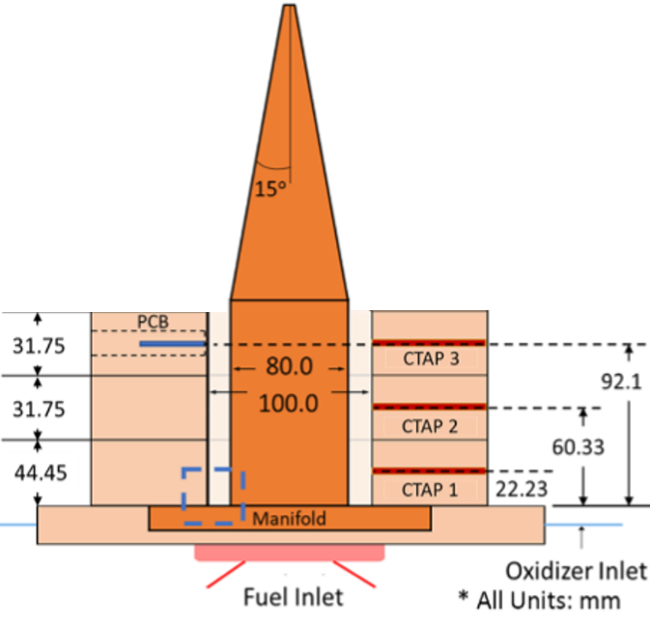
Annular Rotating Detonation Engine
Annular combustion chamber: fuel and oxidizer are fed into annulus annularly.
100 mm OD
80 mm ID
139 mm height
Made of three concentric rings (spools)
Joined together by through-bolts.
Center body that extends into an Aerospike
Figure 10: University of Alabama annular rotating detonation engine.

Slide 7
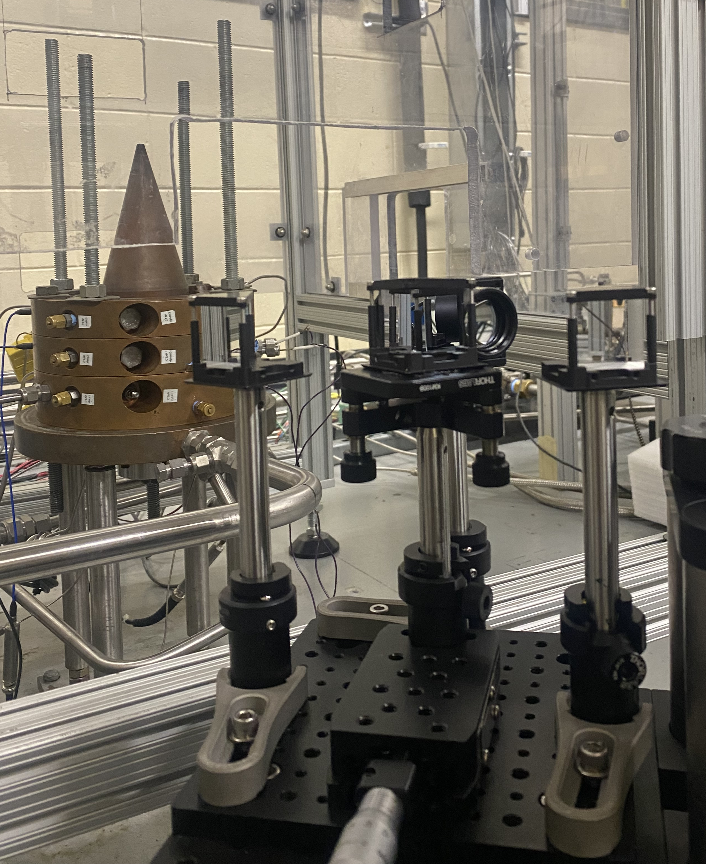
Experimental Setup
A)
B)
Optical Apparatus
C)
Split Signal
High – Speed Camera
UVi Intensifier
ROI
ROI
Optical Table
Figure 11: A) Region of Interest (ROI) , B) Optical apparatus in reference to engine , C) Image of experimental setup.

Slide 8
Test Parameters
Camera Settings
Test Conditions
Photron SA-5:
50,000 fps
Gate Time: 20 µs
Image size: 512x272
Or 0.158 mm/pixel
Uvi 1850-10
Delay: 1 µs
Gate: 18 µs
Equivalence Ratio: 1.0
CH4 Mass Flow Rate: 0.0673 kg/s
Oxidizer (2/3 O2 & Air): 0.386 kg/s
Total Mass Flow Rate: 0.454 kg/s
Heat Release Rate: 3.36 MW

Slide 9
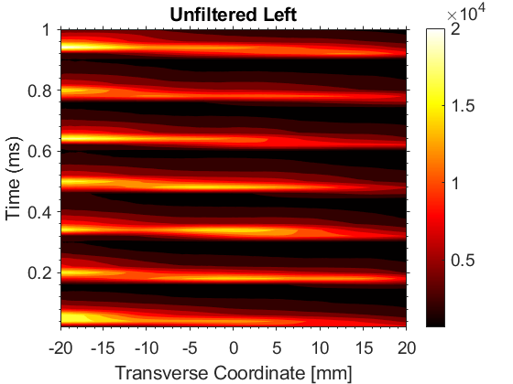
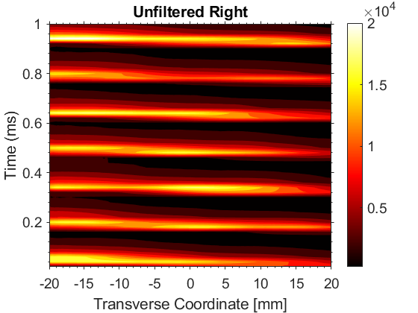
Broadband (unfiltered) CL Results
A)
Identical wave illumination at location seen in both left and right sub-image.
B)
Identical behavior observed in left and right space-time sub-image
Wave seen approximately every 7-8 frames or .15 ms.
Figure 12: A) Video of Unfiltered Data, B) Space-Time plot.

Slide 10
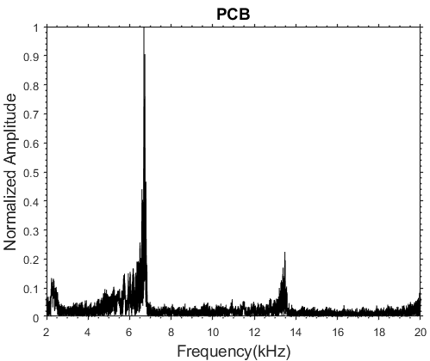
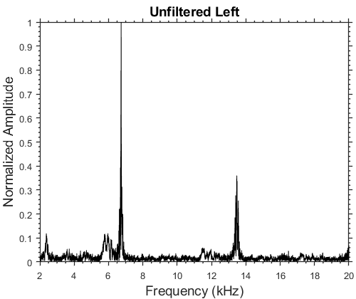
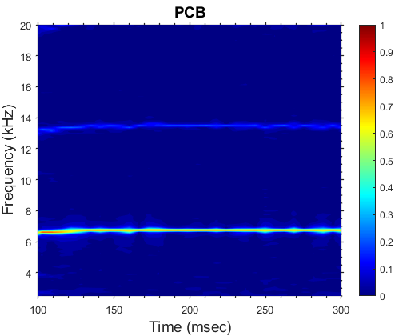
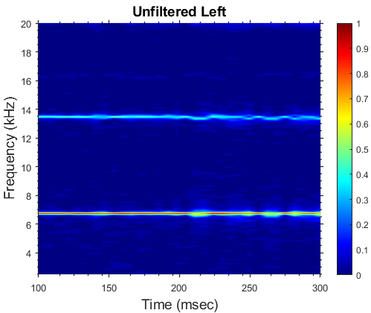
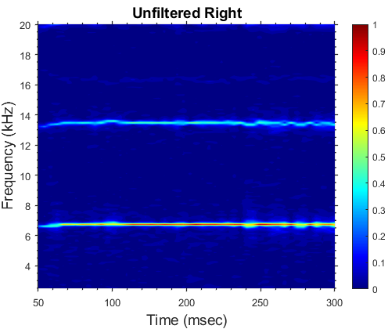
Data Validation: PCB versus CL Imaging
A)
B)
C)
Figure 13: A) PCB FFT/Spectrogram, B) Left sub-image FFT/Spectrogram , C) Right sub-image FFT/Spectrogram.

Slide 11
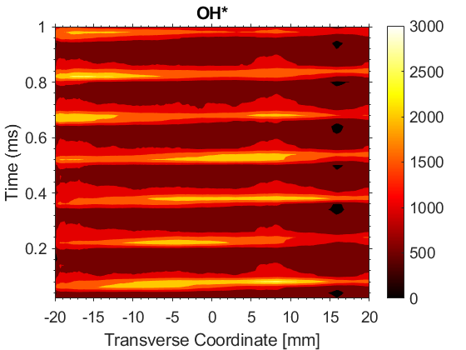
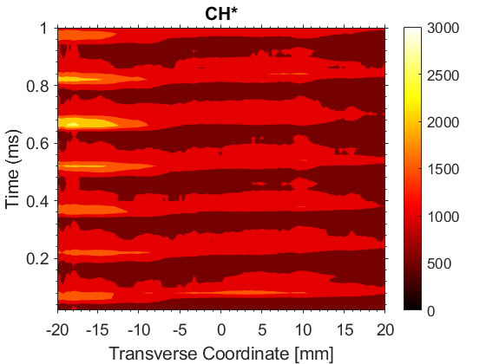
Filtered Results
A)
Clearly defined flow structure and reaction zone in the exhaust plume.
Different intensity values based on individual species.
B)
Various intensity observed in left and right space-time sub-image
Wave seen approximately every 7-8 frames or 0.15 ms.
Figure 14: A) Video of Filtered Data, B) Space-Time plot.

Slide 12
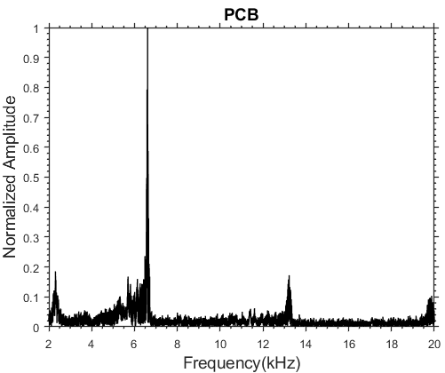
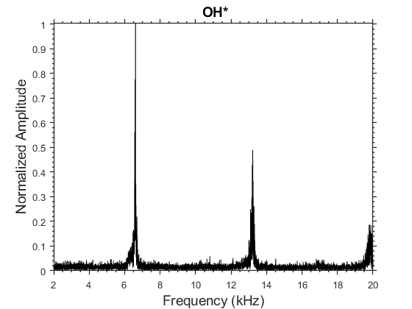
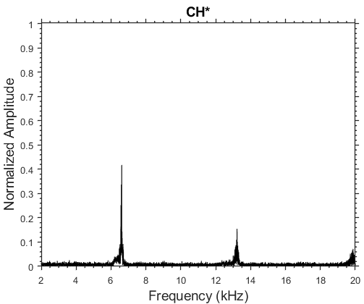
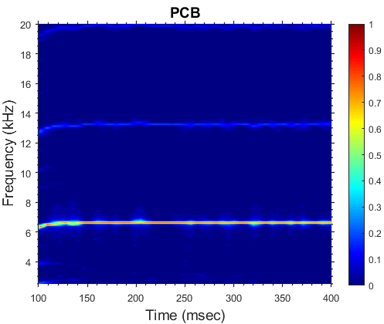
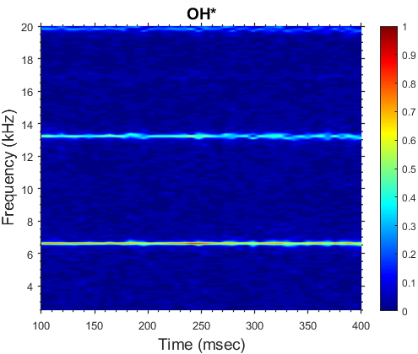
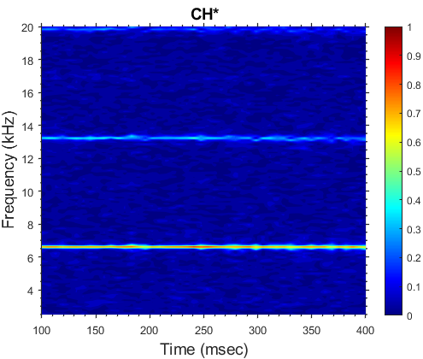
Data Validation: PCB versus CL Imaging
A)
B)
C)
Figure 15: A) PCB FFT/Spectrogram, B) OH* FFT/Spectrogram , C) CH* FFT/Spectrogram.

Slide 13
Conclusions/Future Work
Implemented new optical setup to simultaneously image CL* and OH* CL in an RDE.
Identical wave illumination/location seen in both left and right sub-image.
The filtered results clearly show defined flow structure and reaction zone in the exhaust plume with different intensity values based on individual species.
CL image results of FFT analysis and spectrogram match those obtained from PCB data.

Slide 14
Questions?

Slide 15
References
[1] Rankin, Brent A., et al. "Overview of performance, application, and analysis of rotating detonation engine technologies." Journal of Propulsion and Power 33.1 (2017): 131-143.
[2] Gaetano, Alec R., et al. "Comparative Analysis of Broadband Imaging and CH* Chemiluminescence for Ascertaining Modal Operation in a Rotating Detonation Combustor." AIAA SCITECH 2022 Forum. 2022.
[3] Journell, Christopher L., et al. "High-speed diagnostics in a natural gas–air rotating detonation engine." Journal of Propulsion and Power 36.4 (2020): 498-507.
[4] James, Ashley M., and Ajay K. Agrawal. "Spatially resolved chemiluminescence imaging of multiple combustion species using a single high-speed camera." Measurement Science and Technology 34.12 (2023): 125305.

Slide 16
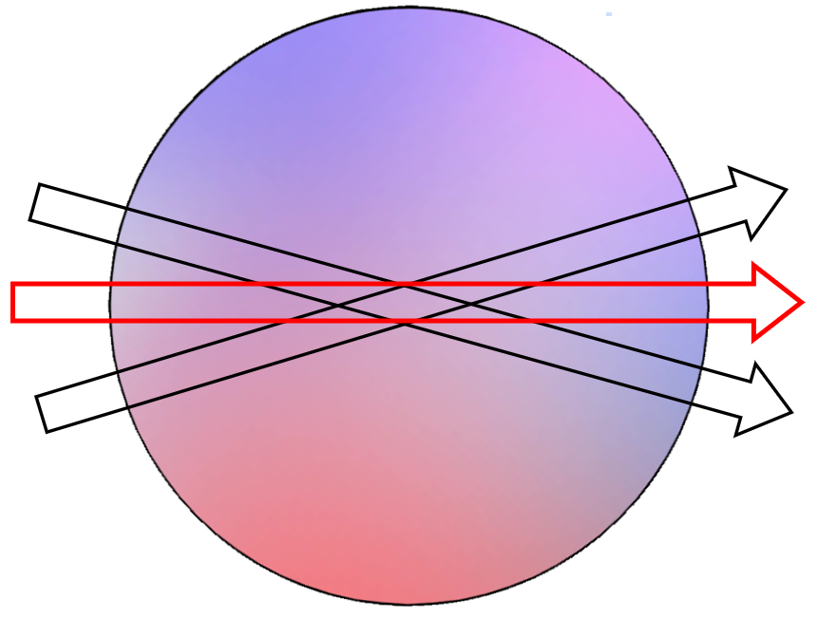
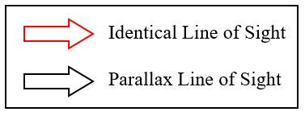
CL Imaging of Multiple Species
Common techniques used for simultaneous imaging
Single Camera
Two Cameras
Image doubler
Other optical arrangements
Present technique
Utilizes an identical line of sight
No need for extensive post processing and error correction
Figure 5: Line of sight conceptualization illustration.

