Slide 1


Soot and gaseous emissions characterization of butyl-acetate/diesel blend in a heavy-duty engine
Paper Number: 23PFL-0478
Spencer Hall, Joshua Bittle
University of Alabama, Tuscaloosa
WCX SAE 2023
WCX SAE World Congress Experience
April 18–20, 2023, Detroit, Michigan

Slide 2

Outline
Background
Objectives
Experimental setup
Data Processing Methods
Test conditions
Results

Slide 3
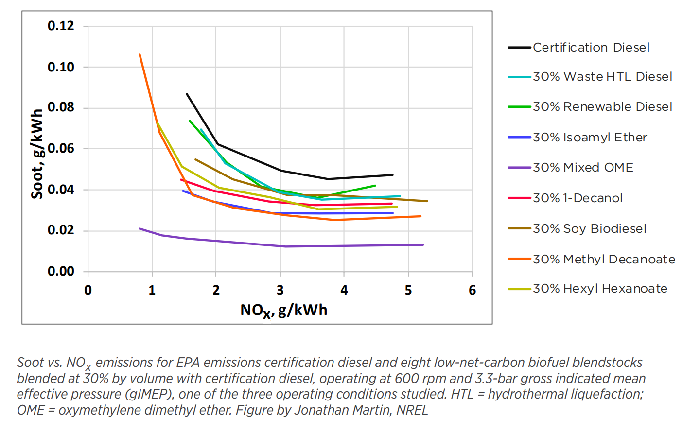
DOE Co-Optima Project
Improving MD and HD Diesel Engines
  Engine efficiency
  Maintain fuel density
  Lower Emissions
Combustion Mode
  MCCI – mixing-controlled compression ignition
Goal – identify new blendstocks & engine technology
  Improve economic and environmental impacts
Tier 1 screening [3]
  8 possible biofuels
  Blended at 30% by vol.
  Reduced NOx and Soot Emissions
[3]
[3] Co-Optimization of Fuels & Engines Year in Review (FY20). United States: N. p., 2021. Web. doi:10.2172/1782424.

Slide 4
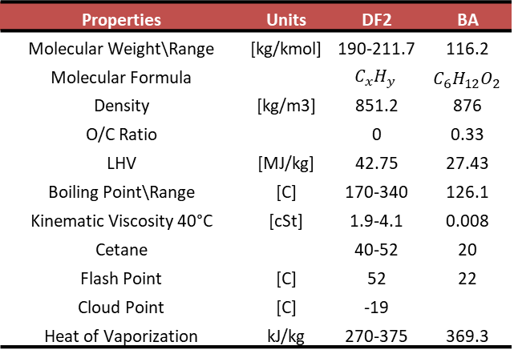
Butyl Acetate for MCCI Operation
Not obvious choice for drop in blending with due to low cetane (~20)
Advantages of Butyl Acetate
  Improved cold flow performance
  High O to C ratio
  Impact on ignition characteristics
  no reactivity between lubricants and oxygenates [3]
Conventionally produced by Fischer esterification process
  Purity of 99.9%
  Consumes relatively large amounts of energy
  Produces toxic waste - sulfuric acid
New microbial fermentation process [4]
  Systematic genome engineered - C.saccharoperbutylacetonicum FJ-1201 bacteria
  Uses monosugars (glucose...etc) from biomass in batch fermentation – High Yield
Synthesized by a new and sustainable biological process
  Contain some miscible by-products
  Influence of those components investigated by ICEF2022-90634 & [4]
Properties | Units | DF2 | BA
Molecular Weight\Range | [kg/kmol] | 190-211.7 | 116.2
Molecular Formula |  | $$C_{x}H_{y}$$ | $$C_{6}H_{12}O_{2}$$
Density | [kg/m3] | 851.2 | 876
O/C Ratio |  | 0 | 0.33
LHV | [MJ/kg] | 42.75 | 27.43
Boiling Point\Range | [C] | 170-340 | 126.1
Kinematic Viscosity 40°C | [cSt] | 1.9-4.1 | 0.008
Cetane |  | 40-52 | 20
Flash Point | [C] | 52 | 22
Cloud Point | [C] | -19
Heat of Vaporization | kJ/kg | 270-375 | 369.3
[5,6,7]
[4] Wang, Yujie, et al. "Combustion of n-butyl acetate synthesized by a new and sustainable biological process and comparisons with an ultrapure commercial n-butyl acetate produced by conventional Fischer esterification." Fuel 304 (2021): 121324.
[5] U.S. Department of Energy. “Fuel Properties Database.” Available at at https://www.nrel.gov/transportation/ fuels-properties-database/ (Accessed 10/10/2022).
[6] McCormick, Robert L., and Richard Parish. "Advanced petroleum based fuels program and renewable diesel program." NREL/MP (2001): 540-32674.
[7] Kumar, B. Rajesh, and S. Saravanan. "Use of higher alcohol biofuels in diesel engines: A review." Renewable and Sustainable Energy Reviews 60 (2016): 84-115.

Slide 5
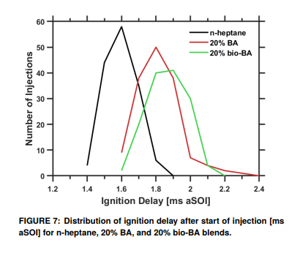
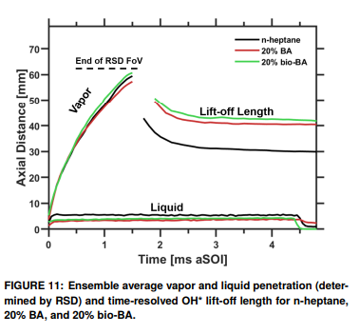
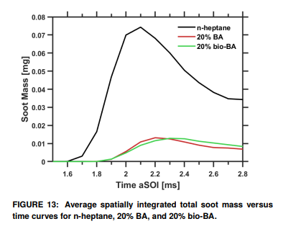
Optical Studies in Spray Chamber
Prior results* from Optically Accessible Spray Chamber found significant reduction in soot mass with BA blend at 20% by vol.
20% BA Blend
  Increased ignition delay
  Shorter liquid length
  Longer lift-off length
Cannot de-couple increased air entrainment from longer ignition delay and lift-off length from any effect of fuel bound oxygen
Delayed Ignition
Longer Lift-Off
Reduced Soot
*Stevenson, A, et al. "Sooting Behavior of Commercial and Bio-Derived Butyl-Acetate/N-Heptane Blends in High-Pressure Spray Combustion Experiments." Proceedings of the ASME 2022 ICE Forward Conference. https://doi.org/10.1115/ICEF2022-90634

Slide 6
Objectives
Test BA blend as drop-in blend at 5% by vol HDD
Compare Engine Performance between fuels
  Soot Emissions
  Efficiency & Performance
  Emissions & Combustion
Investigate how engine ECU responds to different fuel
Identify potential benefits and drawbacks to BA and why it performs differently

Slide 7
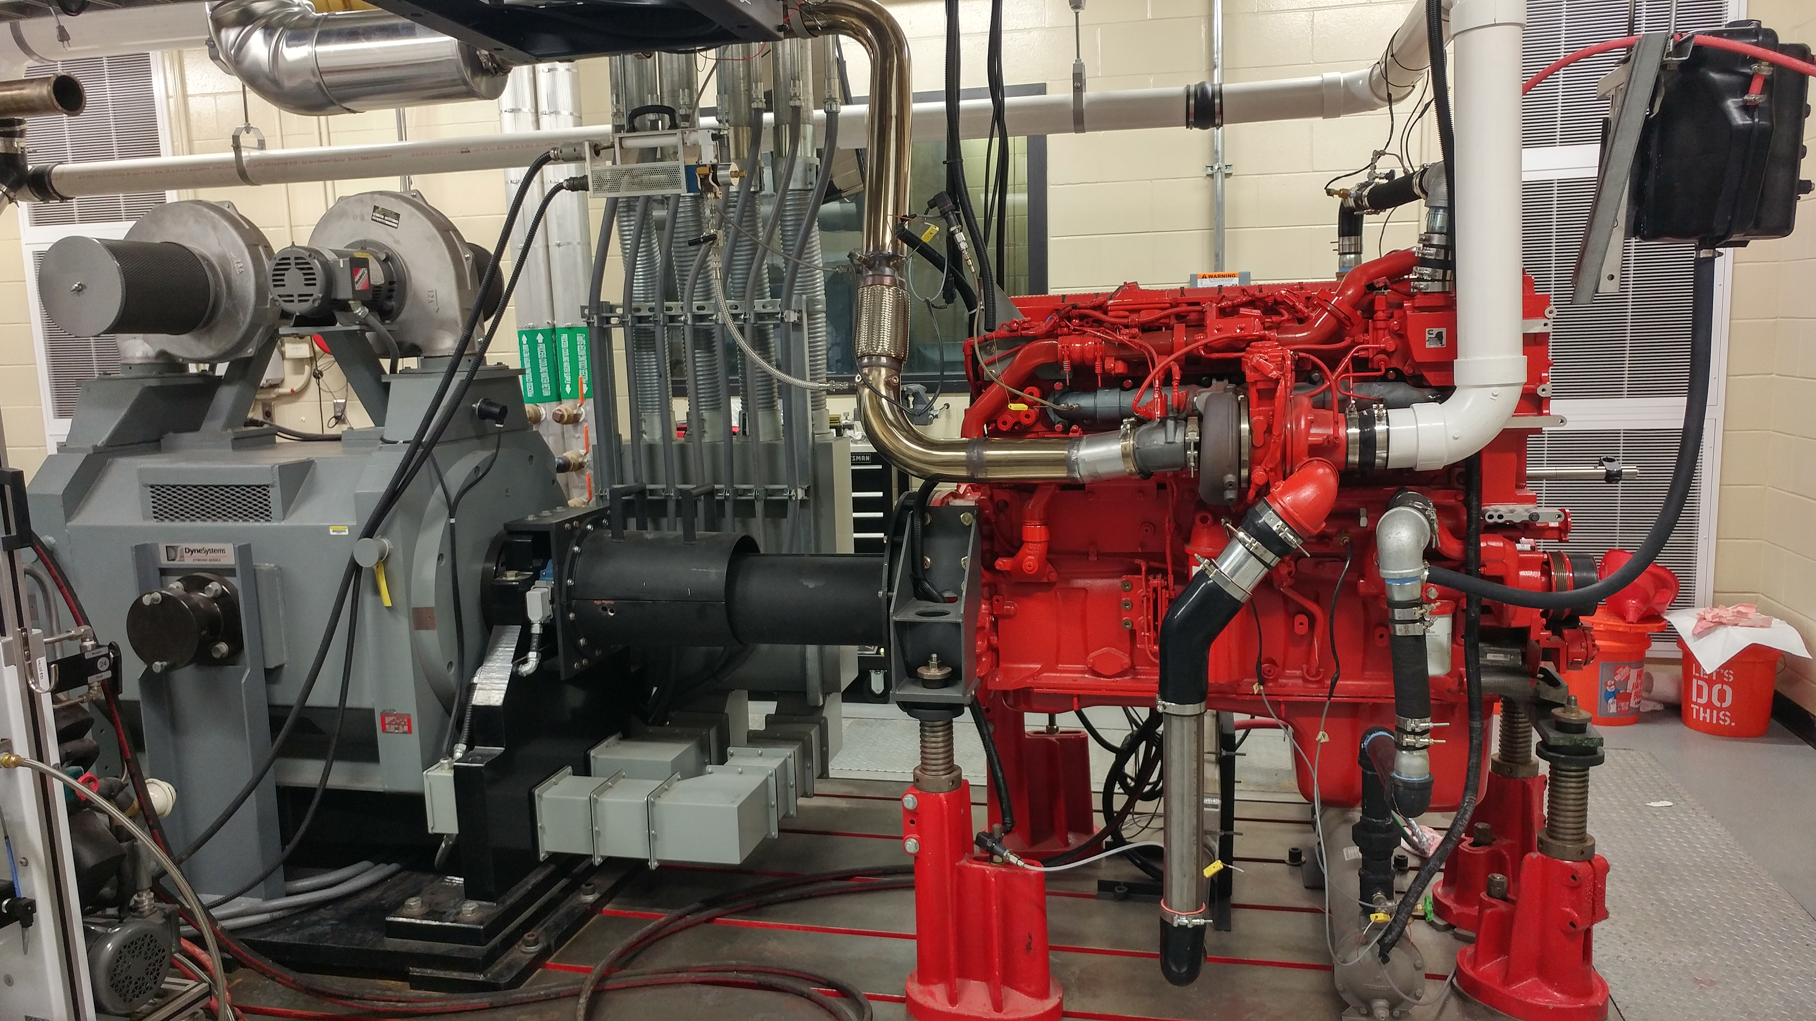
Experimental setup – Engine
Cummins ISX15 450ST
450 hp at 1800 rpm
1800 lb-ft at 1000 rpm
Variable Geometry Turbocharger
Cooled EGR
3000 bar injection pressure
Stock ECU
  Except modified to run without aftertreatment

Slide 8
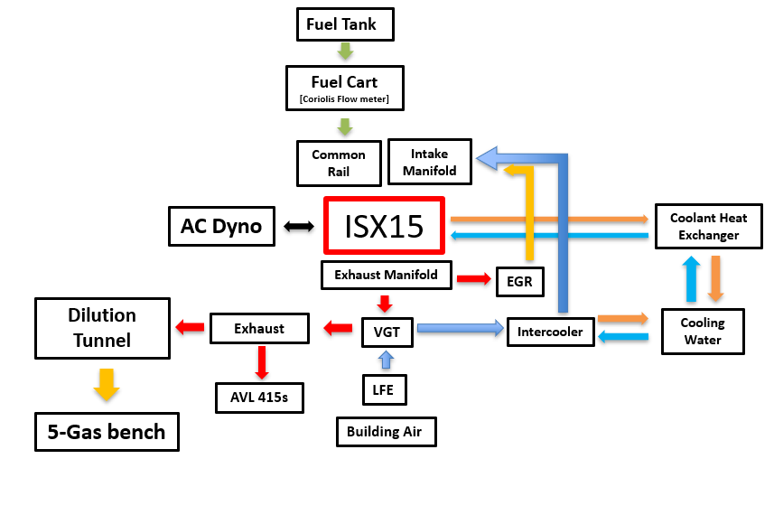
Experimental setup – Test Cell
5 – Gas Emissions Bench
AVL 415s Smoke Meter
Fuel Cart – Coriolis Flow meter
Data Acquisition through LabVIEW/National Instruments hardware
  Vieletech Combustion Analysis Toolkit
  Slow Speed (1 or 10 Hz)
  High Speed (200 kHz)
Dynamic Pressure measurements (Kistler)
  Cylinder Pressure
  Intake Manifold
  Exhaust Manifold
  Injector Line

Slide 9
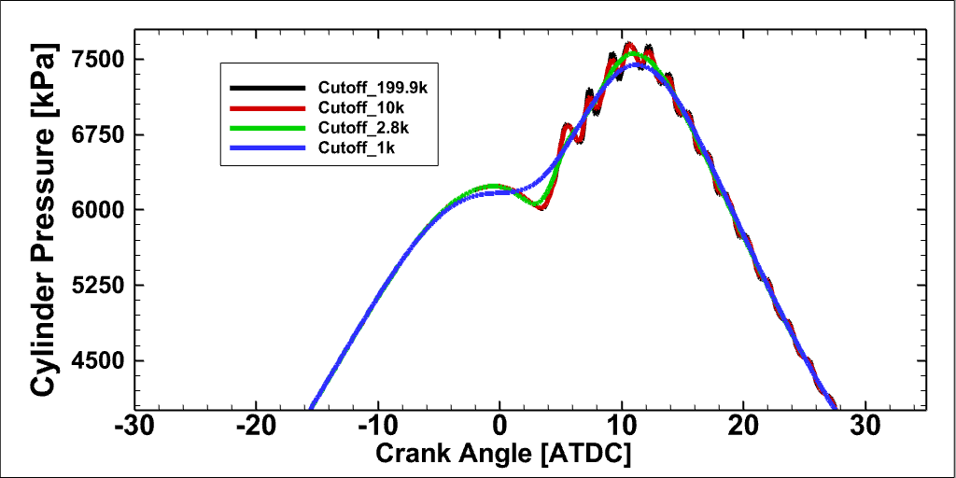
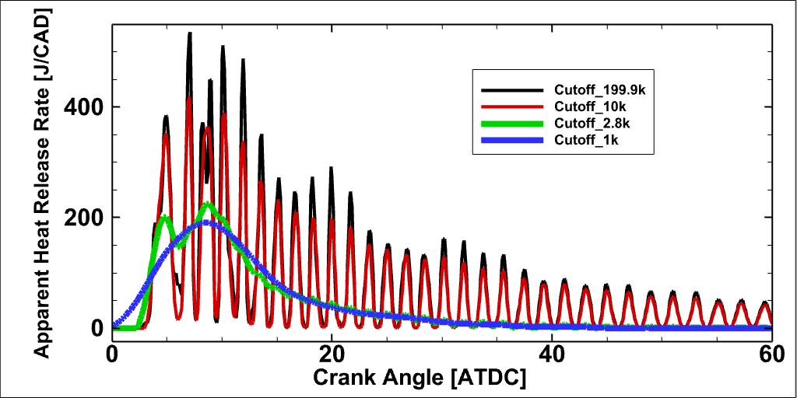
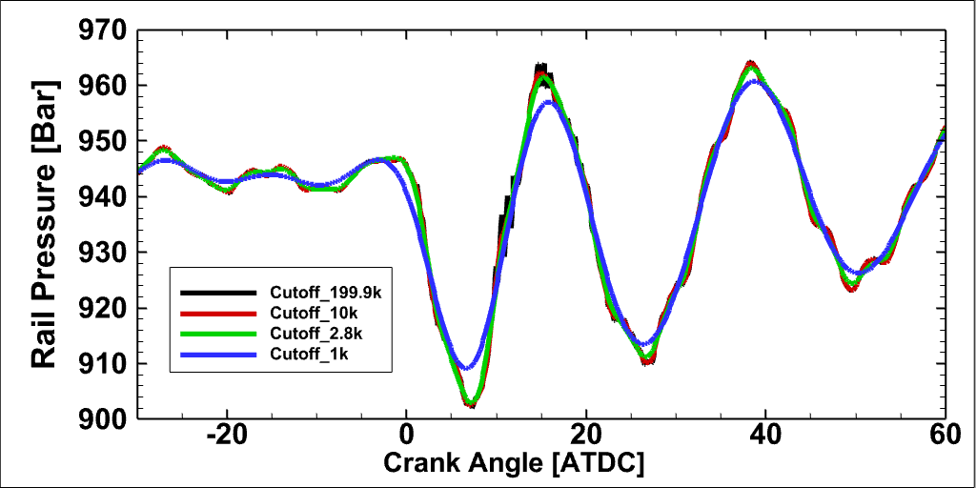
Post Processing -Filtering, Aligning, and Pegging
High-Speed Raw TDMS files post-processed in Python
HS Filter in the time domain
  Butterworth
  Lowpass, 2nd
  2.8kHz Cutoff
Aligned and converted to CAD from A and Z pulse time stamps
Cylinder pressure pegged at IVC with dynamic intake manifold pressure

Slide 10
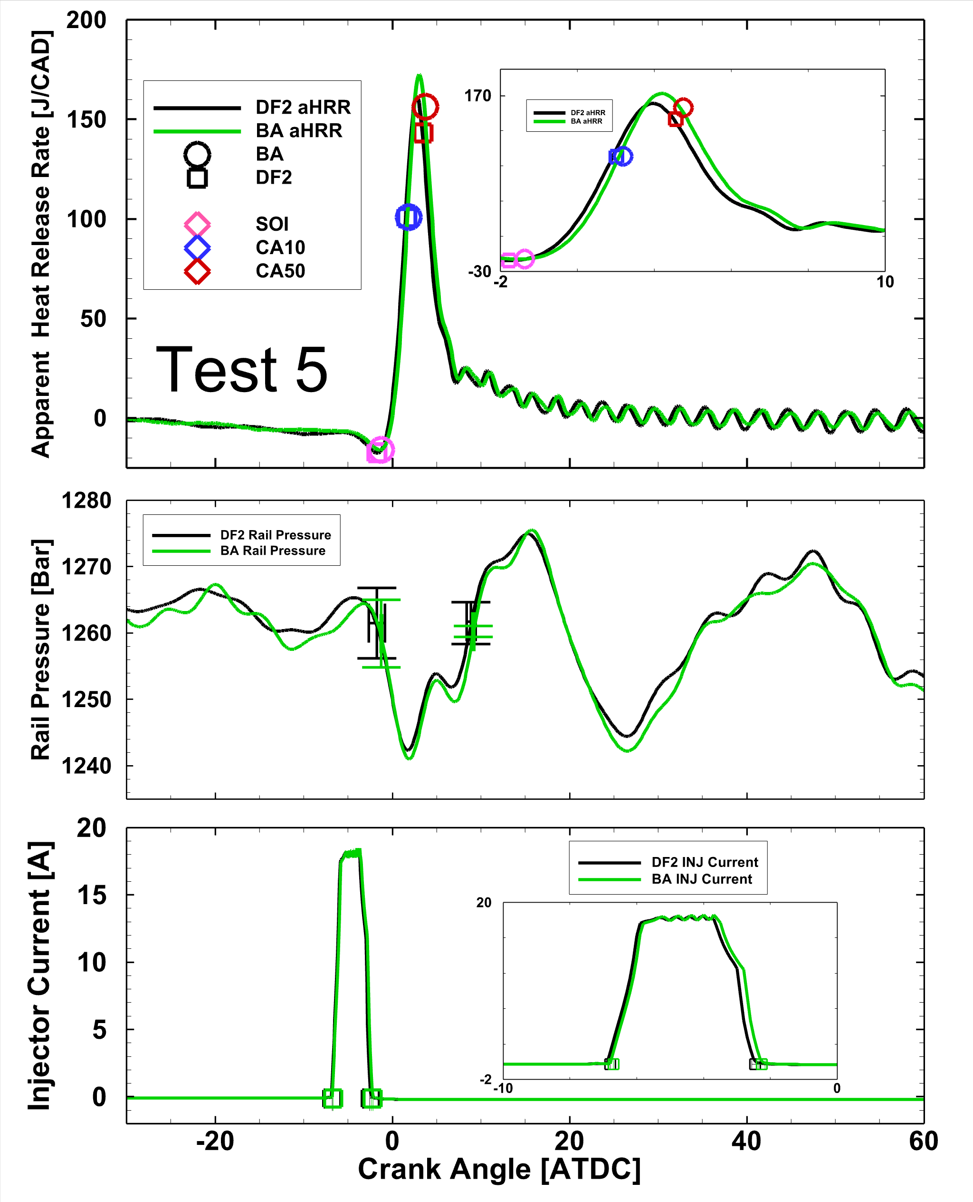
  Combustion Calculations and Injection Parameters
Estimating Actual Start/End of Injection
No needle lift sensor, but use line dynamic pressure
Injector Line Pressure Dynamics are very repeatable
Injector Current SOI initial starting point
Actual SOI/EOI estimated by rising/falling pressure crossing average pressure
Rail SOI & EOI more representative of actual injection than current but sensitive to rail pressure fluctuations
Ign. Delay = SOI_{act} – CA10
Inj. Dwell = EOI_{act} – CA10
Max IMEPn CoV 2.9%, Avg IMEPn CoV ≈ 1%

Slide 11
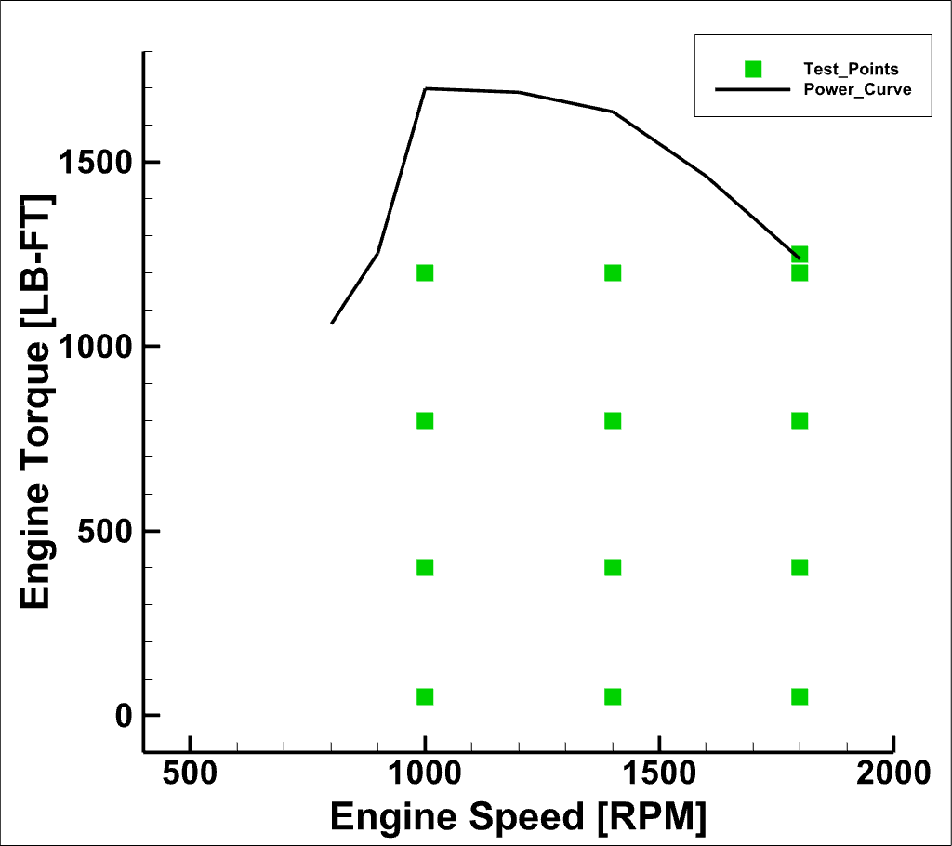
Test Conditions
Drop-in fuel at 5% by vol.
OEM ECU
Only control speed & pedal
  Dyno controlled speed
  Virtual Pedal Torque Control
13 Test points
  Low, mid, high speed and torque
Also, tested Peak Power
  1800 RPM & Max Pedal
  Power reduced by 1.24% but only used 0.67% more fuel
Tests
1200 | 4 | 8 | 12
800 | 3 | 7 | 11
400 | 2 | 6 | 10
50 | 1 | 5 | 9
Load/Speed | 1000 | 1400 | 1800

Slide 12
Results - ECU Parameters – Air Control
Comparison of ECU Setpoints for MAP, VGT, and EGR
Average Difference
  MAP – 1.2%
  VGT Pos.– 3.5%
  EGR Pos.– 8.5%
EGR Valve has the most variation
MAP and VGT correlate as expected
Higher MAP requires less EGR Valve position
1800 rpm, 400 lb-ft only condition seems to be at different setpoint in ECU
Manifold Pressure
[abs, kPa]
VGT Position
% Closed
EGR Position
% Open
 | 1200 | 195.2 | 267.3 | 306.9 |  | 1200 | 60.3 | 62.9 | 51.0 |  | 1200 | 20.3 | 22.2 | 25.2
Torque | 800 | 151.9 | 195.5 | 259.2 |  | 800 | 58.8 | 62.1 | 60.1 |  | 800 | 25.9 | 27.9 | 27.2
[LB-FT] | 400 | 121.8 | 118.2 | 168.8 |  | 400 | 60.0 | 36.3 | 56.6 |  | 400 | 29.1 | 75.0 | 41.0
 | 50 | 106.9 | 108.3 | 133.1 |  | 50 | 89.6 | 39.5 | 59.8 |  | 50 | 34.0 | 46.5 | 35.8
 |  | 1000 | 1400 | 1800 |  |  | 1000 | 1400 | 1800 |  |  | 1000 | 1400 | 1800
 | 1200 | 195.5 | 264.8 | 306.3 |  | 1200 | 59.2 | 62.9 | 50.3 |  | 1200 | 23.4 | 24.0 | 26.4
Torque | 800 | 150.3 | 189.3 | 255.2 |  | 800 | 56.9 | 59.0 | 58.6 |  | 800 | 31.5 | 33.7 | 29.2
[LB-FT] | 400 | 121.2 | 117.0 | 159.7 |  | 400 | 58.1 | 34.2 | 51.3 |  | 400 | 32.5 | 75.0 | 52.2
 | 50 | 106.8 | 108.1 | 133.5 |  | 50 | 89.6 | 37.1 | 59.3 |  | 50 | 34.1 | 46.9 | 36.4
 |  | 1000 | 1400 | 1800 |  |  | 1000 | 1400 | 1800 |  |  | 1000 | 1400 | 1800
 | 1200 | 0 | 1 | 0 |  | 1200 | 2 | 0 | 1 |  | 1200 | -13 | -8 | -5
Torque | 800 | 1 | 3 | 2 |  | 800 | 3 | 5 | 3 |  | 800 | -18 | -17 | -7
[LB-FT] | 400 | 0 | 1 | 6 |  | 400 | 3 | 6 | 10 |  | 400 | -10 | 0 | -21
 | 50 | 0 | 0 | 0 |  | 50 | 0 | 6 | 1 |  | 50 | 0 | -1 | -2
 |  | 1000 | 1400 | 1800 |  |  | 1000 | 1400 | 1800 |  |  | 1000 | 1400 | 1800
 |  | Speed [RPM] |  |  |  |  | Speed [RPM] |  |  |  |  | Speed [RPM]
Relative Diff. [%] BA DF2

Slide 13
Results - ECU Parameters – Fuel Control
Comparison of setpoints for Rail pressure, fuel command, and actual fuel flow rate
Average Difference
  Rail – 1%
  Fuel Cmd – -9%
  Fuel Flow – 3%
Again 1800 rpm, 400 lb-ft seems to be different setpoint
Fuel command differs by up to 43% but little difference in flow rate… cause unclear
May expect BA to be higher fuel command by 2% due to LHV difference
Fuel flow difference approaches LHV difference near peak power
Rail Pressure
[bar]
Rail Pressure
[bar]
ECU Fuel Cmd.
[kg/hr]
Fuel Meas.
[kg/hr]
ECU Fuel Cmd.
[kg/hr]
Fuel Meas.
[kg/hr]
 | 1200 | 1251 | 1969 | 2377 |  | 1200 | 40.6 | 56.7 | 70.9 |  | 1200 | 35.6 | 49.3 | 65.6
Torque | 800 | 1120 | 1446 | 2058 |  | 800 | 27.6 | 38.7 | 51.9 |  | 800 | 22.0 | 33.3 | 45.9
[LB-FT] | 400 | 901 | 1299 | 1614 |  | 400 | 17.4 | 23.4 | 29.7 |  | 400 | 13.0 | 18.0 | 25.1
 | 50 | 631 | 1259 | 1439 |  | 50 | 10.0 | 12.4 | 15.7 |  | 50 | 4.1 | 6.2 | 10.0
 |  | 1000 | 1400 | 1800 |  |  | 1000 | 1400 | 1800 |  |  | 1000 | 1400 | 1800
 | 1200 | 1251 | 1950 | 2374 |  | 1200 | 56.4 | 56.3 | 70.3 |  | 1200 | 34.1 | 48.4 | 64.4
Torque | 800 | 1114 | 1412 | 2044 |  | 800 | 44.3 | 39.5 | 51.5 |  | 800 | 22.7 | 32.1 | 44.9
[LB-FT] | 400 | 890 | 1290 | 1528 |  | 400 | 30.9 | 24.4 | 30.0 |  | 400 | 12.2 | 17.5 | 24.4
 | 50 | 630 | 1259 | 1439 |  | 50 | 9.4 | 11.9 | 15.7 |  | 50 | 4.1 | 5.8 | 9.9
 |  | 1000 | 1400 | 1800 |  |  | 1000 | 1400 | 1800 |  |  | 1000 | 1400 | 1800
 | 1200 | 0 | 1 | 0 |  | 1200 | -28 | 1 | 1 |  | 1200 | 4 | 2 | 2
Torque | 800 | 1 | 2 | 1 |  | 800 | -38 | -2 | 1 |  | 800 | -3 | 4 | 2
[LB-FT] | 400 | 1 | 1 | 6 |  | 400 | -43 | -4 | -1 |  | 400 | 7 | 3 | 3
 | 50 | 0 | 0 | 0 |  | 50 | 6 | 4 | 0 |  | 50 | 1 | 7 | 1
 |  | 1000 | 1400 | 1800 |  |  | 1000 | 1400 | 1800 |  |  | 1000 | 1400 | 1800
 |  | Speed [RPM] |  |  |  |  | Speed [RPM] |  |  |  |  | Speed [RPM]
 | 1200 | 1251 | 1969 | 2377 |  | 1200 | 40.6 | 56.7 | 70.9 |  | 1200 | 35.6 | 49.3 | 65.6
Torque | 800 | 1120 | 1446 | 2058 |  | 800 | 27.6 | 38.7 | 51.9 |  | 800 | 22.0 | 33.3 | 45.9
 | 400 | 901 | 1299 | 1614 |  | 400 | 17.4 | 23.4 | 29.7 |  | 400 | 13.0 | 18.0 | 25.1
 | 50 | 631 | 1259 | 1439 |  | 50 | 10.0 | 12.4 | 15.7 |  | 50 | 4.1 | 6.2 | 10.0
 |  | 1000 | 1400 | 1800 |  |  | 1000 | 1400 | 1800 |  |  | 1000 | 1400 | 1800
 | 1200 | 1251 | 1950 | 2374 |  | 1200 | 56.4 | 56.3 | 70.3 |  | 1200 | 34.1 | 48.4 | 64.4
Torque | 800 | 1114 | 1412 | 2044 |  | 800 | 44.3 | 39.5 | 51.5 |  | 800 | 22.7 | 32.1 | 44.9
[LB-FT] | 400 | 890 | 1290 | 1528 |  | 400 | 30.9 | 24.4 | 30.0 |  | 400 | 12.2 | 17.5 | 24.4
 | 50 | 630 | 1259 | 1439 |  | 50 | 9.4 | 11.9 | 15.7 |  | 50 | 4.1 | 5.8 | 9.9
 |  | 1000 | 1400 | 1800 |  |  | 1000 | 1400 | 1800 |  |  | 1000 | 1400 | 1800
 | 1200 | 0 | 1 | 0 |  | 1200 | -28 | 1 | 1 |  | 1200 | 4 | 2 | 2
Torque | 800 | 1 | 2 | 1 |  | 800 | -38 | -2 | 1 |  | 800 | -3 | 4 | 2
[LB-FT] | 400 | 1 | 1 | 6 |  | 400 | -43 | -4 | -1 |  | 400 | 7 | 3 | 3
 | 50 | 0 | 0 | 0 |  | 50 | 6 | 4 | 0 |  | 50 | 1 | 7 | 1
 |  | 1000 | 1400 | 1800 |  |  | 1000 | 1400 | 1800 |  |  | 1000 | 1400 | 1800
 |  | Speed [RPM] |  |  |  |  | Speed [RPM] |  |  |  |  | Speed [RPM]
Relative Diff. [%] DF2 BA

Slide 14
Results - Performance Comparison
Net Indicated Fuel Conversion Efficiency [%]
Brake Specific Fuel Consumption [g/kWh]
Comparison of efficiency metrics
Average Difference
  BSFC – 4%
  IFCE – -5.5%
Idle and Low load show largest difference
At higher loads and speeds fuels show smaller difference
May expect BA to be higher fuel command by 2% due to LHV difference
 | 1200 | 42.6 | 42.5 | 42.7 |  | 1200 | 210 | 207 | 210
Torque | 800 | 40.7 | 43.2 | 39.4 |  | 800 | 219 | 209 | 225
[LB-FT] | 400 | 39.1 | 43.1 | 41.1 |  | 400 | 238 | 226 | 245
 | 50 | 28.1 | 34.0 | 30.2 |  | 50 | 611 | 618 | 757
 |  | 1000 | 1400 | 1800 |  |  | 1000 | 1400 | 1800
 | 1200 | 44.8 | 44.8 | 45.1 |  | 1200 | 201 | 203 | 211
Torque | 800 | 43.9 | 44.2 | 43.2 |  | 800 | 201 | 202 | 219
[LB-FT] | 400 | 43.2 | 42.8 | 42.0 |  | 400 | 218 | 220 | 239
 | 50 | 30.9 | 33.4 | 35.1 |  | 50 | 571 | 585 | 776
 |  | 1000 | 1400 | 1800 |  |  | 1000 | 1400 | 1800
 | 1200 | -4.9 | -5.2 | -5.5 |  | 1200 | 5 | 2 | 0
Torque | 800 | -7.2 | -2.4 | -8.9 |  | 800 | 9 | 4 | 2
[LB-FT] | 400 | -9.5 | 0.8 | -2.3 |  | 400 | 9 | 3 | 3
 | 50 | -9.1 | 1.9 | -14.0 |  | 50 | 7 | 6 | -2
 |  | 1000 | 1400 | 1800 |  |  | 1000 | 1400 | 1800
 |  | Speed [RPM] |  |  |  |  | Speed [RPM]
Relative Diff. [%] DF2 BA

Slide 15
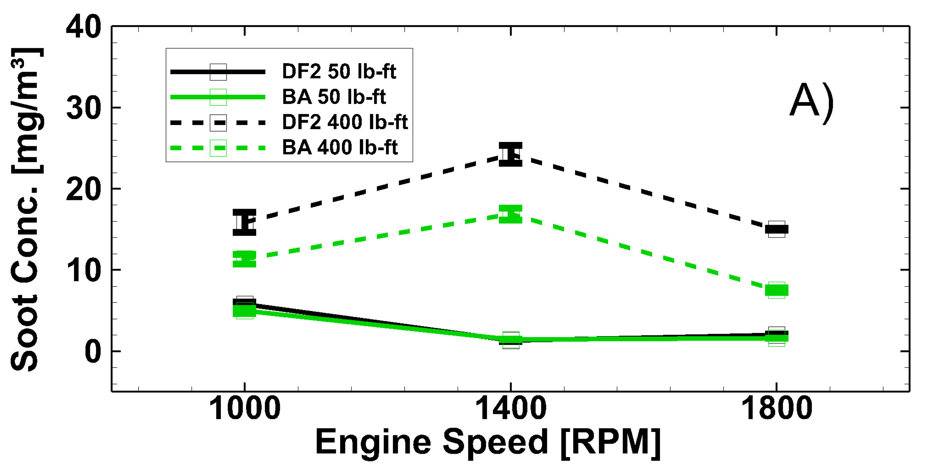
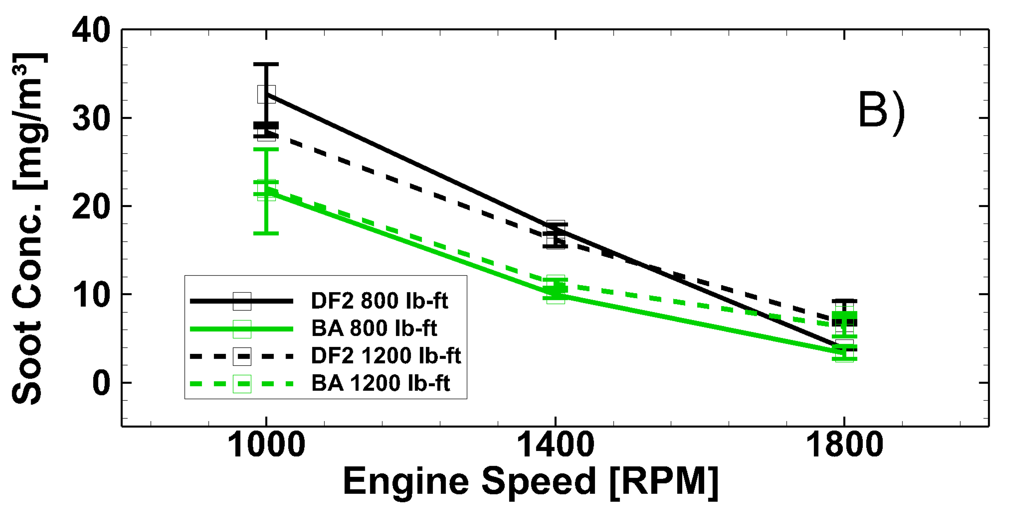
Results - Soot Concentration
AVL 415S Smoke Meter
  FSN converted to mg/m³ per AVL method
Soot is reduced with BA compared to DF2 at all but one idle point
  FSN 0.097 and 0.107 DF2 and BA
  Soot Conc. [mg/m³] 1.31 and 1.46
  Fall within repeatability of Smoke meter
Soot Conc. [mg/m³] is reduced by an average of about 30%
Soot generally reduces as speed increasing

Slide 16
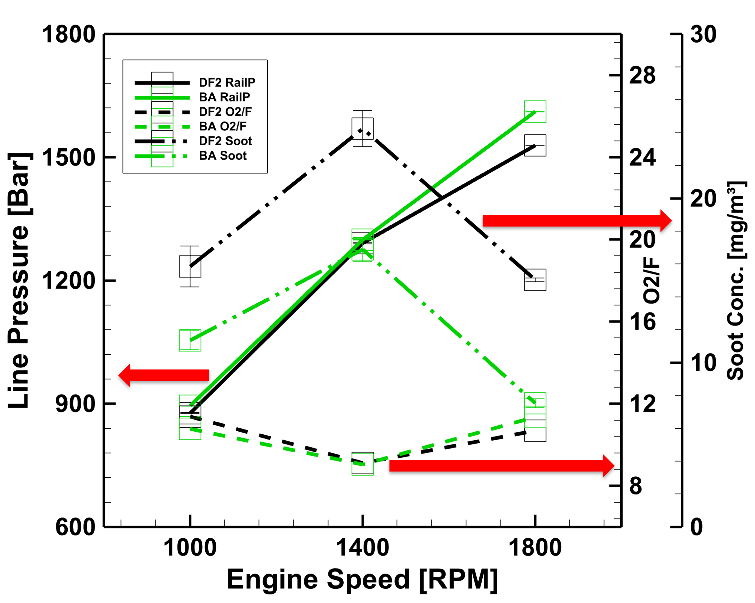

Results - Influence on Soot
Oxygen-to-fuel ratio calculated to account for fuel-bound oxygen.
As expected,
  increase in injection/rail pressure
  and/or
  increase in oxygen concentration lowers soot
As example, at low load available oxygen dominates
No clear difference in $O_{2}$ or injection pressure between fuels
  $O_{2}$ in fuel < 0.2% total mass of $O_{2}$ , yet large reduction in soot.
  Fuel effect is unclear at this point

Slide 17
Results - Emissions
Brake Specific NOx [g/kWh]
Soot Concentration [mg/m³]
  Summary:
  Brake Specific NOx worst at idle
  NOx is best at high speed and idle (BA slightly better)
  BA significantly lowers soot concentrations than DF2
  BA Blend:
  Avg Soot dropped 30%
  Avg BSNOX increased 3.5%
 | 1200 | 5.19 | 2.85 | 4.04 | 1200 | 22.04 | 11.20 | 6.38
Torque | 800 | 4.35 | 3.57 | 3.95 | 800 | 21.66 | 9.99 | 3.39
[LB-FT] | 400 | 3.38 | 3.00 | 2.64 | 400 | 11.36 | 16.89 | 7.53
 | 50 | 13.58 | 13.79 | 0.63 | 50 | 4.99 | 1.46 | 1.62
 |  | 1000 | 1400 | 1800 |  | 1000 | 1400 | 1800
 | 1200 | 5.14 | 2.69 | 3.57 | 1200 | 28.4 | 16.15 | 6.8
Torque | 800 | 4.04 | 3.25 | 3.35 | 800 | 32.71 | 17.4 | 3.85
[LB-FT] | 400 | 3.04 | 2.67 | 2.53 | 400 | 15.86 | 24.25 | 15.04
 | 50 | 13.86 | 14.09 | 0.71 | 50 | 5.78 | 1.31 | 1.99
 |  | 1000 | 1400 | 1800 |  | 1000 | 1400 | 1800
 | 1200 | 1.0 | 6.0 | 13.2 | 1200 | -16.9 | -25.8 | -12.9
Torque | 800 | 7.6 | 10.0 | 17.7 | 800 | -25.6 | -36.0 | -11.1
[LB-FT] | 400 | 11.3 | 12.5 | 4.4 | 400 | -23.3 | -24.0 | -44.0
 | 50 | -2.0 | -2.1 | -10.5 | 50 | -12.3 | 7.0 | -20.7
 |  | 1000 | 1400 | 1800 |  | 1000 | 1400 | 1800
 |  | Speed [RPM] |  |  |  | Speed [RPM]
Relative Diff. [%] DF2 BA

Slide 18
Results - Emissions Cont.
Brake Specific THC [g/kWh]
Brake Specific CO [g/kWh]
  Summary:
  BA Blend slightly reduces HC emissions
  Largest improvement in HC is at slow speed
  BA reduces CO emissions except for two idle points
  BA Blend on average
  Decreases BSHC by 6%
  Decreases BSCO by 8.2%
 | 1200 | 0.05 | 0.05 | 0.05 | 1200 | 1.05 | 0.81 | 0.59
Torque | 800 | 0.07 | 0.06 | 0.07 | 800 | 0.84 | 0.77 | 0.48
[LB-FT] | 400 | 0.13 | 0.12 | 0.11 | 400 | 1.13 | 1.22 | 0.81
 | 50 | 1.16 | 1.14 | 0.95 | 50 | 10.92 | 8.43 | 6.29
 |  | 1000 | 1400 | 1800 |  | 1000 | 1400 | 1800
 | 1200 | 0.05 | 0.05 | 0.06 | 1200 | 1.19 | 0.95 | 0.61
Torque | 800 | 0.07 | 0.07 | 0.07 | 800 | 0.95 | 0.92 | 0.52
[LB-FT] | 400 | 0.15 | 0.12 | 0.12 | 400 | 1.20 | 1.39 | 0.97
 | 50 | 1.30 | 1.20 | 1.05 | 50 | 10.52 | 8.11 | 6.67
 |  | 1000 | 1400 | 1800 |  | 1000 | 1400 | 1800
 |  | Relative % Diff |  |  |  | Relative % Diff
 | 1200 | -7.4 | -6.3 | -0.9 | 1200 | -11.3 | -14.8 | -3.5
Torque | 800 | -7.0 | -3.7 | 0.1 | 800 | -12.0 | -16.6 | -7.7
[LB-FT] | 400 | -10.1 | -6.1 | -4.0 | 400 | -5.8 | -12.8 | -16.4
 | 50 | -10.9 | -4.7 | -9.3 | 50 | 3.8 | 4.0 | -5.7
 |  | 1000 | 1400 | 1800 |  | 1000 | 1400 | 1800
 |  | Speed [RPM] |  |  |  | Speed [RPM]
Relative Diff. [%] DF2 BA

Slide 19
Results - Ignition Characteristics
Injection Dwell Time [ms]
Ignition Delay [ms]
Ign. Delay = SOI_{act} – CA10
Inj. Dwell = EOI_{act} – CA10
More dwell indicates more injection/combustion overlap
Increase with load and speed
Delay Behavior
BA Blend slight increase for most points
Most differences fall within the repeatability
Dwell Behavior
Virtually same
Differences are very minor as SOI, EOI and aHRR are very similar
Summary:
If differences observed it could impact soot, but no clear trends
 |  | BA Dwell Time [msec] |  |  |  |  | BA Ignition Delay [msec]
 | 1200 | 1.26 | 1.32 | 1.60 |  | 1200 | 0.76 | 0.59 | 0.59
Torque | 800 | 1.12 | 1.25 | 1.28 |  | 800 | 0.69 | 0.47 | 0.53
[LB-FT] | 400 | 1.12 | 1.07 | 1.10 |  | 400 | 0.56 | 0.43 | 0.48
 | 50 | 0.96 | 0.87 | 0.73 |  | 50 | 0.79 | 0.36 | 0.36
 |  | 1000 | 1400 | 1800 |  |  | 1000 | 1400 | 1800
 | 1200 | 1.59 | 1.35 | 1.40 |  | 1200 | 0.73 | 0.58 | 0.50
Torque | 800 | 1.33 | 1.22 | 1.13 |  | 800 | 0.65 | 0.49 | 0.48
[LB-FT] | 400 | 1.11 | 1.02 | 1.13 |  | 400 | 0.55 | 0.43 | 0.48
 | 50 | 0.80 | 0.87 | 0.99 |  | 50 | 1.46 | 0.40 | 0.37
 |  | 1000 | 1400 | 1800 |  |  | 1000 | 1400 | 1800
 | 1200 | 0.01 | -0.03 | -0.13 |  | 1200 | 0.03 | 0.01 | 0.08
Torque | 800 | -0.05 | 0.03 | -0.02 |  | 800 | 0.04 | -0.02 | 0.05
[LB-FT] | 400 | -0.01 | 0.04 | -0.01 |  | 400 | 0.01 | 0.00 | 0.00
 | 50 | -0.07 | 0.01 | -0.03 |  | 50 | -0.67 | -0.03 | -0.01
 |  | 1000 | 1400 | 1800 |  |  | 1000 | 1400 | 1800
Relative Diff. [%] DF2 BA

Slide 20
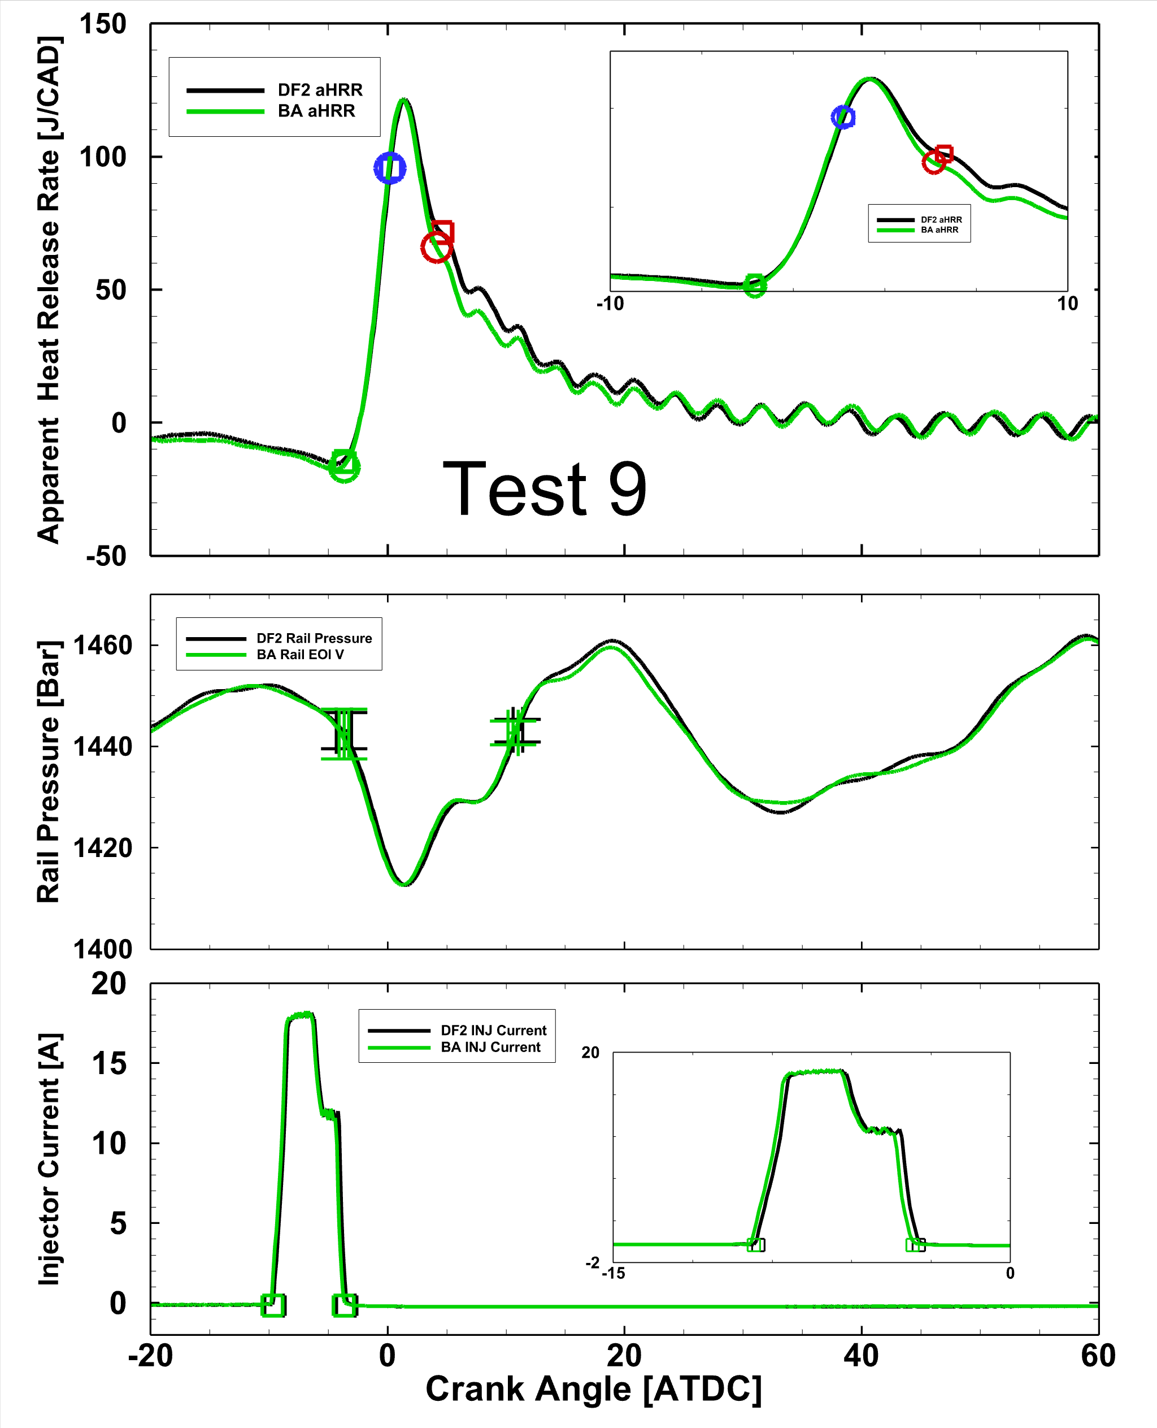
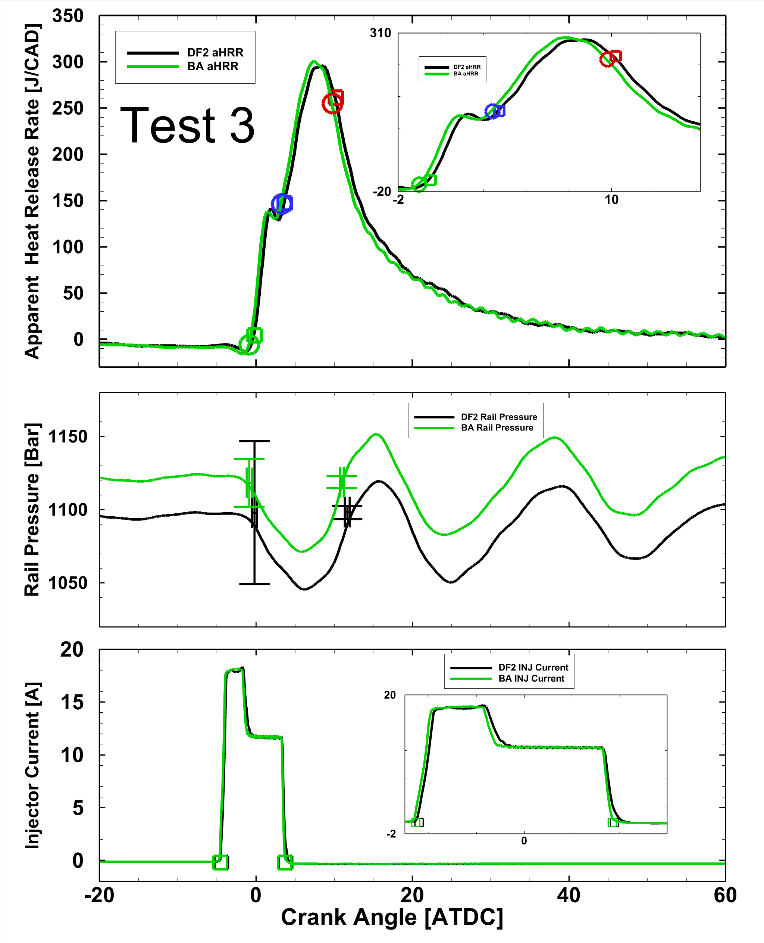
Results - High-Speed Comparison
All cases have nearly identical combustion phasing, injection pressure, injector current timing
Selected points for comparison
1000 rpm, 800 lb-ft
Large soot difference – 25.6%
BA slightly earlier SOI command
BA slightly higher injector line pressure (20 bar)
  Could this cause soot difference?
1800 rpm, 50 lb-ft
BA Smoke only reduced 20.7%
BA BSNOx reduced by 10.5%
Identical injection pressure
  Minor rail pressure changes aren’t causing soot differences
1800 RPM, 50 lb-ft
1000 RPM, 800 lb-ft

Slide 21
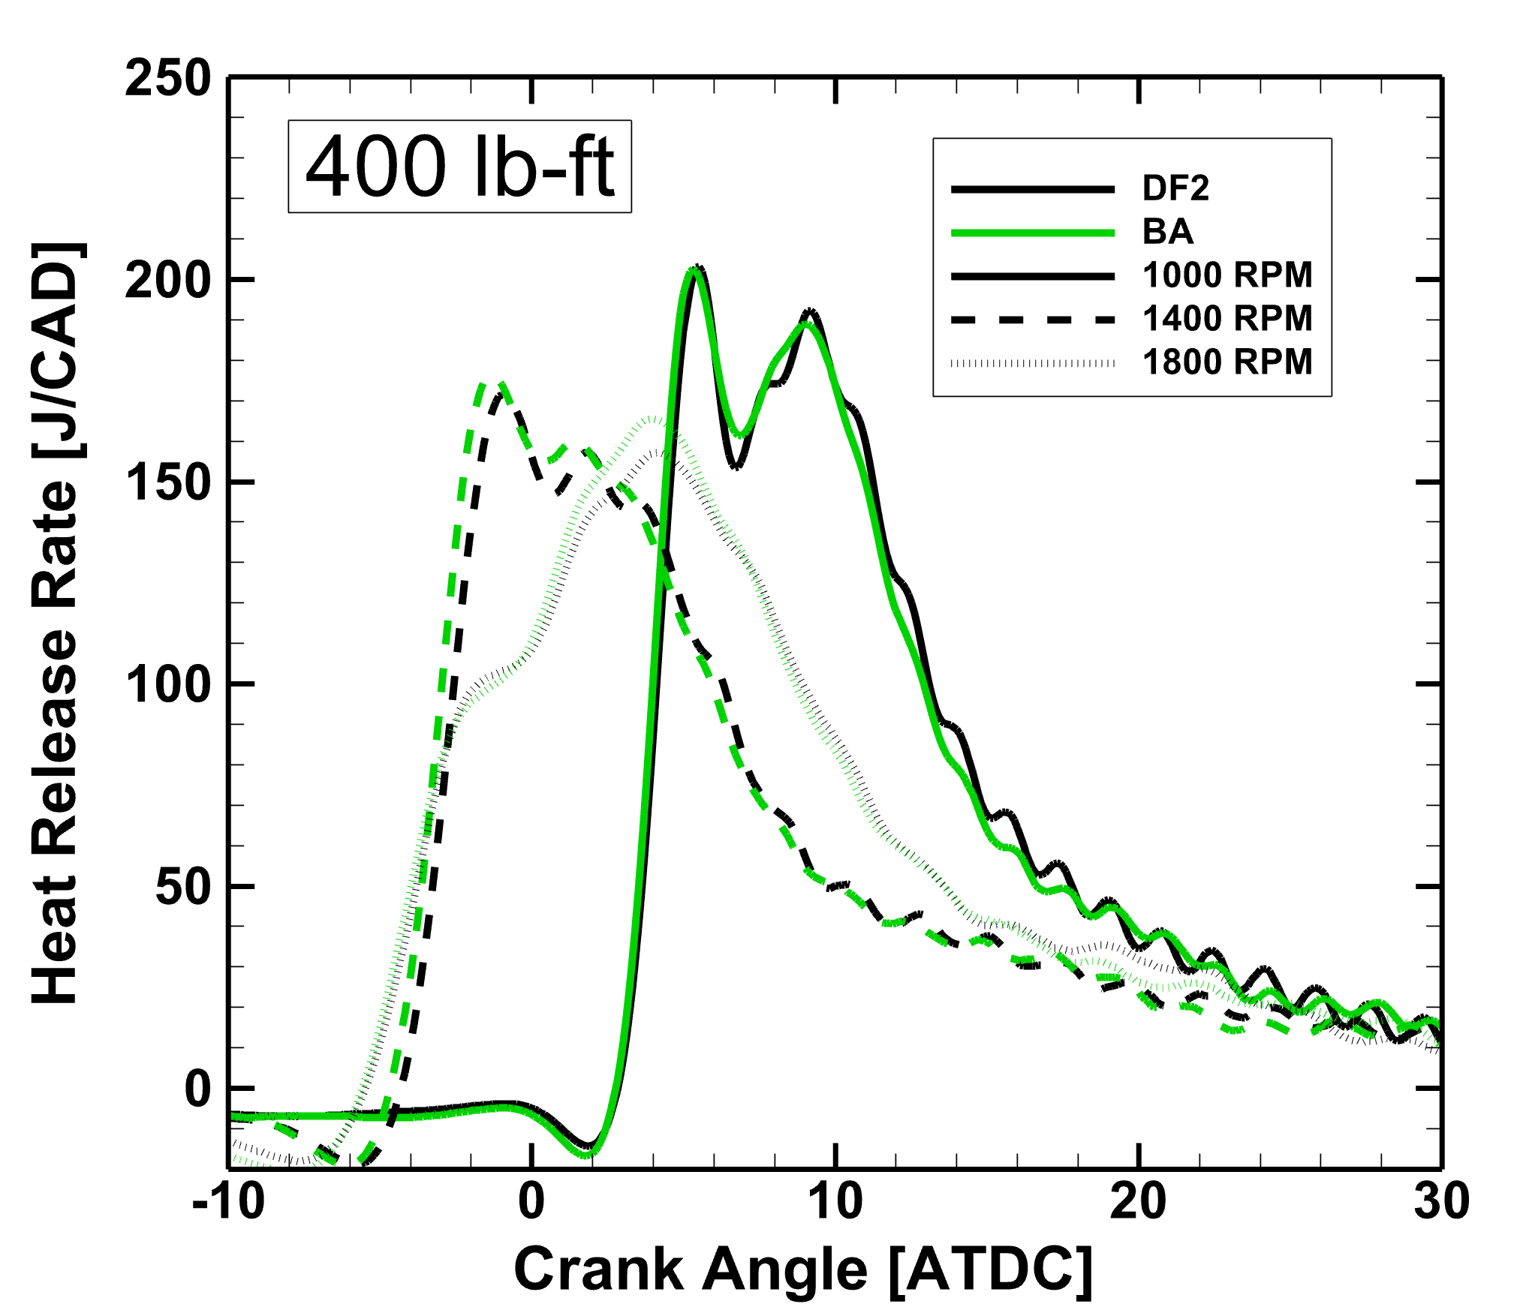
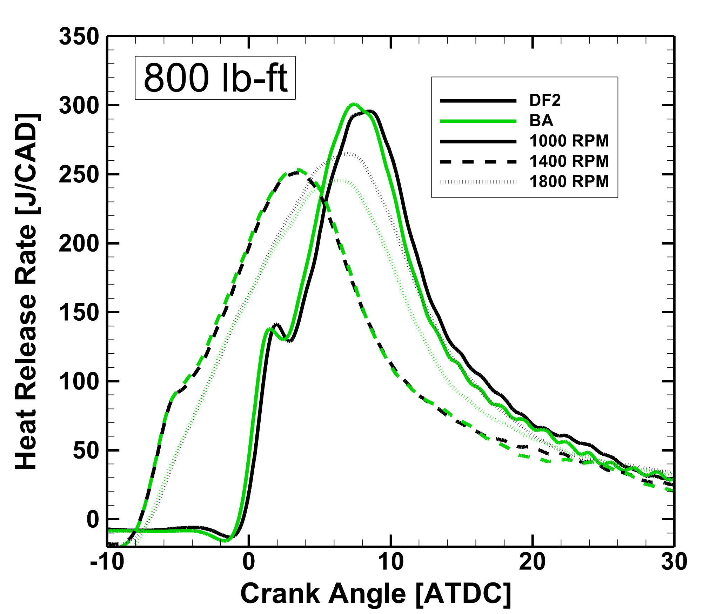
Results – Combustion Phasing
Combustion phasing in a cycle can have a large impact on soot production (premixed/diffusion reactions)
Heat Release Rates between the fuels are all very similar for each test
Combustion phasing differences do not seem to be dominate in soot reduction

Slide 22
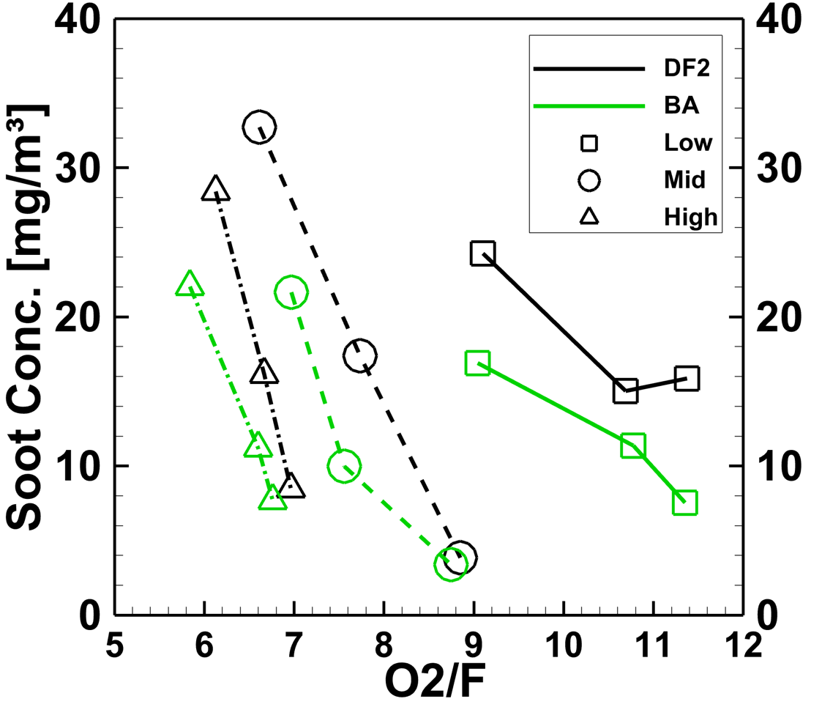
Summary – Soot Reduction
O2/F ratio was determined for all points with higher ratios favoring lower soot
DF2 has similar or higher O₂/F ratio but higher soot
Oxygen in BA blend is less than 0.2% mass of total oxygen
Unlikely that such a small amount of fuel bound O₂ can cause such a reduction in soot
Differences in spray mixing behavior could be driving the reduction
Idle points not shown (much higher O₂/F & lower soot) but similar trends

Slide 23
Conclusion
5% by volume blend of Butyl-Acetate in DF2 was tested across the engine operating range using a stock ECU with negligible differences.
Minimal changes to performance (efficiency, combustion phasing, etc.)
Soot reduced by roughly 30% while BSNOx increased by only 3.5%
Global O₂/F ratio trend doesn’t match soot behavior, and with matched combustion phasing
Improved mixing, further aided by local oxygenation likely driving soot reduction
Butyl Acetate reduces soot without significant negative impacts

Slide 24
Acknowledgements
This material is based upon work supported by the U.S. Department
of Energy’s Office of Energy Efficiency and Renewable Energy
(EERE) under the Vehicle Technologies Office (VTO) and Bioenergy
Technologies Office (BETO) as part of the Co-Optimization of Fuels
& Engines program and award number DE-EE0008483. The views
expressed herein do not necessarily represent the views of the U.S.
Department of Energy or the United States Government.
Thank you for your attention.
Questions?

Slide 25
Figure References
[1] Rakopoulos, C. D., et al. "Comparative performance and emissions study of a direct injection diesel engine using blends of diesel fuel with vegetable oils or bio-diesels of various origins." Energy conversion and management 47.18-19 (2006): 3272-3287.
[2] McCormick, Robert L., Jeffrey D. Ross, and Michael S. Graboski. "Effect of several oxygenates on regulated emissions from heavy-duty diesel engines." Environmental Science & Technology 31.4 (1997): 1144-1150.
[3] Co-Optimization of Fuels & Engines Year in Review (FY20). United States: N. p., 2021. Web. doi:10.2172/1782424.
[4] Wang, Yujie, et al. "Combustion of n-butyl acetate synthesized by a new and sustainable biological process and comparisons with an ultrapure commercial n-butyl acetate produced by conventional Fischer esterification." Fuel 304 (2021): 121324.
[5] U.S. Department of Energy. “Fuel Properties Database.” Available at at https://www.nrel.gov/transportation/ fuels-properties-database/ (Accessed 10/10/2022).
[6] McCormick, Robert L., and Richard Parish. "Advanced petroleum based fuels program and renewable diesel program." NREL/MP (2001): 540-32674.
[7] Kumar, B. Rajesh, and S. Saravanan. "Use of higher alcohol biofuels in diesel engines: A review." Renewable and Sustainable Energy Reviews 60 (2016): 84-115.

Slide 26
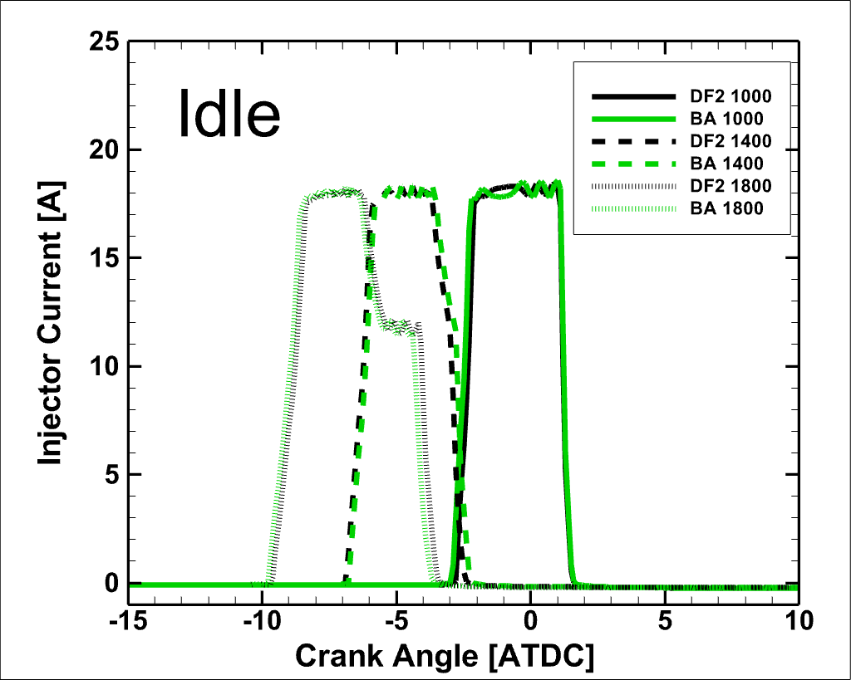
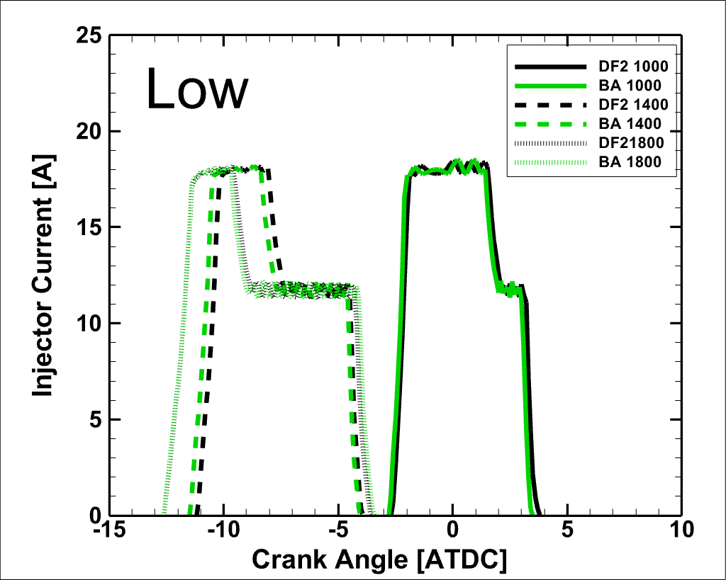
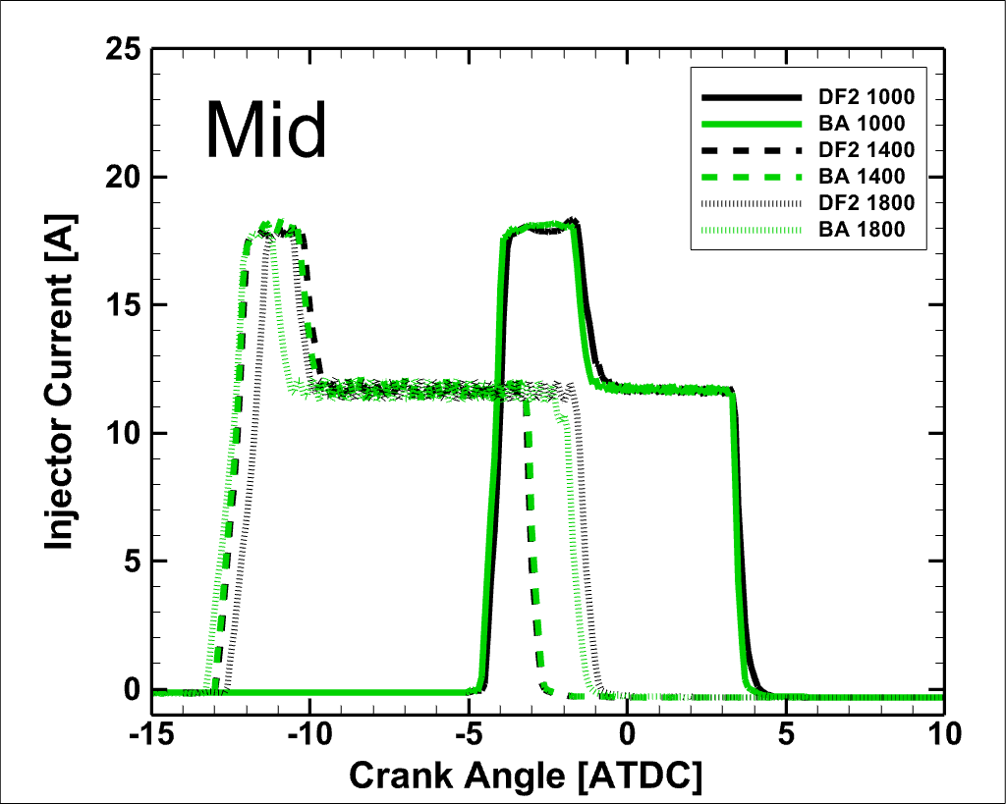
Injector Current

Slide 27
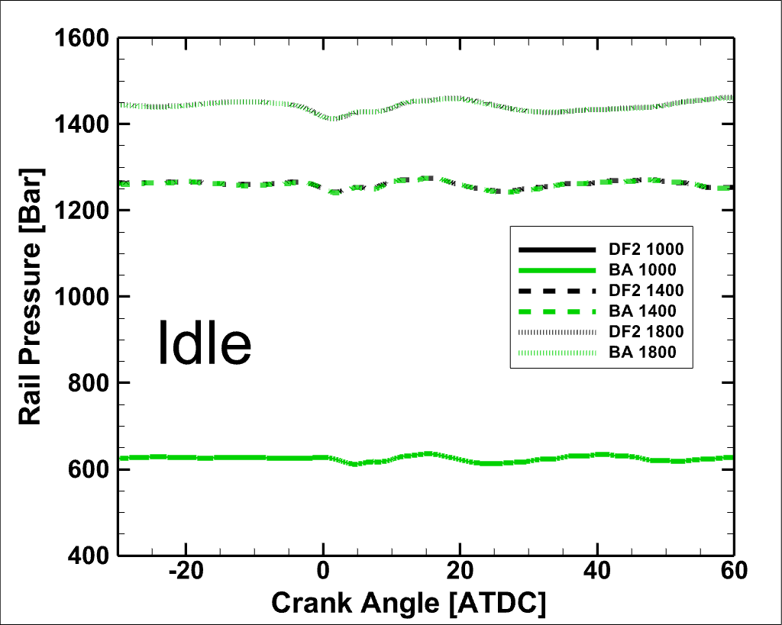
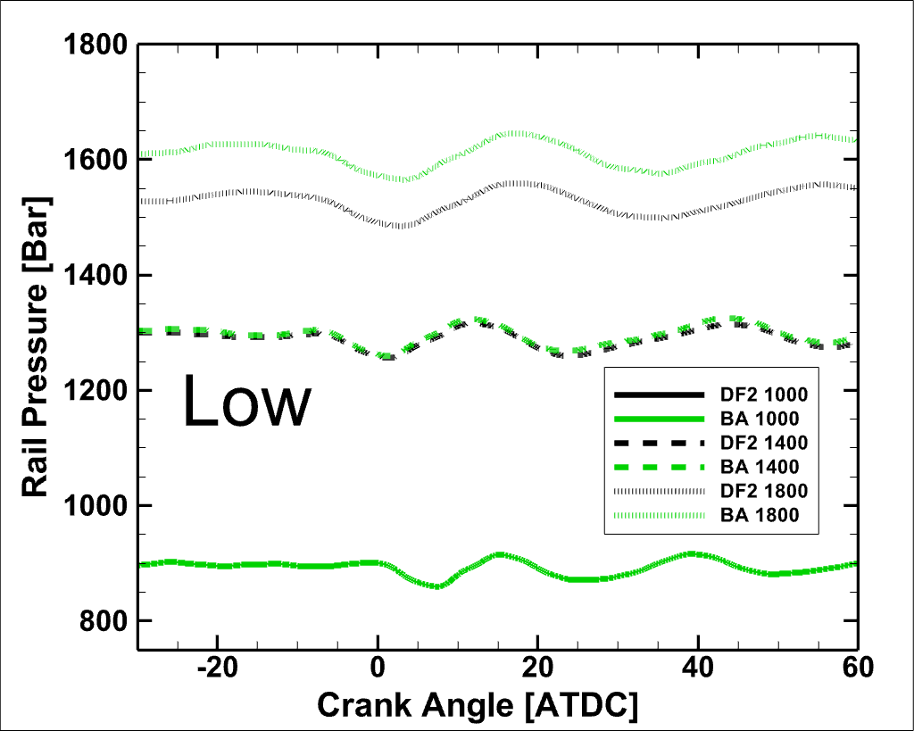
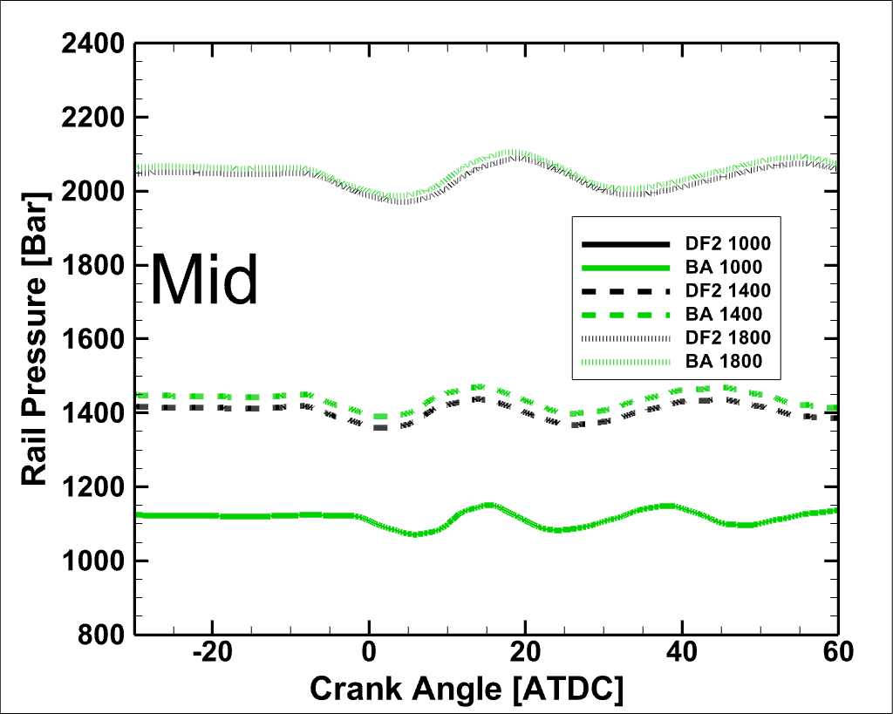
Rail Pressure

Slide 28
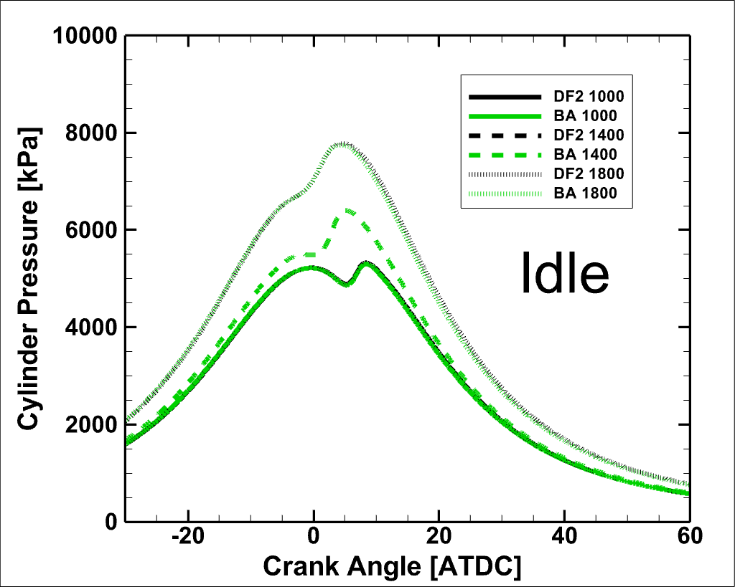
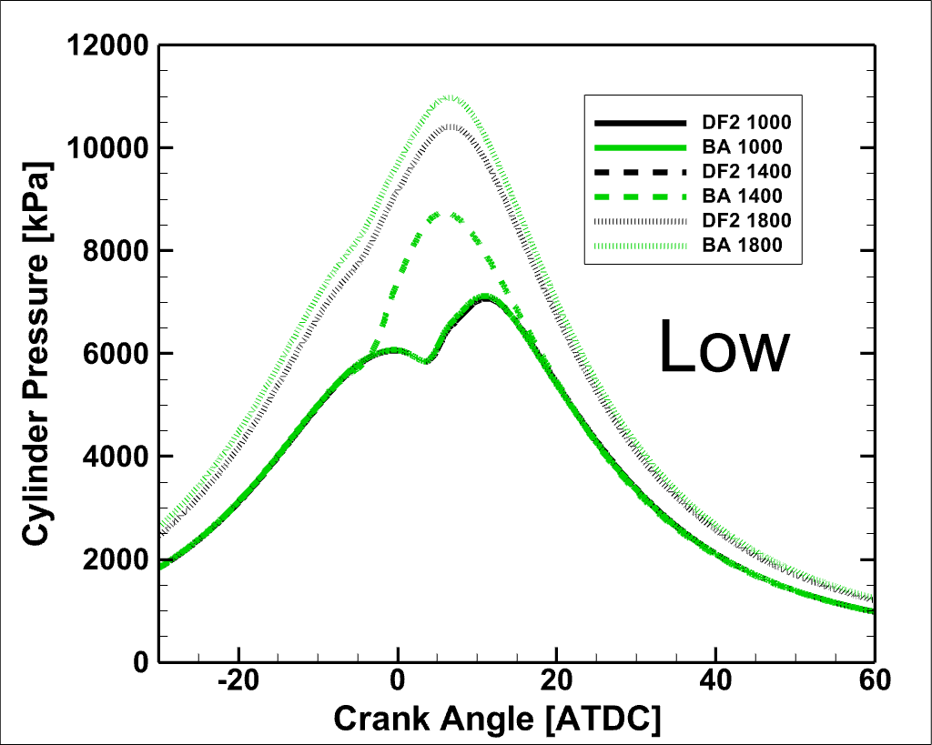
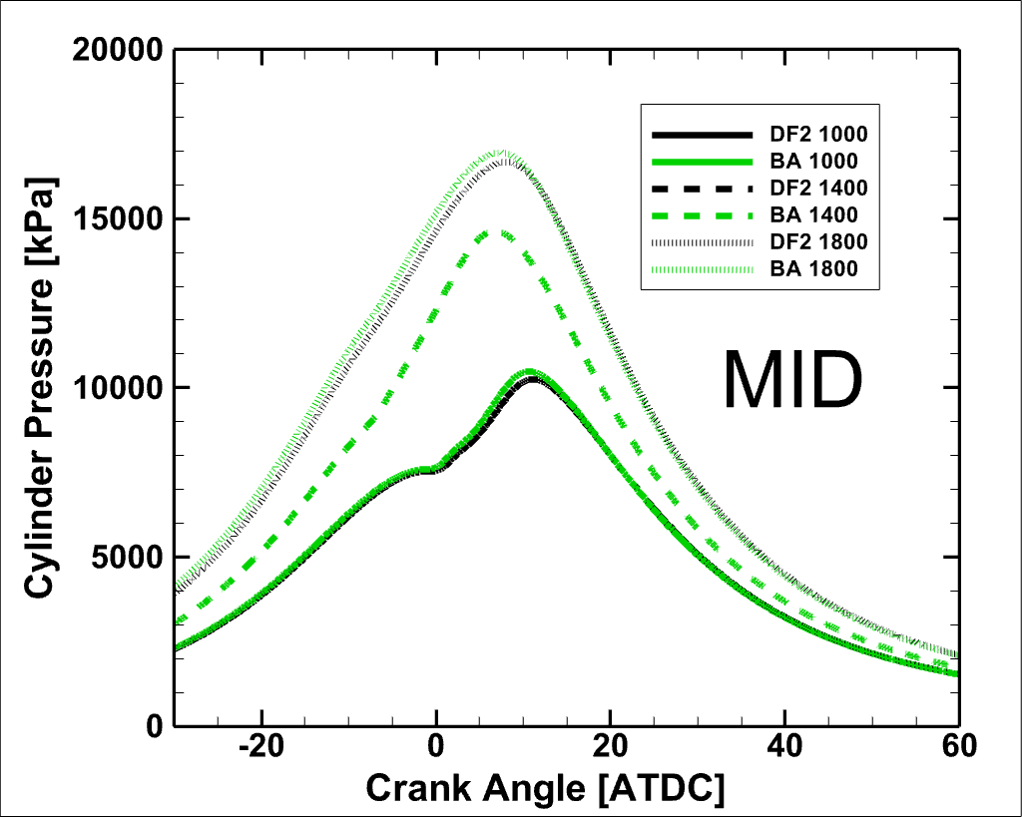
Cylinder Pressure

Slide 29
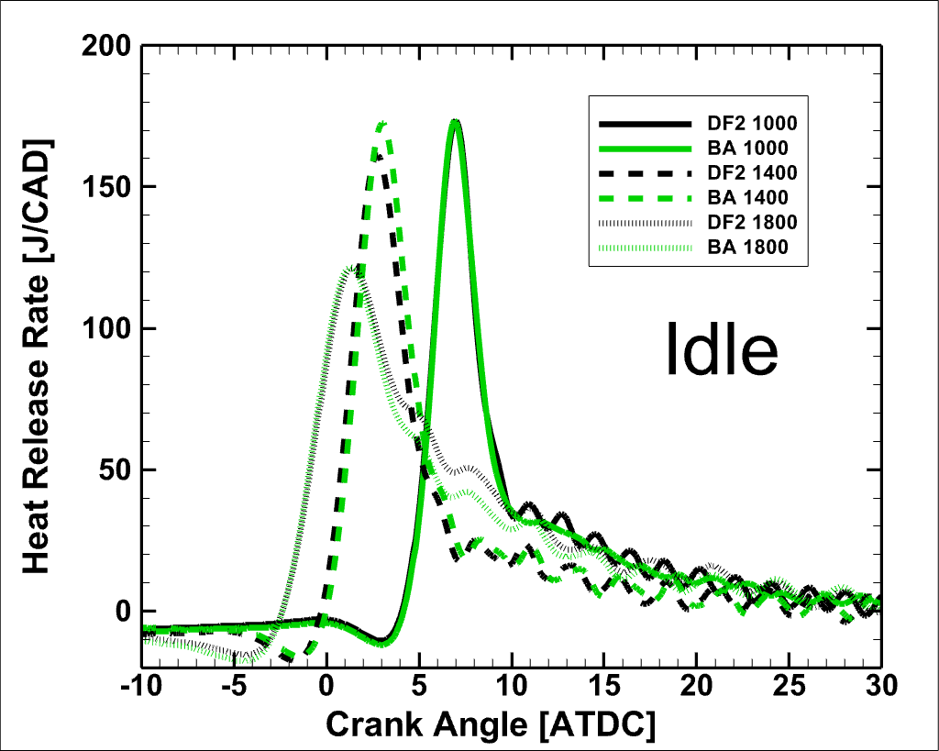
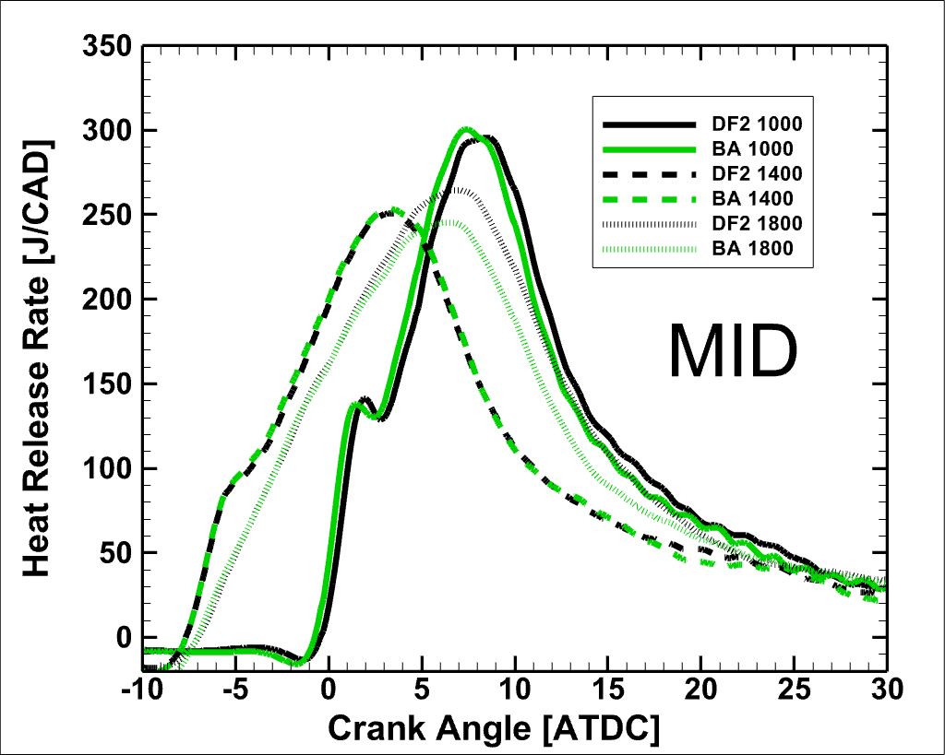
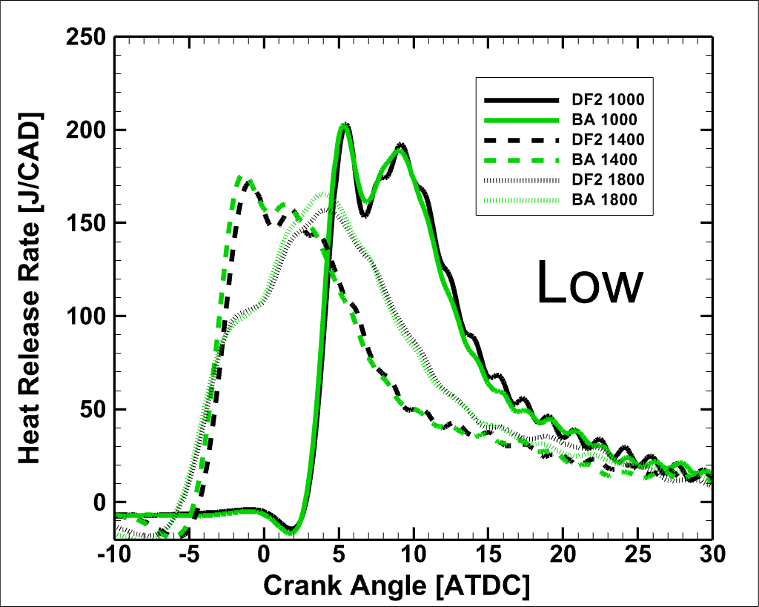
Results – Combustion Phasing

Slide 30
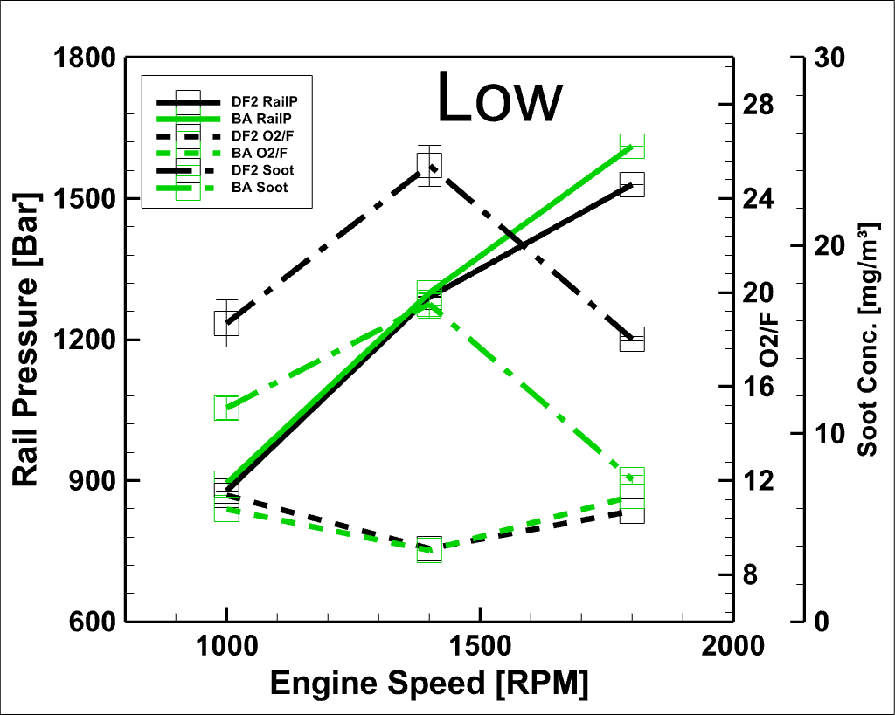
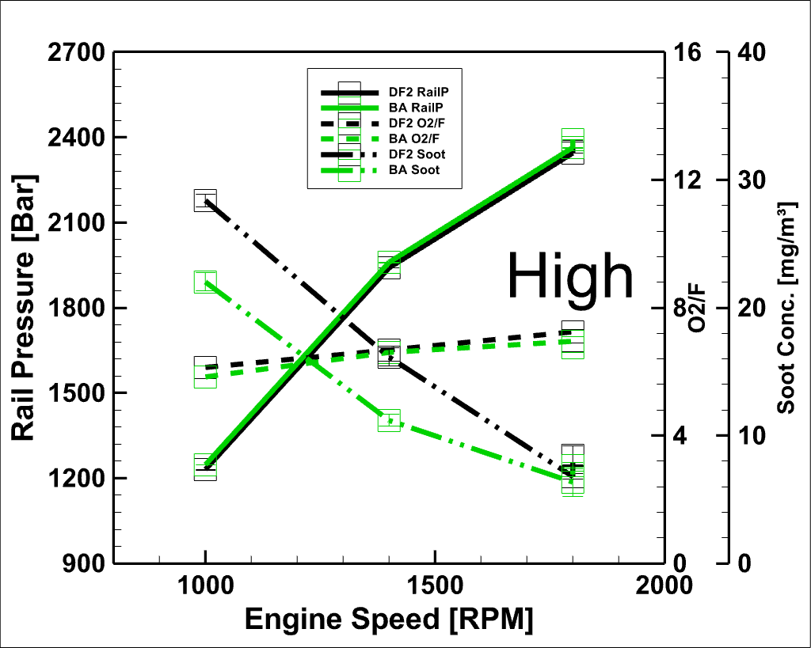
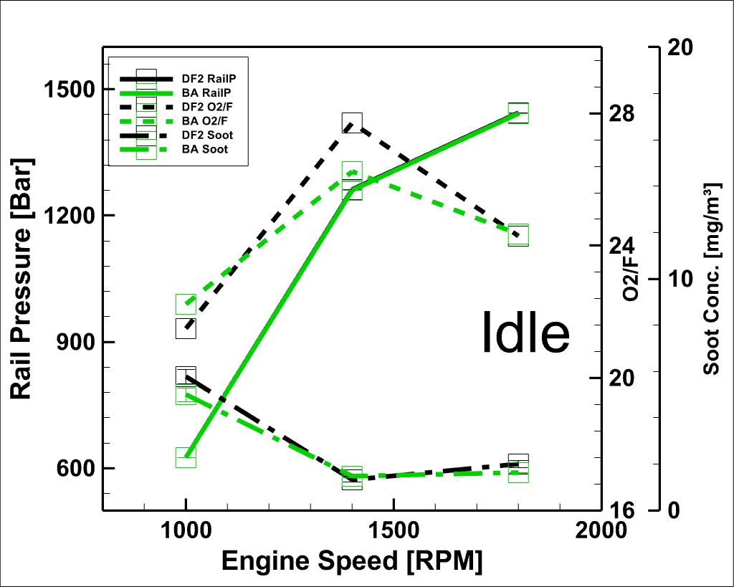
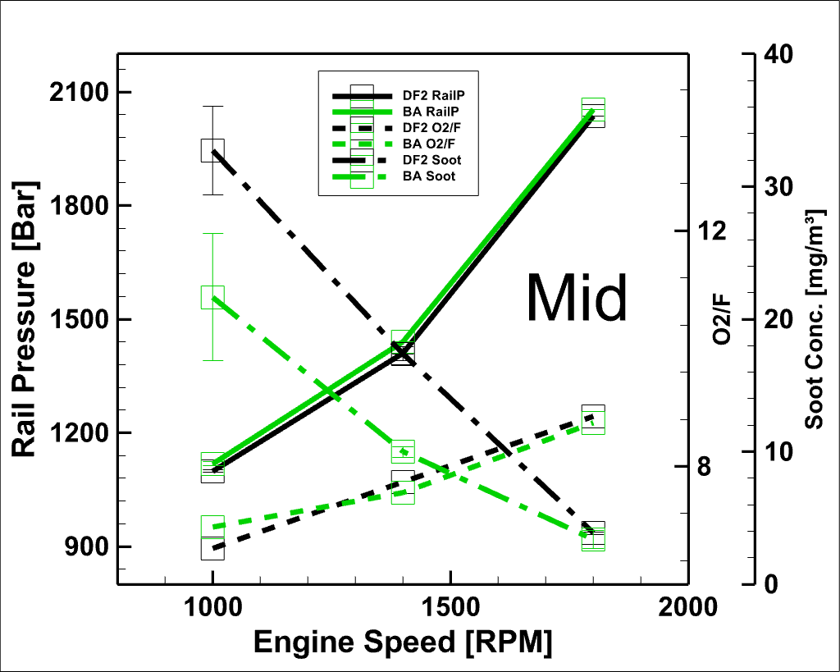
Results - Influence on Soot

Slide 31
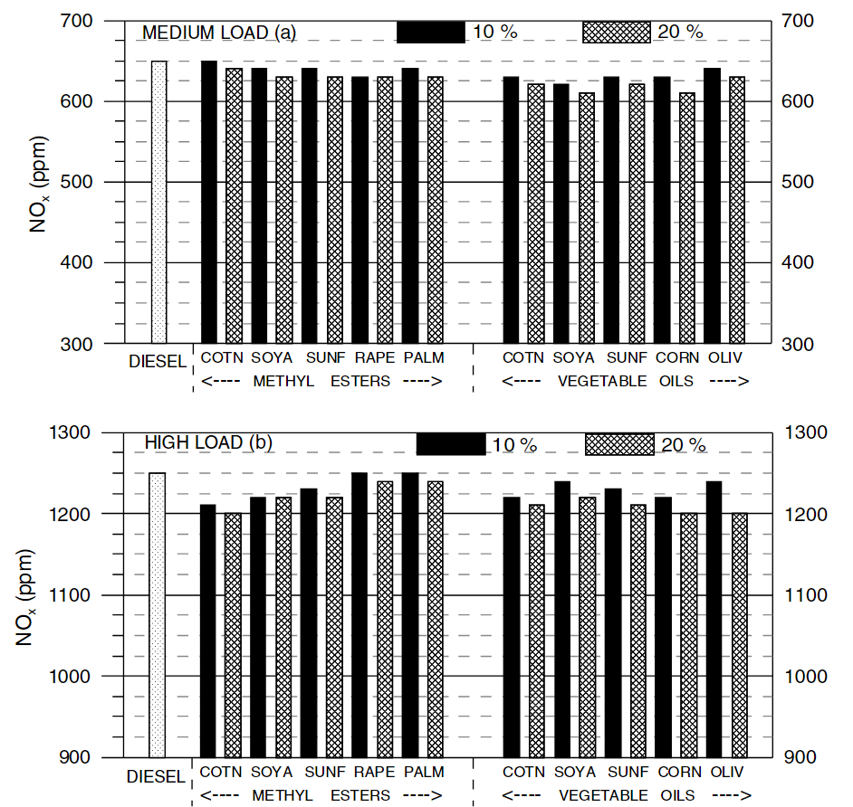
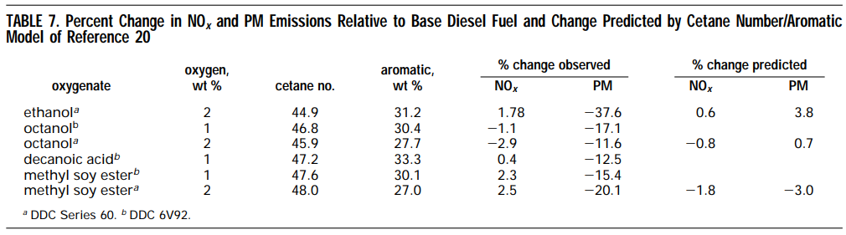
Evolution of Biofuels
G1 – fuel produced from food-chain feedstock
G2 – non-food biomass (leftovers)
G3 – produced from or aided by bio-engineering – Butyl Acetate
Biofuels in General
  Increase BSFC due to lower heating value
  Vegetable Oils
    Lower NOx
    Increase Soot, CO
  Methyl Esters
    Lower – Soot, NOx, CO
  Single Component Oxygenates
    Significantly reduce PM
    Either increase or decrease NOx
[1]
[2]
[1] Rakopoulos, C. D., et al. "Comparative performance and emissions study of a direct injection diesel engine…." Energy conversion and management 47.18-19 (2006): 3272-3287.
[2] McCormick, Robert L., Jeffrey D. Ross, and Michael S. Graboski. "Effect of several oxygenates on regulated emissions from heavy-duty diesel engines." Environmental Science & Technology 31.4 (1997): 1144-1150.

