Slide 1


Demonstrating a direct-injection constant-volume combustion chamber as a validation tool for chemical kinetic modeling of liquid fuels
Aaron Suttle¹, Brian Fisher², Dennis Parnell¹, and Joshua Bittle¹
¹The University of Alabama, ²Naval Research Laboratory
ASME 2018 Internal Combustion Engine
Fall Technical Conference
San Diego, CA

Slide 2

Presentation Overview
Ignition Research Techniques
Background Motivation
Experimental Setup and Modifications
Data Processing and Test Plan
Results
Summary and Future work

Slide 3
Ignition Research Techniques
Computationally based combustion research utilizes chemical-kinetic mechanisms to model the complex chemical reactions and the combustion phenomena
Experimentally based studies use a variety of devices:
  Rapid Compression Machines (RCM)
  Shock Tubes
  Constant Volume Combustion Chambers (CVCC)-The ignition quality tester (IQT) and derived cetane tester (CID)
Combustion occurring within each of these devices is then captured via combustion pressure transducers or optical ports
In order to facilitate mechanism development, each system would be approximated as a perfect stirred reactor

Slide 4
Ignition Research
Techniques - CVCC
When using a CVCC considerations must be made, which form limitations on the device’s capabilities
Due to the transient nature of the fuel injection process, there exists a time below which, the chamber cannot be considered “well mixed”
Accurate measurement of thermodynamic state of contained air mass for estimation of initial conditions and global equivalence ratio is critical
Accurate characterization and control of the fuel injection system is of utmost importance for limiting uncertainty associated with the fuel injection process

Slide 5
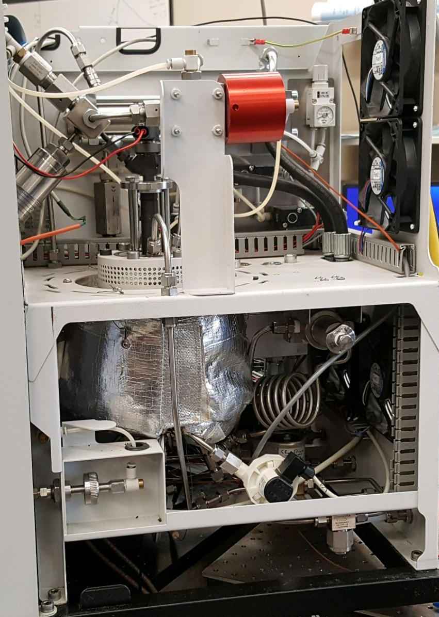
Project Motivation and Background
Combustion of liquid fuels is often studied for the validation or refinement of chemical-kinetic mechanisms
A particular difficulty for traditional combustion test apparatuses are low volatility fuels
These fuels can be difficult to evaporate, and maintain in a vapor state prior to mixing with air and increasing mixture temperature
The Derived Cetane Tester (CID 510) addresses this by injecting liquid fuel into a heated, high pressure constant volume combustion chamber by utilizing a commercial diesel engine injector
High Pressure Fuel Supply and Transducer
Injector
Combustion Chamber
Combustion Pressure Transducer
Gas Supply

Slide 6
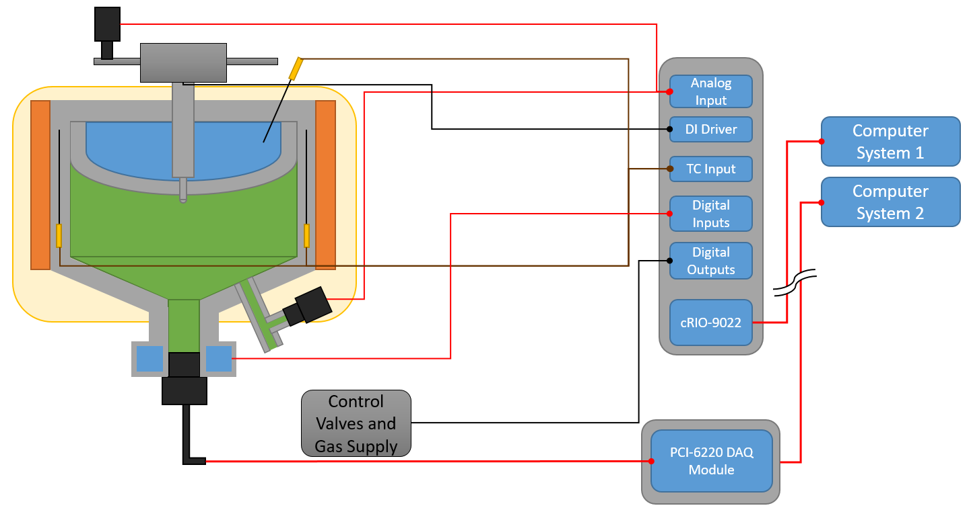
Experimental Setup and Modifications
Beginning with the unmodified CID, an external control and DAQ system was developed to expand the chambers range of testable temperatures, pressures, and equivalence ratios

Slide 7
Device Characterization
After completing expansion of the CID controls, the various processes related to the device’s accuracy were characterized
These included:
Chamber wall temperature offset and temperature spatial homogeneity
Volume of injected fuel calibration
Effects of evaporative cooling
Calibration of all onboard pressure transducers

Slide 8
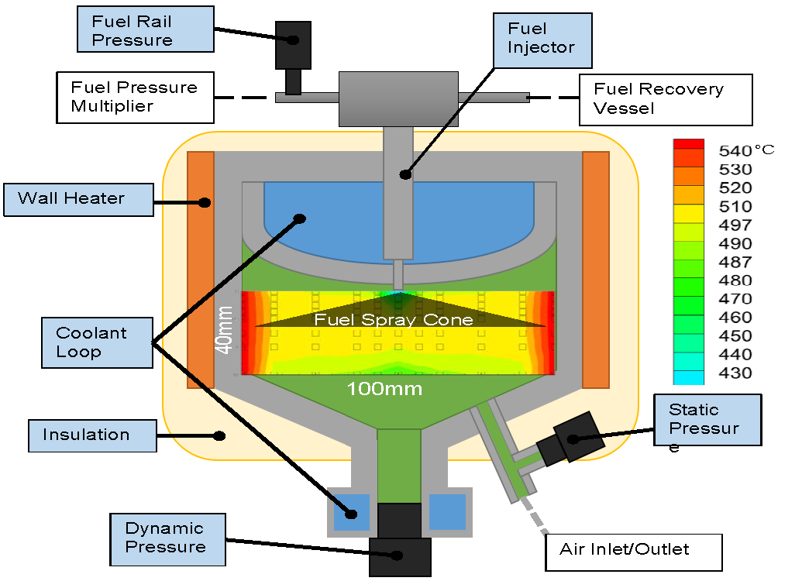
Device Characterization

Slide 9
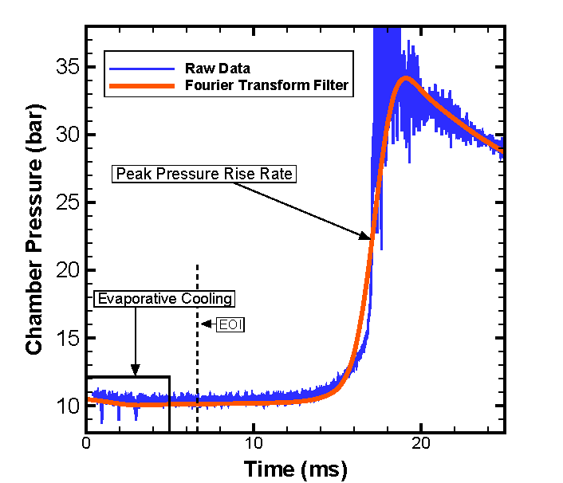
Test Plan and Data Processing

Slide 10
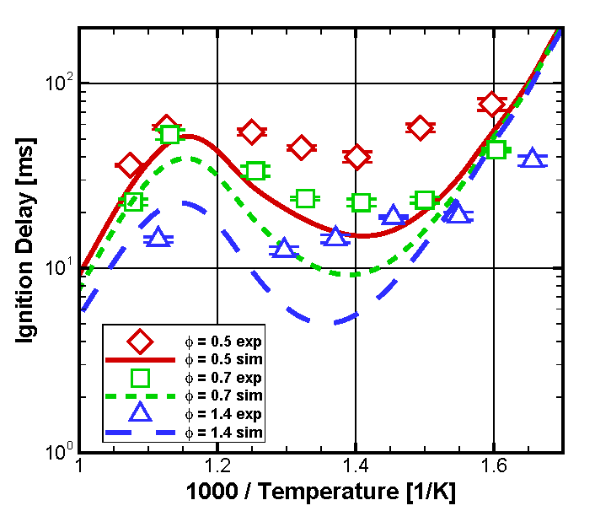
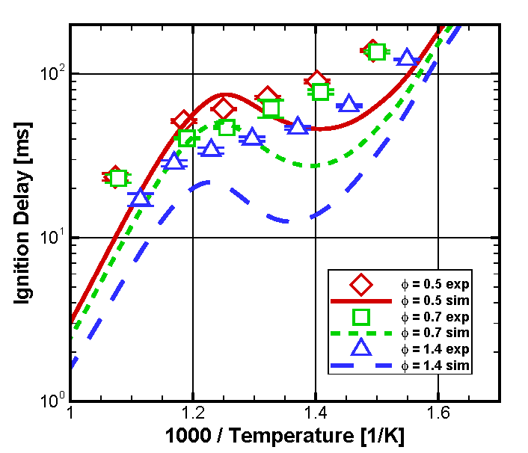
Initial Results – φ,T sweeps
n-heptane – P_{amb} = 5 bar
iso-octane – P_{amb} = 20 bar
Based on confidence in thermodynamic state and injection durations, a minimum threshold ignition delay of 10 ms results in a kinetics dominated ignition event that can reasonably be compared to a 0-D model.

Slide 11
Initial Results – φ,T sweeps
Why would n-heptane have better agreement with model than iso-octane at nominally same ignition delay range?
Next step:
  try to study pressure effects
  Must use iso-octane due to τ_{ign} range
n-heptane – P_{amb} = 5 bar
iso-octane – P_{amb} = 20 bar

Slide 12
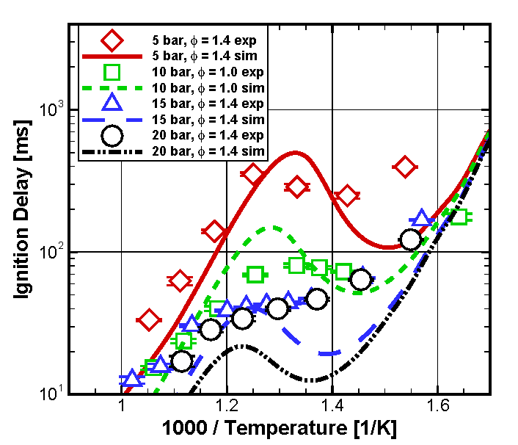
Octane Pressure Sweep
Relative pressure effects are captured
Extremes of NTC region are not and only low P cases show reversal in τ_{ign}
Capturing pressure dependence is a focus of kinetic model developers.
In this case the dependence is over predicted.

Slide 13
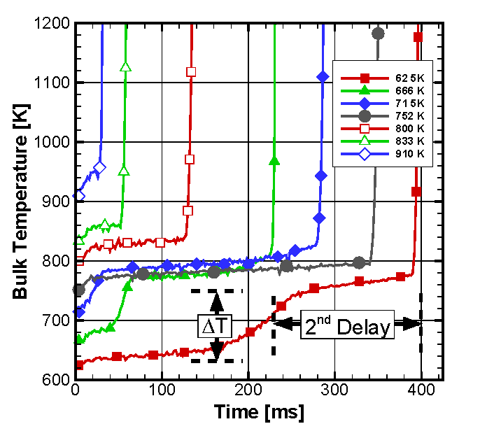
Bulk Temperature Histories
iso-octane – P_{amb} = 5 bar
Process pressure histories into bulk temperature assuming ideal gas and constant gas constant*
Plotted range of 600-1200 K highlights low-temp. regime
Apparent low-temp kinetics barrier around 800 K.
Correlation between temp. increase during 1st stage and secondary delay to main ignition.
*during the 1st stage reactions the bulk gas constant does not change much and will not affect trends.

Slide 14
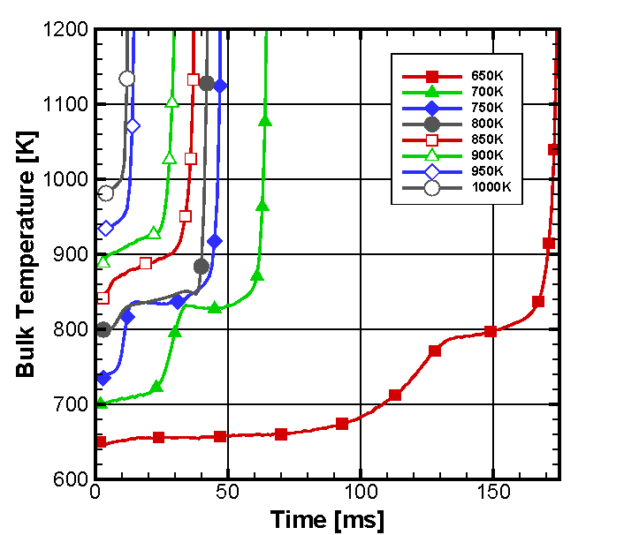
Bulk Temperature Histories
iso-octane – P_{amb} = 15 bar
Same observations, except no reversal in main ignition delay trend.
Apparent low-temp kinetics barrier around 825 K in this case.
This barrier tends to slow the overall ignition process for temperatures in the NTC region.
For T_{amb}>850 K, 1st stage begins before 10 ms threshold.
*during the 1st stage reactions the bulk gas constant does not change much and will not affect trends.

Slide 15
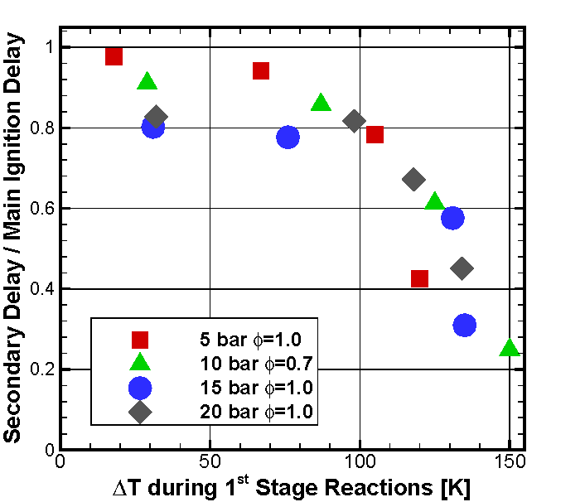
Connection of 1st to 2nd Delay
Results suggest concentrations of main ignition precursors (e.g. H₂O₂) after 1st stage is proportional with 1st statge heat release (α ΔT)
Increase in initial temp reduces 1st stage HR and thus more time is needed for accumulation of precursors before main ignition.
Above the kinetic barrier, 1st stage kinetics still present, but precursor accumulation is primarily through other pathways.
iso-octane

Slide 16
Comparison With Other Devices Work
While not included in paper, the key difference is that CID, IQT, RCM all show suppressed NTC behavior compared to model and shock tubes.
n-heptane – 3-4.5 bar
CID to RCM
iso-octane – 15 bar
CID to shocktube

Slide 17
Summary and Conclusions
The modified CID is a capable ignition delay test apparatus based on extensive characterization of thermodynamic state.
Under conditions with more than 10 ms ignition delay the results may be reasonably compared to 0-D simulations.
Temperature profiles highlight interesting NTC behavior and illustrate low-temperature kinetic barriers.
Comparing CID and other apparatus to models suggest over prediction of sensitivity to pressure (at least in context of internal combustion engines).

Slide 18
Thank you for your attention!

Slide 19
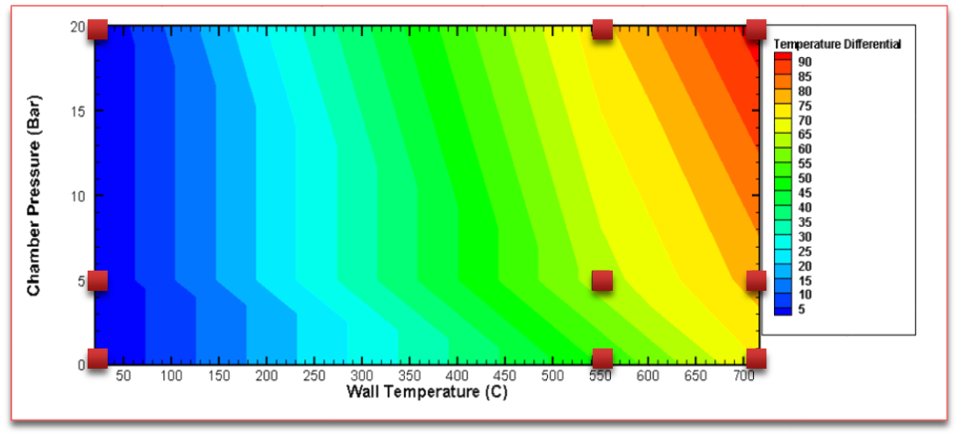
Chamber Temperature Offset
Chamber temperature offset was measured at 9 temperature and pressure conditions
The plot below was used to curve fit a surface equation for the purpose of estimating total wall temperature offset

