Slide 1
Numerical Analysis of a Reacting Radial Rotating Detonation Combustor for Different Cross-Sectional Areas
Kayla Bell and Ajay Agrawal
Department of Mechanical Engineering,
University of Alabama, Tuscaloosa, AL, USA
AIAA SciTech 2024, Orlando, FL

Slide 2
Background
Rotating detonation combustion (RDC) has received significant research interest because of compactness and the potential for pressure gain in the combustor.
Radial RDCs involve detonation between plates as opposed to widely studied annular RDCs where detonation occurs between concentric pipe.
Radial RDCs could be even more compact, especially for rocket propulsion, in addition to their higher predicted performance compared to annular RDCs.
In addition to physical experimentation, computational fluid dynamics (CFD) analysis has been an integral part in understanding the complex flow field of RDCs.
Prior CFD studies have typically focused on RDC by isolating it from the upstream injection system and/or the downstream expansion nozzle hardware.
In practice however RDC operation is coupled strongly with upstream and downstream systems. Thus, a coupled high-fidelity 3D simulation will provide further insight into RDC operation at realistic operating conditions.

Slide 3
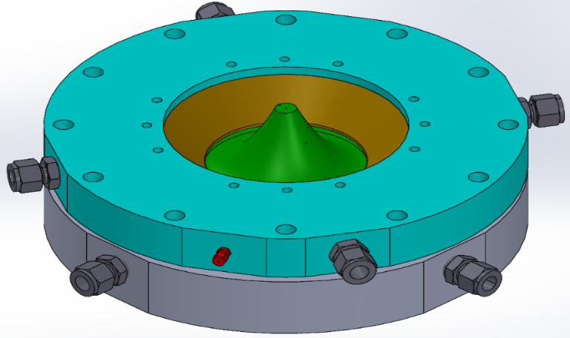
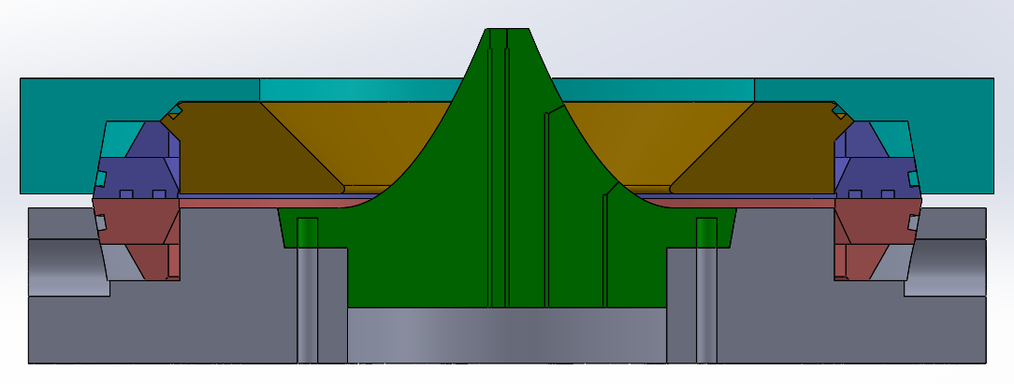
Radial RDC Integrated with an Aerospike
1
3
4
5
6
2
1 – Top Support Plate
2 – Bottom Support Plate
3 – Contour Plate
4 – Oxidizer Injector Ring
5 – Fuel Injector Ring
6 – Aerospike

Slide 4
Objectives
Perform high-fidelity RANS-based 3D simulation of a radial RDC with realistic geometric features, i.e., supply inlets, reactant plenums, fuel and oxidizer injectors, detonation tube, combustion channel, aerospike, and cowl.
Analyze stability and operation of the detonation wave and the coupling with supply plenums and downstream aerospike.
Investigate the effects of combustion channel area variation from the inlet to the throat: (a) parallel plates providing a linear decrease in flow area, and (b) rapid to gradual (RTG) change in flow area.

Slide 5
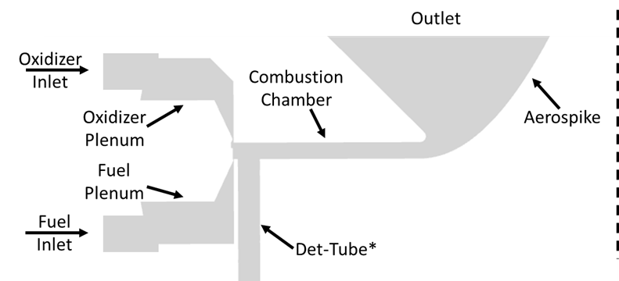
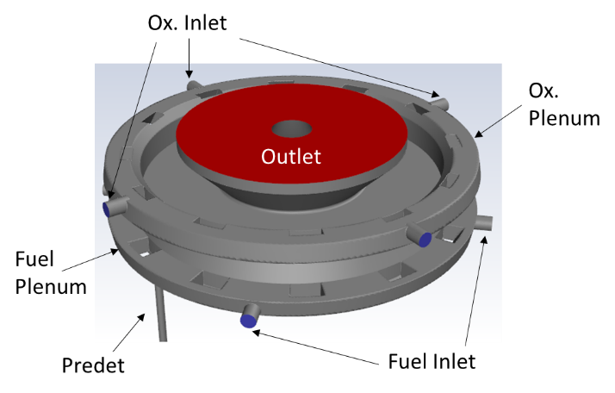
Computational Domain
The domain is comprised in accordance with the radial RDC designed and operated at the Engines and Combustions Laboratory at The University of Alabama (ECL at UA).
The model includes four ports each for oxidizer and fuel inlets, separate supply plenums and injection schemes, combustion channel, predet. tube, aerospike, and cowl.
The simulation is initialized with a steady-state cold flow solution. A flow of hot reactants is introduced through the predet to form a detonation front that is allowed to propagate into the combustion chamber.

Slide 6
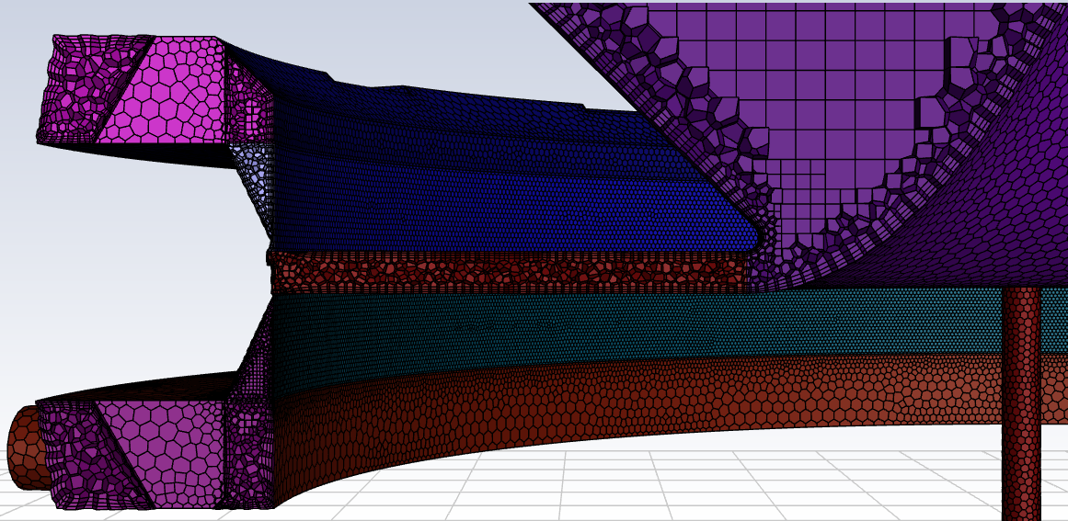
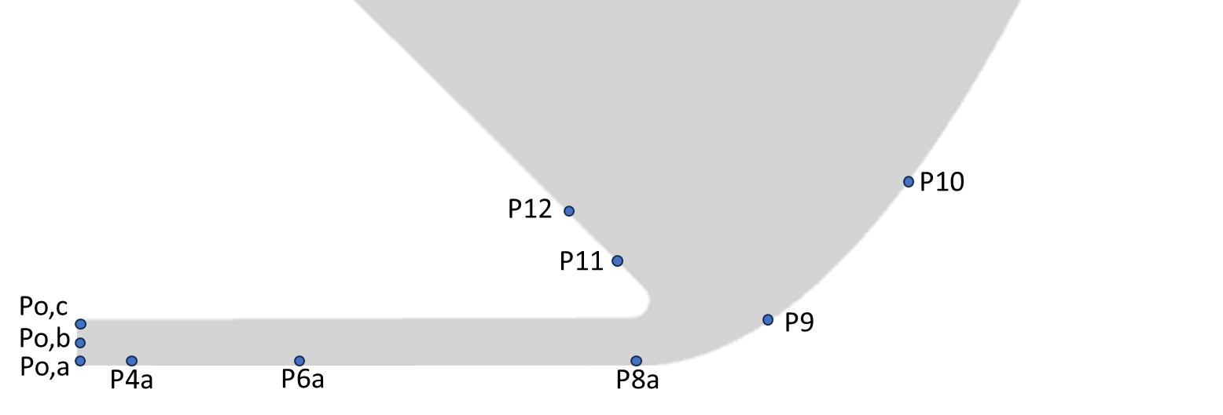
Grid Generation
A poly-hexcore mesh was created using local element sizes of 0.8 mm, 0.6 mm and 2.0 mm in the combustion chamber, injectors, and downstream exhaust plenum, respectively. Using a global element size of 1.0 mm, this yield a mesh of over 3 million elements.
Pressure probes are added to monitor absolute pressure near the injector, along the top and bottom walls of the combustion chamber, on the aerospike, and on the outer cowl.

Slide 7
Numerical Model
Describes models, difference schemes, how predet is introduced
Hydrogen and air are used as the working fluids and are modeled using a 1-step hydrogen-air model, which has accurately predicted the detonation speed and correct number of waves as compared to experimental data.

Slide 8
Combustion Channel Geometry
Case 1: Parallel plates to achieve a linear area reduction throughout the combustion channel
Case 2: A constant area section, followed by a rapid to gradual (RTG) reduction in area.

Slide 9
Evolution of Detonation: Case 1

Slide 10
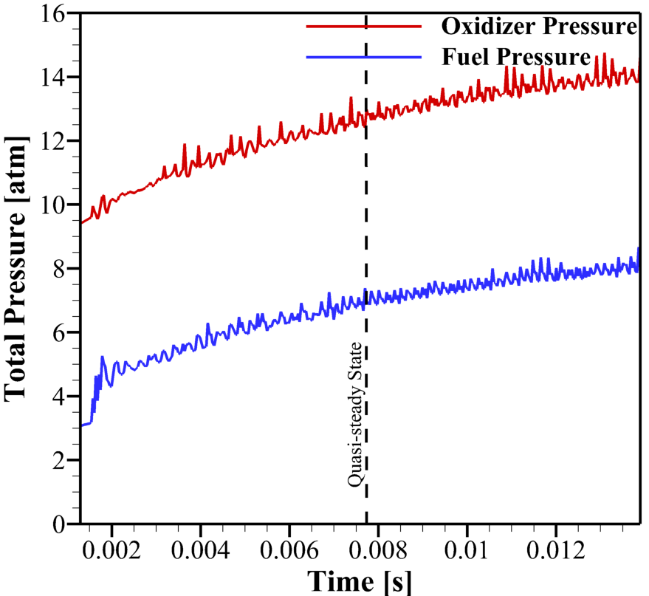
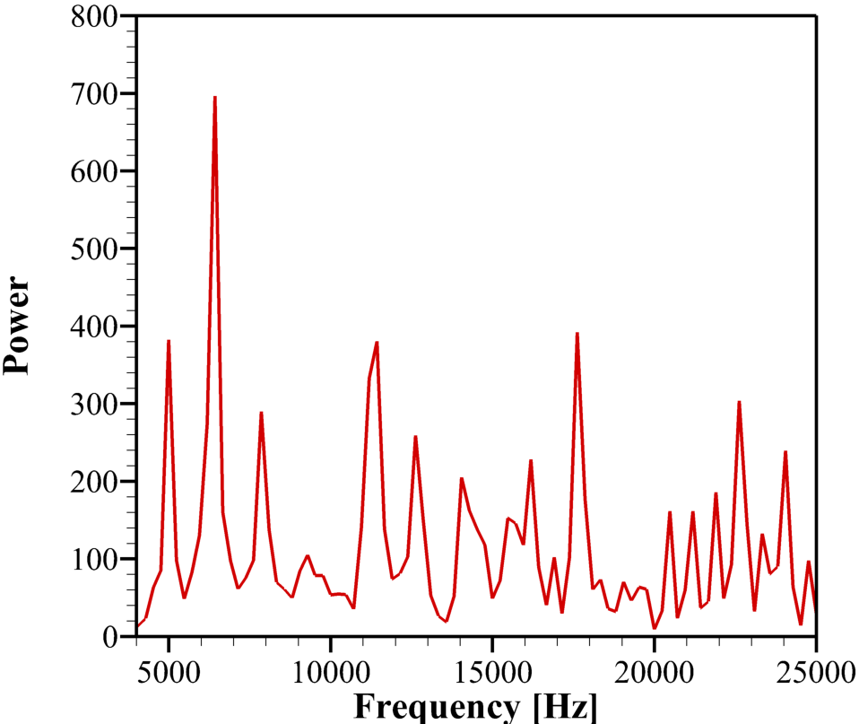
Plenum Pressures and Frequency Analysis
6.4 kHz,
70% of Chapman-Jouguet speed

Slide 11
Visualization at the Bottom Plate: Case 1

Slide 12
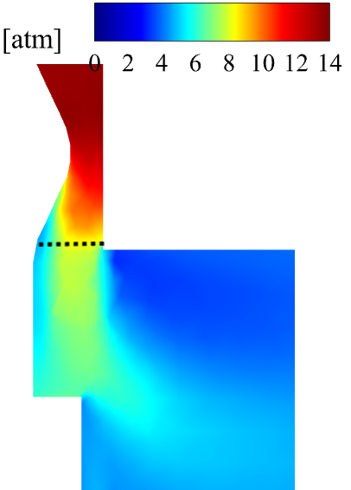
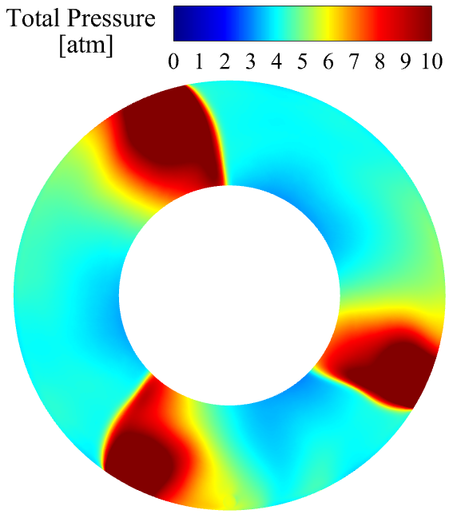
Total Pressure near Bottom Plate and Injector
Total Pressure [atm]
Left contour depicts total pressure profile around oxidizer injector before detonation has passed.
Injection pressure near oxidizer plenum fluctuates throughout the test.
Middle plot shows total pressure along the dotted line at all angle for an instant in time.
Total pressure varies significantly in the combustion channel.
Total Pressure [atm]

Slide 13
Visualization at the Throat: Case 1
Low temperature regions near the top plate at all circumferential locations.
Localized high- and low- pressure segments in the circumferential direction
Mach number varying from low of 0.7 to a high of 1.09.

Slide 14
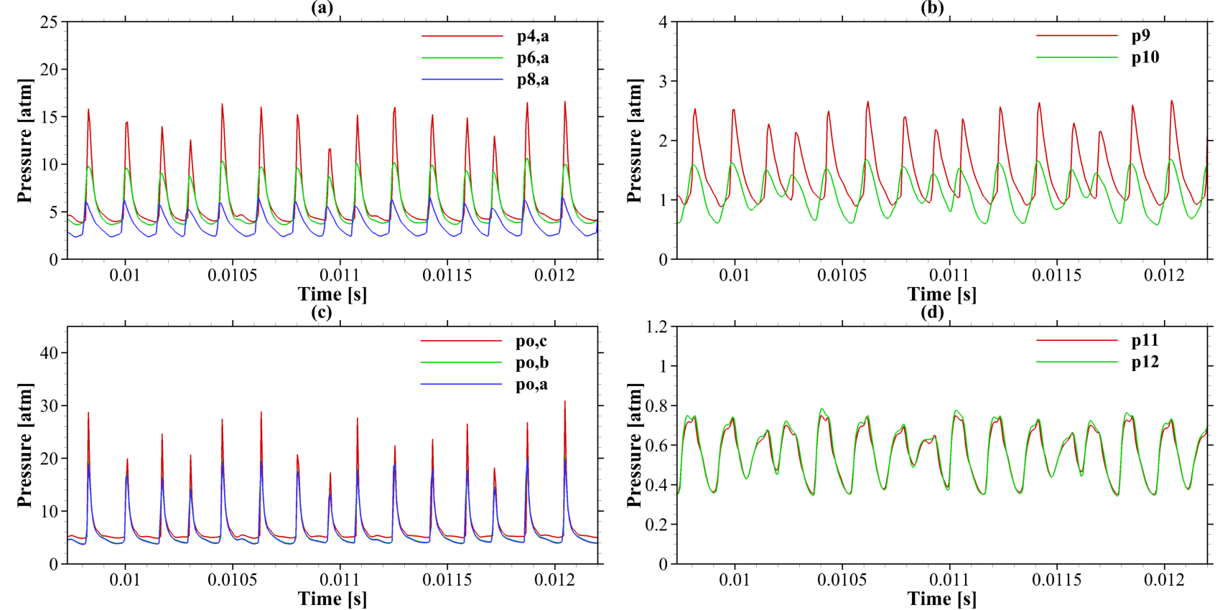
Pressure Traces

Slide 15
Evolution of Flow over the Aerospike

Slide 16
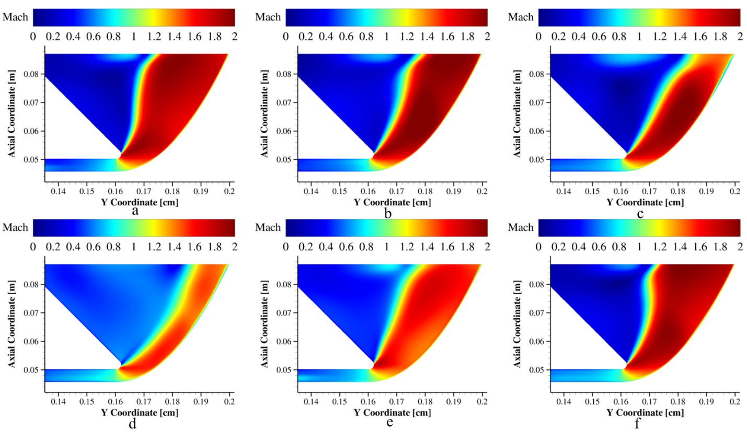
Evolution of Flow over the Aerospike

Slide 17
Visualization at Bottom Plate: Case 2

Slide 18
Conclusions
A radial RDC is numerically investigated using a full 3D simulation domain including inlet ports, supply plenums, injectors, combustion channel, aerospike, and exhaust.
Though both cases had the same mass flow rates, equivalence ratio, and area ratio, the parallel plate design yielded three co-rotating detonation waves at a combined wave frequency of 6.4 kHz, 70% of CJ speed, and the RTG design yielded two detonation waves at 83% of CJ.
For both cases, the angle between waves and pressures (as well as other flow properties) varied and switched among waves throughout the simulation and plenum pressures continued to rise throughout the simulation.
Interactions from the detonation wave propagated both upstream in the supply plenum and in the downstream exhaust field. Fluctuations were observed to be at the detonation wave frequency.
Flow fluctuations remain prevalent in each case, though slightly improved in the RTG design.

Slide 19
Acknowledgements
This research is supported in part by NASA Grant 80NSSC20K0305.
Kayla Bell was supported by The National Defense Science Engineering Graduate (NDSEG) Fellowship.
We would like to thank Bruce Crawford of ANSYS and Dr. Dan Paxson of NASA GRC for helpful discussions.

Slide 20
Questions?

Slide 21
Throat Uniformity for RTG Case

Slide 22
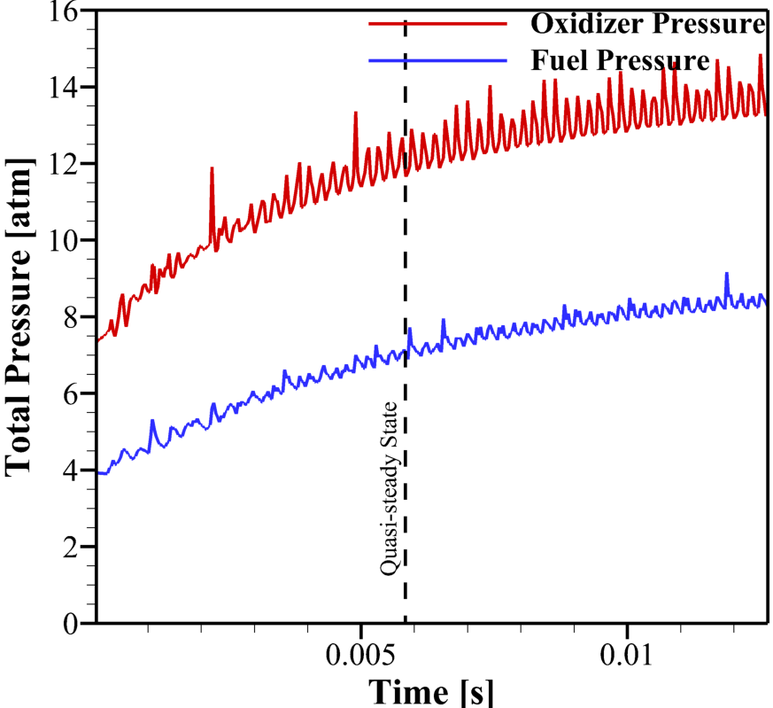
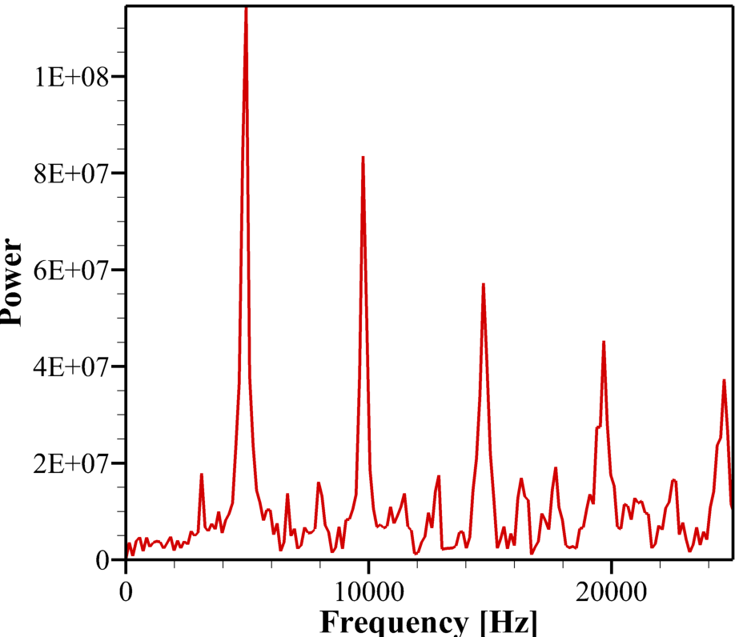
Plenum Pressures and Frequency Analysis

Slide 23
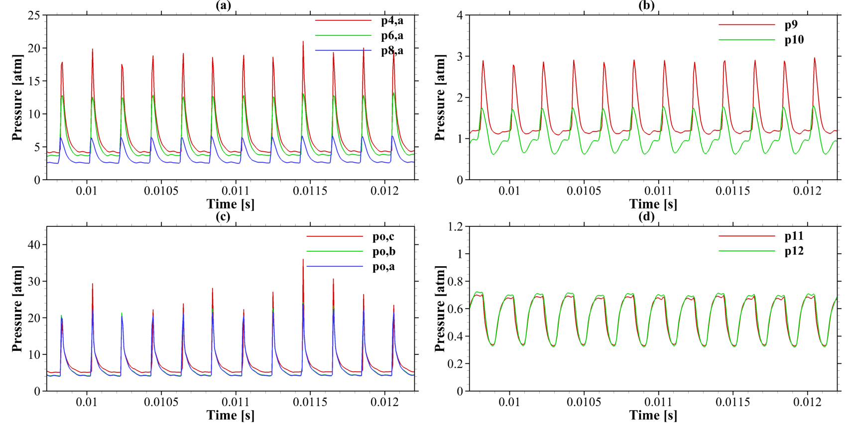
Pressure Traces for RTG

Slide 24
Evolution of Flow over the Aerospike

Slide 25
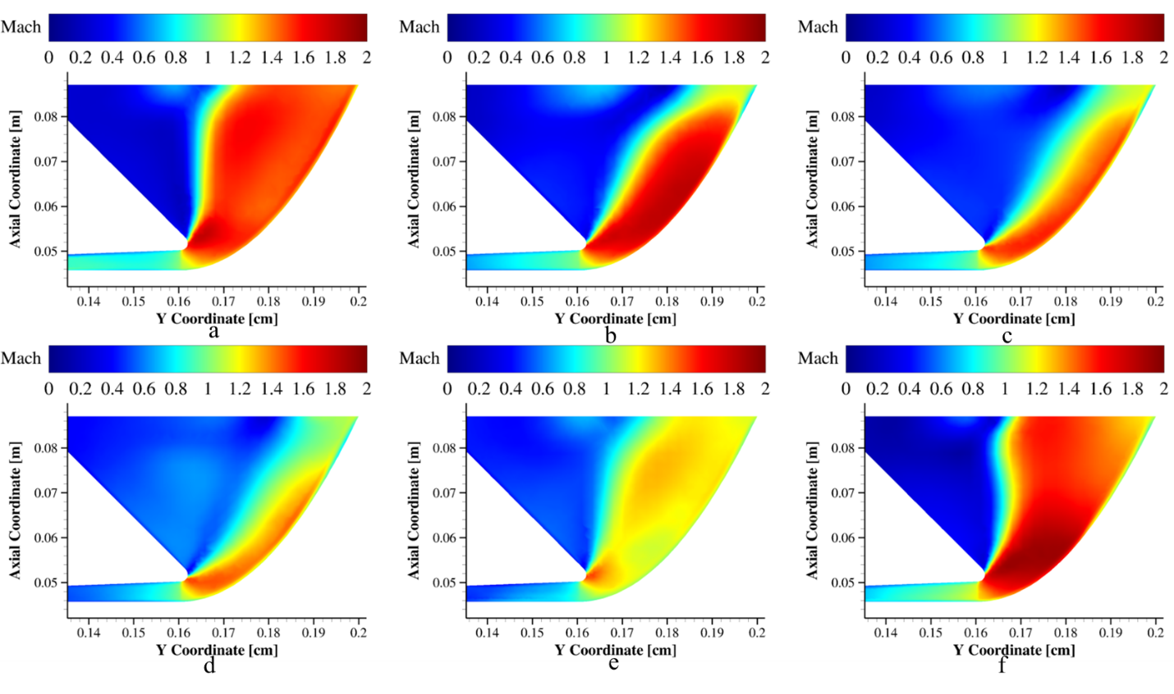
Evolution of Flow over the Aerospike

